Slide 1
Sure of Forgiveness
September 5

Slide 2

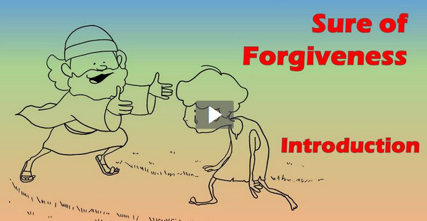
Video Introduction
View Video

Slide 3
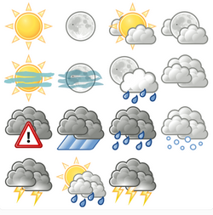


You can be sure …
What are some things you can count on in life?
Some people remain unsure of their relationship with God
  God assures us that we are forgiven when we confess our sin and walk with Christ.

Slide 4

Listen for a contrast.
1 John 1:5-7 (NIV) This is the message we have heard from him and declare to you: God is light; in him there is no darkness at all. 6 If we claim to have fellowship with him yet walk in the darkness, we lie and do not live by the truth. 7 But if we walk in the light, as he is in the light, we have fellowship with one another, and the blood of Jesus, his Son, purifies us from all sin.

Slide 5
Turn from Darkness to Light
What contrasting imagery did John use to describe what God is like?
Why is it not possible to be in fellowship with God and live a life of sin?
What does verse 7 say about the results of “walking in the light”?

Slide 6
Turn from Darkness to Light
What evidence do you see of darkness and light in your town or community?
In what way do we sometimes “walk in darkness”?
In what way is God similar to light?
What does it mean to walk in the light?
Darkness | Light

Slide 7
Listen for the importance of confession.
1 John 1:8-10 (NIV) If we claim to be without sin, we deceive ourselves and the truth is not in us. 9 If we confess our sins, he is faithful and just and will forgive us our sins and purify us from all unrighteousness. 10 If we claim we have not sinned, we make him out to be a liar and his word has no place in our lives.

Slide 8
Willing to Confess Our Sin
In what ways do we sometimes deceive ourselves about our own sin?
What is the relationship of confession to forgiveness and spiritual cleansing?
What have you found challenging about accepting God’s forgiveness?
How can people get out from under the burden of guilt after God has forgiven them?

Slide 9
Listen for who is our advocate.
1 John 2:1-2 (NIV) My dear children, I write this to you so that you will not sin. But if anybody does sin, we have one who speaks to the Father in our defense--Jesus Christ, the Righteous One. 2 He is the atoning sacrifice for our sins, and not only for ours but also for the sins of the whole world.

Slide 10
Forgiveness through Christ
So, why did John write this letter?
Why did John write that they “will not sin” but discuss options if they did?
In what way is Jesus an advocate?
How do God’s character qualities (such as holiness, love, and justice) contribute to His forgiveness?

Slide 11
Forgiveness through Christ
What does it mean that He is the propitiation for our sins?
How do God’s character qualities (such as holiness, love, and righteousness/justice) contribute to His forgiveness?

Slide 12
Application
Examine.
  Consider the principles taught today.
  They will either encourage you as a believer or accuse you as a nonbeliever.

Slide 13
Application
Meditate.
  Every day this week pray according to Psalm 139:23-24, “Search me, God, and know my heart; test me and know my anxious thoughts. See if there is any offensive way in me, and lead me in the way everlasting.”

Slide 14
Application
Share.
  Share your personal story of forgiveness with someone this week.
  “‘Do not fear their threats; do not be frightened.’ But in your hearts revere Christ as Lord. Always be prepared to give an answer to everyone who asks you to give the reason for the hope that you have. But do this with gentleness and respect” (1 Peter 3:14b-15).

Slide 15
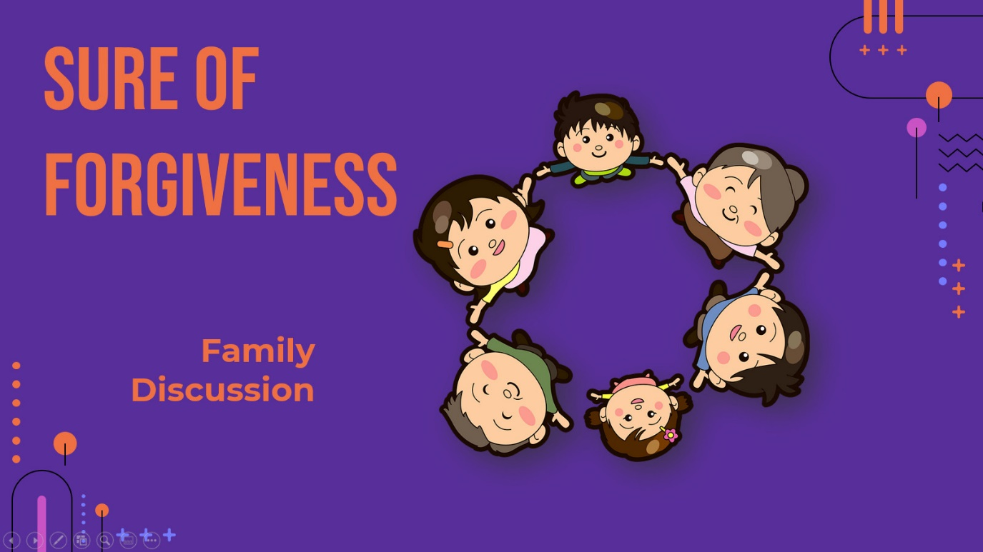
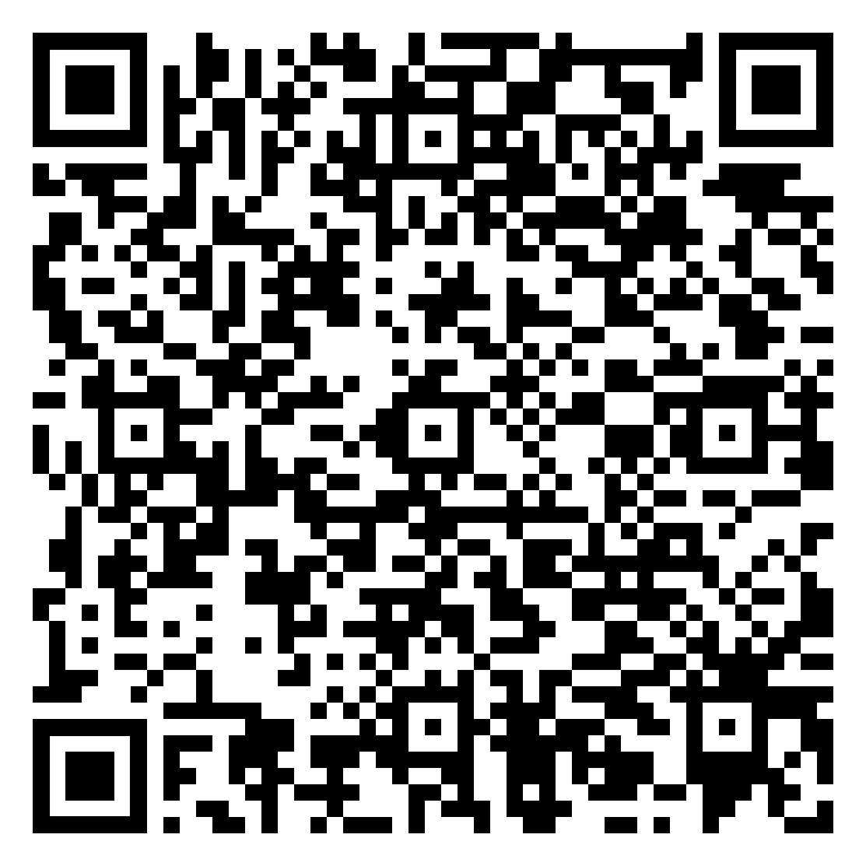
Check out the family discussion video!

Slide 16

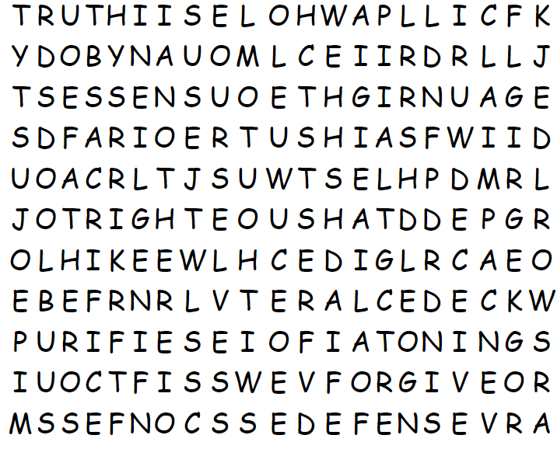
Family Activities
Those words won’t find themselves! Humph! You have work to do! If you wimp out, there’s still the Crossword Puzzle. Find it all at https://tinyurl.com/hy2c7vu7

Slide 17
Sure of Forgiveness
September 5

