Slide 1
Sufficient in Christ Alone
July 18

Slide 2


Video Introduction
View Video

Slide 3

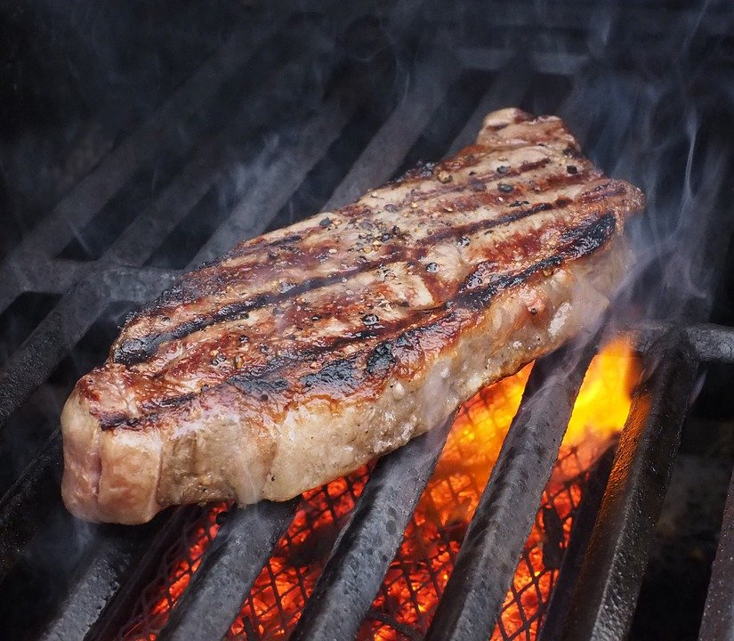
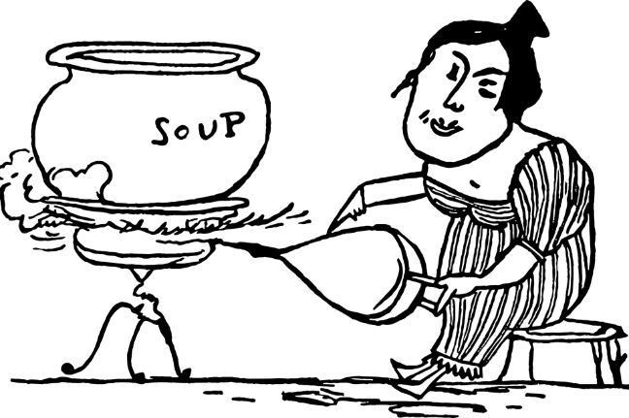
Admit it, now …
What do you hate to eat or drink lukewarm?
Today we see God’s view of lukewarm Christians.
  We don’t have to live a tepid Christian experience.
  God provides all we need to be on fire for Jesus.

Slide 4
Listen for Christ’s condemnation.
Revelation 3:14-17 (NIV) "To the angel of the church in Laodicea write: These are the words of the Amen, the faithful and true witness, the ruler of God's creation. 15 I know your deeds, that you are neither cold nor hot. I wish you were either one or the other!

Slide 5
Listen for Christ’s condemnation.
So, because you are lukewarm--neither hot nor cold--I am about to spit you out of my mouth. 17 You say, 'I am rich; I have acquired wealth and do not need a thing.' But you do not realize that you are wretched, pitiful, poor, blind and naked.

Slide 6
Don’t Fool Yourself
With what terms did the Lord identify Himself to the church at Laodicea and what does each descriptor say about Him?
Now what issue does He have with the church there? What analogy did the Lord use to illustrate His initial complaint against the Laodicean Christians?

Slide 7
Don’t Fool Yourself
Note the background about the city.
  Water supply from other cities with hot springs, cold streams
  Lucrative trade in black wool cloth
  Center for eye medicine
Jesus uses these economic issues to highlight spiritual issues

Slide 8
Don’t Fool Yourself
How much stock do we tend to put in our own resources (especially money and things)?
What are some things or situations that may lead a person or a church to become self-sufficient, convinced he/she/it has everything needed to succeed?
Why do these things cause us to feel self-sufficient?

Slide 9
Don’t Fool Yourself
Missionaries to China have been told by Christians there not to pray that persecution in China would end … they are afraid they will become lukewarm, like the church in America
Why would Chinese Christians be afraid of becoming lukewarm without persecution?

Slide 10
Listen for Jesus’ admonition to the church.
Revelation 3:18-19 (NIV) I counsel you to buy from me gold refined in the fire, so you can become rich; and white clothes to wear, so you can cover your shameful nakedness; and salve to put on your eyes, so you can see. 19 Those whom I love I rebuke and discipline. So be earnest, and repent.

Slide 11
What the Lord Requires
What three commercial ventures mentioned here did the Lord draw upon to communicate His message to the Laodiceans?
How do these apply to each of their spiritual problems we saw in the previous passage?
Spiritual Problem | Spiritual Recommendation
Wretched, pitiful, poor Blind Naked

Slide 12
What the Lord Requires
What key requirement for being in right relationship with God does Jesus mention here?
How does God use discipline to refine our faith?

Slide 13
Listen for an invitation.
Revelation 3:20-22 (NIV) Here I am! I stand at the door and knock. If anyone hears my voice and opens the door, I will come in and eat with him, and he with me. 21 To him who overcomes, I will give the right to sit with me on my throne, just as I overcame and sat down with my Father on his throne. 22 He who has an ear, let him hear what the Spirit says to the churches."

Slide 14
Open the Door to Christ
What is the promise given to the victors in Christ?
In what sense was Jesus Himself a model of one who overcame?
What imagery is used in verse 20 to communicate the Lord’s desire to be in relationship with any person?

Slide 15

Open the Door to Christ
What must be our response to see the fulfillment of His desire for us?
We often use verse 20 in a salvation presentation … how does this actually apply to a believer?

Slide 16
Application
Confess.
  Pray and ask God to reveal those areas where you have been relying on yourself instead of relying on Him.
  Confess the sin of self-reliance and commit to letting Him be Lord of all your life.

Slide 17
Application
Refocus.
  Refocus your priorities.
  Work to eliminate the activities and people in your life that take you away from having an intimate relationship with Christ.
  Determine not to let anything come between you or your walk with God.

Slide 18
Application
Share.
  Share with someone how you plan to make Christ first in your life.
  Tell them of the specific steps you are planning to take to get you there.

Slide 19
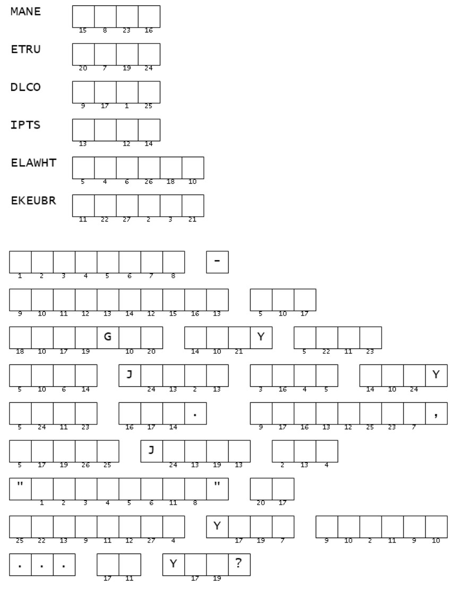

Family Activities
I’m confused. Ribbit, ribbit! Those words from the lesson are scrambled. It looks like you need those to figure out the message. If you’re stuck, hop on over to https://tinyurl.com/xyvxc3bm for help. You could also find a video for a family discussion!

Slide 20
Sufficient in Christ Alone
July 18

