Slide 1
Study God’s Word
October 30

Slide 2
Video Introduction
View Video

Slide 3
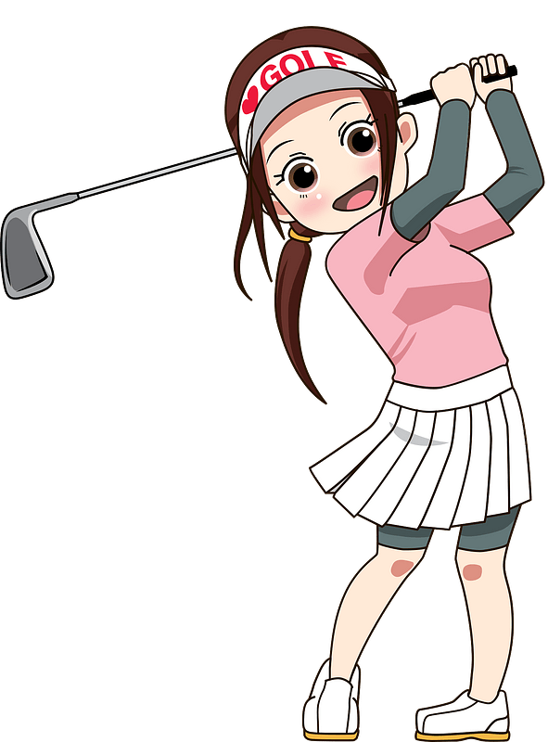
Think about it …
When have you really enjoyed learning something?
Over a lifetime we have many learning opportunities.
God’s Word is the most important thing to learn
Regular study of God’s Word keeps us firmly grounded.

Slide 4
Listen for a warning and an exhortation.
2 Timothy 2:14-15 (NIV) Keep reminding them of these things. Warn them before God against quarreling about words; it is of no value, and only ruins those who listen. 15 Do your best to present yourself to God as one approved, a workman who does not need to be ashamed and who correctly handles the word of truth.

Slide 5
Diligent to Study God’s Word
What instruction was given to Timothy in verse 14? What were they to avoid in dealing with others who heard their instruction?
What are the results of quarreling about words and involvement in godless chatter?
What are some of the hottest topics of arguments in churches today?

Slide 6
Diligent to Study God’s Word
What are some of the motives behind these arguments?
Instead of getting involved in these arguments and motives, what did Paul tell Timothy to strive for? With what attitude were faithful teachers to approach their work?

Slide 7
Diligent to Study God’s Word
How do you think that properly handling (dividing) God’s Word makes us useful?
How do we become workmen approved by God?

Slide 8
Listen for consequences of empty speech.
2 Timothy 2:16-19 (NIV) Avoid godless chatter, because those who indulge in it will become more and more ungodly. 17 Their teaching will spread like gangrene. Among them are Hymenaeus and Philetus, 18 who have wandered away from the truth. They say that

Slide 9
Listen for consequences of empty speech.
the resurrection has already taken place, and they destroy the faith of some. 19 Nevertheless, God's solid foundation stands firm, sealed with this inscription: "The Lord knows those who are his," and, "Everyone who confesses the name of the Lord must turn away from wickedness."

Slide 10
Grounded in Truth
Paul told Timothy to avoid “godless chatter.” What is the danger of engaging in such talk?
On what can true believers depend if they are to be known as the people of God who are striving to honor the name of Christ through righteous living?

Slide 11
Grounded in Truth
What do you think our culture gets wrong about God’s Word?
What are examples of irreverent and empty speech we should avoid?
How do you change your daily speech to weed out senseless and godless chatter?

Slide 12
Listen for benefits of obeying biblical teaching.
2 Timothy 2:22-26 (NIV) Flee the evil desires of youth, and pursue righteousness, faith, love and peace, along with those who call on the Lord out of a pure heart. 23 Don't have anything to do with foolish and stupid arguments, because you know they produce quarrels

Slide 13
Listen for benefits of obeying biblical teaching.
And the Lord's servant must not quarrel; instead, he must be kind to everyone, able to teach, not resentful. 25 Those who oppose him he must gently instruct, in the hope that God will grant them repentance leading them to a

Slide 14
Listen for benefits of obeying biblical teaching.
knowledge of the truth, 26 and that they will come to their senses and escape from the trap of the devil, who has taken them captive to do his will.

Slide 15
Benefit God’s Kingdom
According to verse 22, how should a servant of the Lord approach those who need to hear the gospel?
What gift from God comes to those who accept the knowledge of the truth?

Slide 16
Benefit God’s Kingdom
How will your life change because of regularly (more than once a week at church) studying God’s Word?
How does the Word of God impact your pursuit of godliness?

Slide 17
Application
Step 1
Evaluate your overall disposition toward those who follow the world’s various distortions of God’s Word.
Ensure that you are demonstrating a gentle spirit rather than a combative attitude.

Slide 18
Application
Step 2
If you don’t have one, consider purchasing a good study Bible.
Consult with your pastor or other trusted leader for a good recommendation.

Slide 19
Application
Step 3
Start studying a book of the Bible more in-depth.
Perhaps you could ask another believer to study with you for mutual accountability.

Slide 20
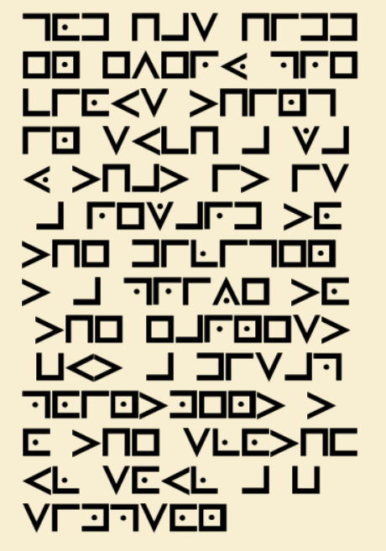
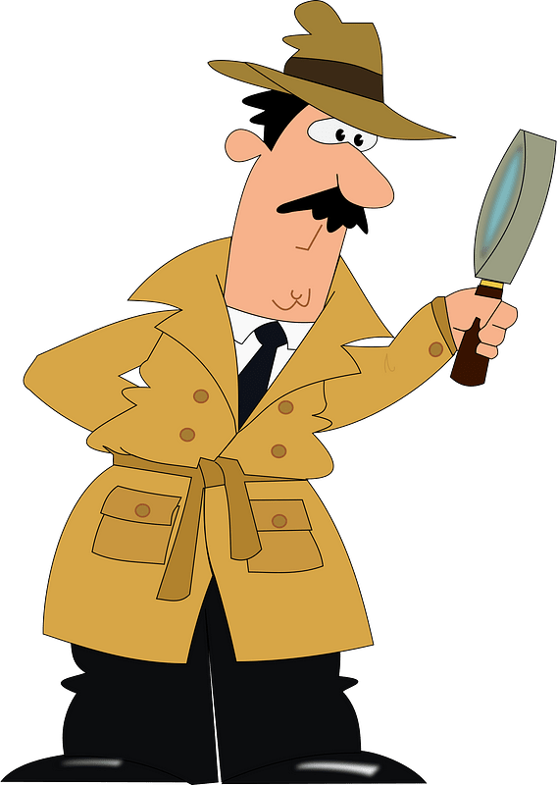
Family Activities
Looks like a code … or maybe a foreign script. I saw something like this once in Ikhstan Tswalandhai. You have the key, Spiros the Spy needs your help for decryption. Technical help is available at https://tinyurl.com/477pm24c You can also find the crossword. For the folks in the front row, check out the color page.

Slide 21
Study God’s Word
October 30

