Slide 1
Steadfast in Difficulties
June 13

Slide 2
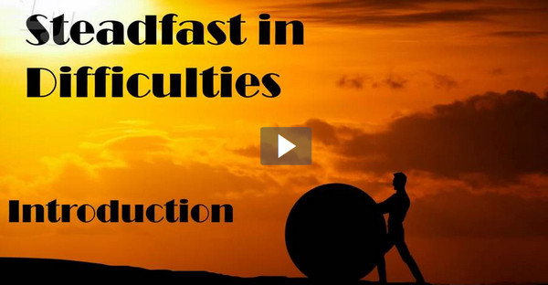
Video Introduction
View Video

Slide 3
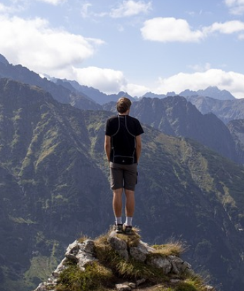
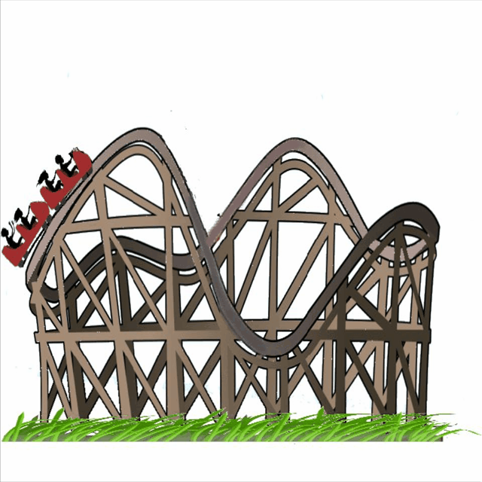
Be honest, now …
What are some fears you’ve had to overcome?
It’s probably good to have a healthy fear of some things.
For other things in life, we do need to learn to manage our fears
Ultimately, we need not fear life’s many difficulties because we are rich in God’s grace.

Slide 4
Listen for a commendation.
Revelation 2:8-9 (NIV) "To the angel of the church in Smyrna write: These are the words of him who is the First and the Last, who died and came to life again. 9 I know your afflictions and your poverty--yet you are rich! I know the slander of those who say they are Jews and are not, but are a synagogue of Satan.

Slide 5
God and His Blessings are Greater
The recipient of the message is “the angle of the church in Smyrna.” What is a church in the most basic sense?
How did Christ Jesus identify Himself to this assembly of believers?
What is significant about the title Christ gave Himself ("the First and the Last, who died and came to life again")?

Slide 6
God and His Blessings are Greater
What did He know about them?
In what way could it be said the church at Smyrna was rich even though the people were poor? How can a person in poverty be considered rich?
What riches have you experienced because of your relationship with Christ?

Slide 7
God and His Blessings are Greater
Who were their opponents and accusers? How did the Lord characterize those who persecuted and blasphemed, those who were faithful to Him?
How would it change things to realize that Jesus knows your situation?

Slide 8
Listen for a promise and encouragement.
Revelation 2:10 (NIV) Do not be afraid of what you are about to suffer. I tell you, the devil will put some of you in prison to test you, and you will suffer persecution for ten days. Be faithful, even to the point of death, and I will give you the crown of life.

Slide 9
Faithfulness to Christ Wins
Of what did He warn them?
In your view, which is worse—physical or verbal persecution? Why?
Physical Problems | Verbal Persecution

Slide 10
Faithfulness to Christ Wins
To what length did He admonish them to go in facing tribulation?
What did He promise to give them? What do you think that means?
When has a difficult season strengthened your relationship with Christ? When have you seen believers overcome adversity through their faith?

Slide 11
Listen for a promise.
Revelation 2:11 (NIV) He who has an ear, let him hear what the Spirit says to the churches. He who overcomes will not be hurt at all by the second death.

Slide 12
Life in Christ Overcomes Death
How can knowing that the Lord speaks to His people be an encouragement to faithful living in times of trial?
What is the promise given to those who persevere?
What are practical ways to reject fear and embrace God’s promises for the future?

Slide 13
Life in Christ Overcomes Death
What are some ways might a church today be like the church at Smyrna?
What message would Jesus want to send us in those situations?

Slide 14
Application
Trust.
Christ tasted death for us so that we would not have to experience the second death.
Turn from your sin and trust Christ to save you. Look on the inside front cover of this book for more about committing your life to Christ

Slide 15
Application
Thank.
Make a list of all the ways you are rich because of God’s grace in your life.
Spend time in prayer, thanking God for all the blessings He has given you.

Slide 16
Application
Encourage.
If you know someone who is struggling in their walk with Christ, encourage them to endure and stand strong in Christ.
Use your example of endurance in the face of difficulties to encourage their steadfastness.

Slide 17
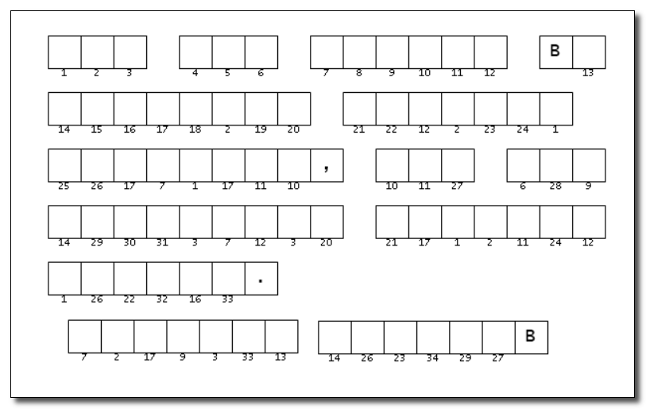
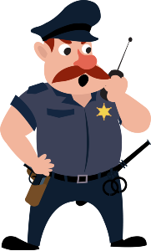
Family Activities
We have reports of missing letters from this sign. Informants suggest the letters can be determined from some obfuscated word clues. We need concerned citizens to render the aid of disobfuscation. Resources are available at https://tinyurl.com/faje5awy

Slide 18
Steadfast in Difficulties
June 13

