Slide 1
Stay Prepared and Ready
May 29

Slide 2
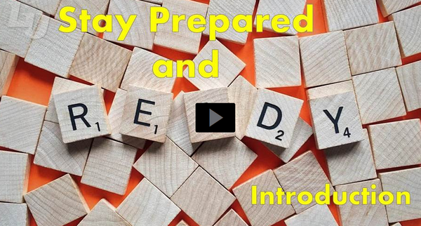
Video Introduction
View Video

Slide 3
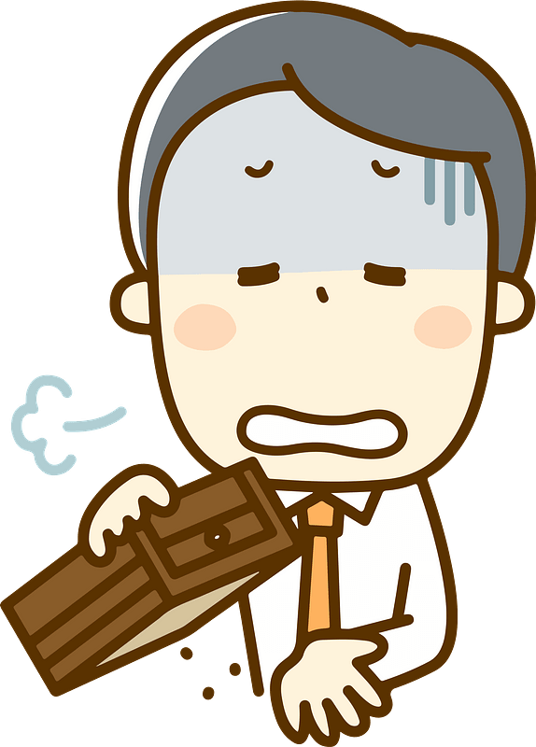
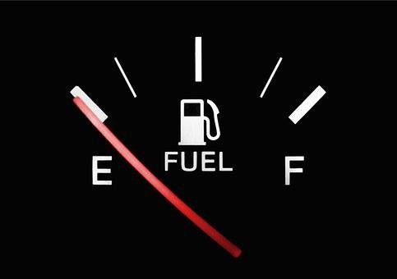
Remember that time …
When have you been caught unprepared?
We have been studying Christ’s teachings on being ready for His return.
We need to be anticipating that event and be prepared.
We can prepare by growing in Christ as we wait.

Slide 4
Listen for a contrast.
Matthew 25:1-5 (NIV) "At that time the kingdom of heaven will be like ten virgins who took their lamps and went out to meet the bridegroom. 2 Five of them were foolish and five were wise. 3 The foolish ones took

Slide 5
Listen for a contrast.
their lamps but did not take any oil with them. 4 The wise, however, took oil in jars along with their lamps. 5 The bridegroom was a long time in coming, and they all became drowsy and fell asleep.

Slide 6
Prepare for Christ’s Return
What is meant by “kingdom of heaven”?
To what is the kingdom likened?
How were the two groups of five maidens differentiated? What made one group foolish and the other group wise?
Since the wedding party was delayed, what did the ten maidens do while they were waiting?

Slide 7
Prepare for Christ’s Return
What makes it difficult to be diligent as we wait for Christ’s return? Why do we tend to think (and act like) we have all the time in the world to get ready for Christ’s return?
What are some disciplines that can help prepare us for Christ’s return?

Slide 8
Prepare for Christ’s Return
What responsibility does each Christian have before God as we anticipate Christ’s return?
Why is continual preparation for Christ’s return better than "last minute cramming"?

Slide 9
Listen for the bridesmaids’ problem.
Matthew 25:6-9 (NIV) "At midnight the cry rang out: 'Here's the bridegroom! Come out to meet him!' 7 "Then all the virgins woke up and trimmed their lamps. 8 The foolish ones said to the wise,

Slide 10
Listen for the bridesmaids’ problem.
'Give us some of your oil; our lamps are going out.' 9 'No,' they replied, 'there may not be enough for both us and you. Instead, go to those who sell oil and buy some for yourselves.'

Slide 11
Personal Responsibility to Prepare
What announcement awakened the maidens from their sleep?
In what way did the foolishness of the five catch up to them?
Why did the five wise maidens refuse them?
What do these verses teach us about the need for individual readiness?

Slide 12
Personal Responsibility to Prepare
What are our personal responsibilities when it comes to preparing for Christ’s return?
What are the possible consequences of putting off thinking about Christ and spiritual growth until later?

Slide 13
Listen for a sobering story end.
Matthew 25:10-13 (NIV) "But while they were on their way to buy the oil, the bridegroom arrived. The virgins who were ready went in with him to the wedding banquet. And the door was shut.

Slide 14
Listen for a sobering story end.
"Later the others also came. 'Sir! Sir!' they said. 'Open the door for us!' 12 "But he replied, 'I tell you the truth, I don't know you.' 13 "Therefore keep watch, because you do not know the day or the hour.

Slide 15
Preparation Time Is Limited
What happened when the foolish maidens went to try to buy oil?
What was the terse and pointed reply they received when they returned?
How does the story illustrate the declaration of verse 13?

Slide 16
Preparation Time Is Limited
What are the consequences of not being prepared for Christ’s return? What are dangers of putting off thinking about Christ and spiritual growth until later?
Why can preaching a gospel of second chances be misleading?

Slide 17
Application
Realize:
Ask God to reveal to you areas of your relationship with Him that need improvement.
Make those areas a priority in your daily walk with the Lord.

Slide 18
Application
Memorize:
Memorize Matthew 25:13, “Therefore be alert, because you don’t know either the day or the hour.”
Let that be a positive motivation for practical preparation.

Slide 19
Application
Exercise:
We can’t change the past, but we can make plans to use our time properly.
What non-essential habit or activity can you eliminate from your schedule and replace with an activity that prepares you for Christ’s return?

Slide 20
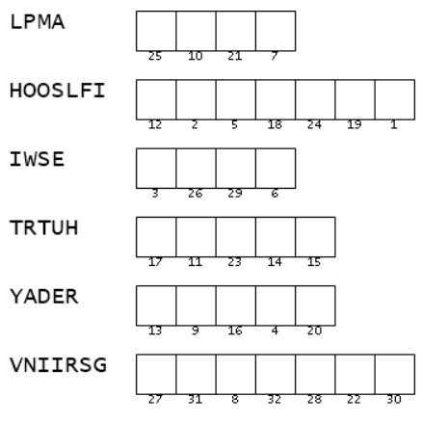
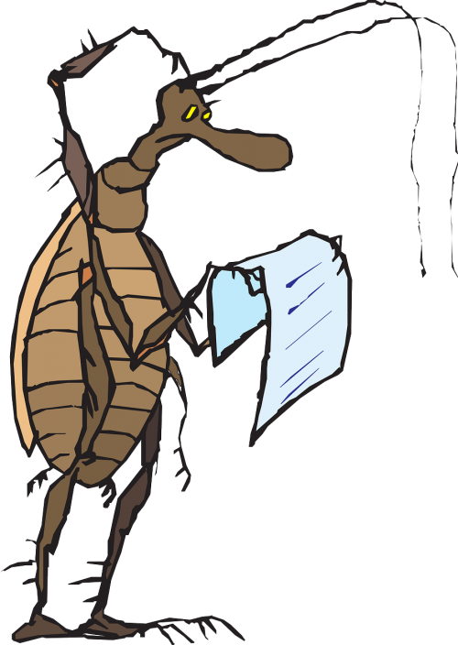
Family Activities
Aiee cucaracha! Those letters are scrambled. We need to sort them out so we can decode the message on your handouts. The words are from our scripture passage. You can find help at https://tinyurl.com/k92befju. Oh yes … the color page is there too.

Slide 21
Stay Prepared and Ready
May 29

