Slide 1
Start with Prayer
May 2

Slide 2

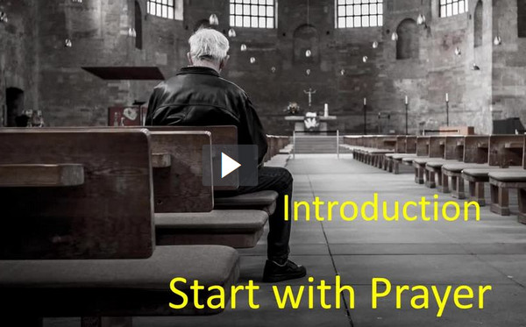
Video Introduction
View Video

Slide 3
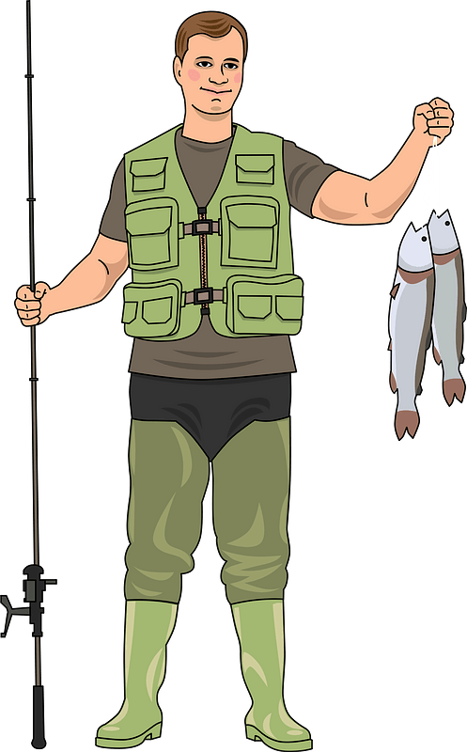


Think About It …
Whom do you know that’s really dedicated to something?
Most of those pursuits are admirable.
  God calls us to be dedicated to prayer
  Today, we consider Paul’s direction to Timothy concerning prayer for spiritual needs.

Slide 4
Listen for Paul’s recommendation.
1 Timothy 2:1-2 (NIV) I urge, then, first of all, that requests, prayers, intercession and thanksgiving be made for everyone-- 2 for kings and all those in authority, that we may live peaceful and quiet lives in all godliness and holiness.

Slide 5
Pray for All People
Why kind of praying did Paul urge Timothy to do? What are different synonyms for prayer used in various translations you have?
For whom was he to pray?
What sort of prayers should we make on behalf of our leaders?
How would Timothy (and we) benefit from praying for those in authority?

Slide 6
Pray for All People
Why do you think the greater majority of our public prayer requests have to do with physical needs … instead of spiritual needs?
It’s not always best to divulge embarrassing personal struggles to a group.
Seeking prayer support privately from an accountability partner is a much better practice.

Slide 7


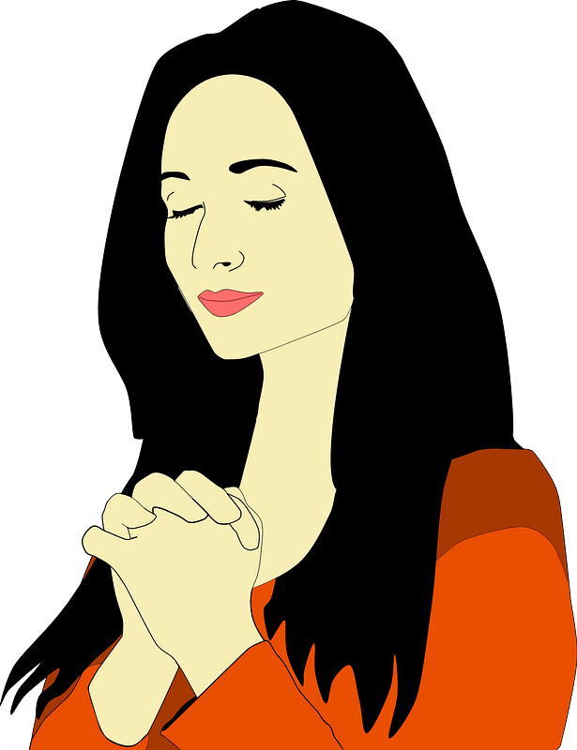
Pray for All People
What does a dynamic or effective prayer life look like in a person’s daily walk?
  A. Adoration
  C. Confession
  T. Thanksgiving
  S. Supplications
Thank you, Lord
HOLY
BIBLE

Slide 8
Listen for God’s desire.
1 Timothy 2:3-6 (NIV) This is good, and pleases God our Savior, 4 who wants all men to be saved and to come to a knowledge of the truth. 5 For there is one God and one mediator between God and men, the man Christ Jesus, 6 who gave himself as a ransom for all men--the testimony given in its proper time.

Slide 9
God’s Desire for All People
How do we use mediators in our society?
Who are the disputants and how does Jesus facilitate the reconciliation?
Based on this passage, what advice would you give to a Christian who insists he/she cannot pray for the salvation of a person who has hurt him/her?

Slide 10
God’s Desire for All People
Paul says here that God wants all men to be saved and come to know Truth. What are some reasons this has not happened?
So, what does this tell us about why we send missionaries to other countries? Is it really our responsibility to tell them about Jesus?

Slide 11
God’s Desire for All People
See also Romans 10:13-15
for, "Everyone who calls on the name of the Lord will be saved." How, then, can they call on the one they have not believed in? And how can they believe in the one of whom they have not heard? And how can they hear without someone preaching to them? And how can they preach unless they are sent? As it is written, "How beautiful are the feet of those who bring good news!"

Slide 12
Listen for Paul’s role.
1 Timothy 2:7-8 (NIV) And for this purpose I was appointed a herald and an apostle--I am telling the truth, I am not lying--and a teacher of the true faith to the Gentiles. 8 I want men everywhere to lift up holy hands in prayer, without anger or disputing.

Slide 13
Pray for the Preaching of the Gospel
What three terms did Paul use to describe his functional role as a follower of Christ?
What did Paul say concerning the attitude when we pray?
Why is prayer an important step in sharing the gospel?

Slide 14
Pray for the Preaching of the Gospel
How can our group pray together for the salvation of others?
How can we pray for others who share the gospel?

Slide 15
Application
Make time.
  Set aside a specific time each day for focused prayer.
  Just as you keep appointments through the day, commit to meet this appointment every day.

Slide 16
Application
Make a list.
  Start a prayer journal.
  List specific individuals for whose salvation you are praying.
  Include the names of those in authority too.

Slide 17
Application
Make contact.
  God often uses us to do more than just pray; He uses us in the answer.
  As God gives you opportunity, talk with those for whom you’ve been praying.
  Trust God to give you the words to say in sharing Christ.

Slide 18

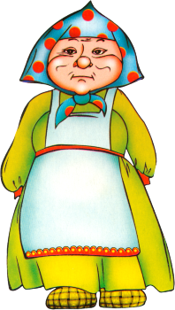
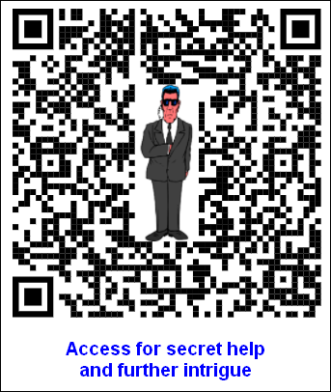
Family Activities
We here in Guipu Macelux are waiting for the message. Can you help move it along?

Slide 19
Start with Prayer
May 2

