Slide 1
Stand Strong to the End
April 24

Slide 2
Video Introduction
View Video

Slide 3
Remember that time?
When have you been surprised by how difficult something turned out to be?
Most of the things we came up with were normal tasks.
Today’s Bible study speaks of more serious difficulties.
Jesus said we should expect difficulty when you choose to follow Him.

Slide 4
Listen for Q and A.
Matthew 24:1-3 (NIV) Jesus left the temple and was walking away when his disciples came up to him to call his attention to its buildings. 2 "Do you see all these things?" he asked. "I tell you the truth, not one stone here will be left

Slide 5
Listen for Q and A.
on another; every one will be thrown down." 3 As Jesus was sitting on the Mount of Olives, the disciples came to him privately. "Tell us," they said, "when will this happen, and what will be the sign of your coming and of the end of the age?"

Slide 6
What Will Be the Sign?
Note the disciples comments as they are leaving the temple area.
Remarking about the size of the buildings.
Noting the beauty of the scene.
May have had to do with how the sun was highlighting them.

Slide 7
What Will Be the Sign?
What kind of response does Jesus have to their mention of the temple complex?
Why might Jesus’ response to their comment about the temple complex have caught the disciples off guard?
What were your feelings when an important place to you was destroyed?

Slide 8
What Will Be the Sign?
So, what did they immediately want to know after hearing what He had to say about the future of the temple?
What questions do you have about Jesus’ return? What do you wonder about when it comes to the end times?

Slide 9
What Will Be the Sign?
We seem to have a natural curiosity about the end of time.
But it is not always well-informed by a biblical perspective.
Remember that God is in control … He accomplishes His purposes in His way, in His time.

Slide 10
Listen for Jesus’ further response.
Matthew 24:4-8 (NIV) Jesus answered: "Watch out that no one deceives you. 5 For many will come in my name, claiming, 'I am the Christ,' and will deceive many. 6 You will hear of wars and rumors of wars, but see to it that you are

Slide 11
Listen for Jesus’ further response.
not alarmed. Such things must happen, but the end is still to come. 7 Nation will rise against nation, and kingdom against kingdom. There will be famines and earthquakes in various places. 8 All these are the beginning of birth pains.

Slide 12
The Beginning of the End
What did He caution them to avoid?
What were some ways in which people could be deceived to think the end of time was near?
Jesus said these things are like “labor pains” that precede a birth. What can encourage us amidst Jesus’ warnings that things are going to get a lot worse?

Slide 13
The Beginning of the End
How does talk of the end times motivate us to live a holy life?
At the same time, how can we become sidetracked by discussion of the end times?
How is it helpful that Jesus didn’t give us a specific time or date for His return?

Slide 14
Listen for a call to faithfulness.
Matthew 24:9-14 (NIV) "Then you will be handed over to be persecuted and put to death, and you will be hated by all nations because of me. 10 At that time many will turn away from the faith and will betray and hate each other, 11 and many false prophets will appear and deceive

Slide 15
Listen for a call to faithfulness.
many people. 12 Because of the increase of wickedness, the love of most will grow cold, 13 but he who stands firm to the end will be saved. 14 And this gospel of the kingdom will be preached in the whole world as a testimony to all nations, and then the end will come.

Slide 16
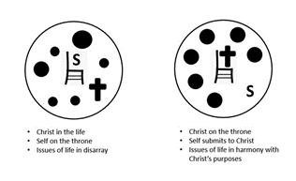
A Call to Faithfulness
What are some examples of external opposition Jesus’ followers would face?
What opposition can come from those who stumble and give up on Jesus?
What threat do false teachers pose?
What happens when wickedness prevails?

Slide 17
A Call to Faithfulness
No matter the opposition, what does Jesus expect from His followers?
This passage encourages you to share the gospel.
Taking the gospel to the whole world is one of the things that must happen.
People have promoted missions with the phrase “Bring Back the King.”
According to Finishing the Task, 218 ethnic groups are unreached … no church, no missionary, no mission agency

Slide 18
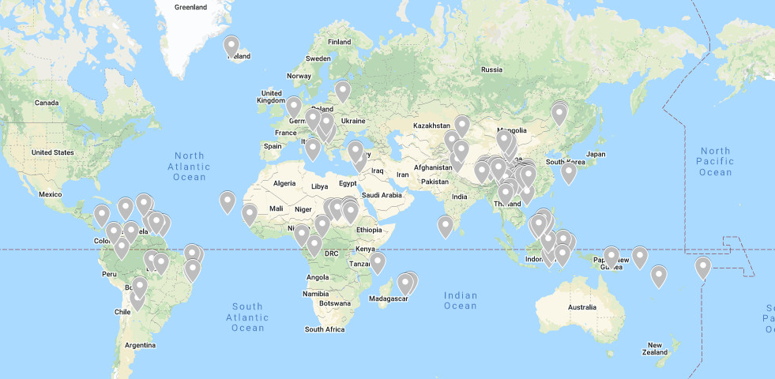
Unreached People Groups

Slide 19
Application
Realize.
Take some time this week to write down your views about the second coming of Jesus and the end of the world.
Pay careful attention to the verses studied today that assure us of God’s plan and His care for us.

Slide 20
Application
Memorize.
Memorize Matthew 24:8, “All these events are the beginning of labor pains.”
Let this verse give you a biblical perspective when you hear of tragic events throughout the world.

Slide 21
Application
Exercise.
Review a list of family members, friends, and acquaintances who are not believers.
Take practical steps to share the good news with at least one of people on your list within the next month.

Slide 22
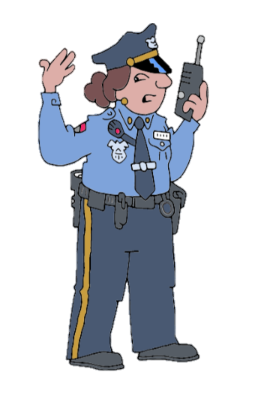
Family Activities
My grandson with the BSS (Bible Security Service) says this is an important message. The .jpg file (whatever that is) got scrambled and letters got shifted. Can you help him? He’s such a nice boy. He says help is available at https://tinyurl.com/yckmujhd . Oh yes, the crossword puzzle is there too.

Slide 23
Stand Strong to the End
April 24

