Slide 1
Speak Truth Boldly
September 17

Slide 2

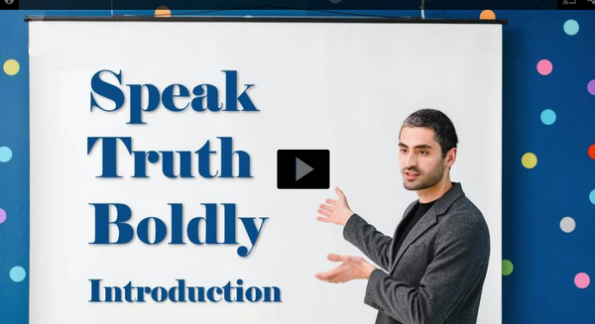
Video Introduction
View Video

Slide 3
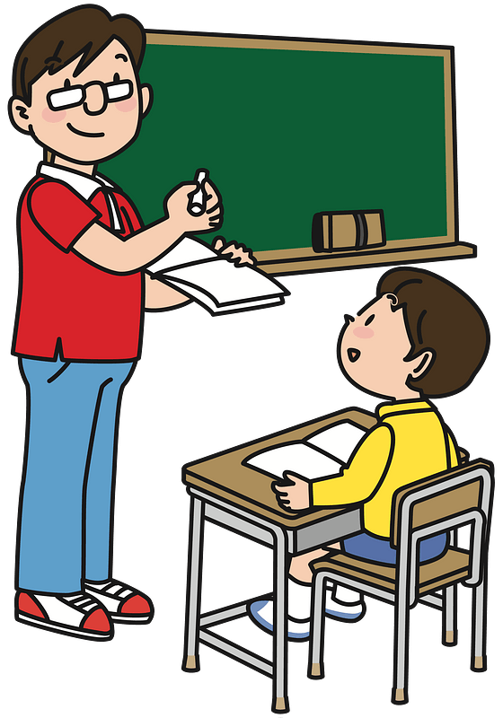


Remember that time?
When have you appreciated someone’s honesty?
Sometimes being honest can be hurtful to the other person.
  We might call it “hard truth” or “tough love”
  Being a bold witness for God sometimes means speaking hard truth.
Sorry, I was wrong
I mis graded your test, you actually got an A
It was me that broke the dish … sorry

Slide 4
Listen for Daniel’s reputation.
Daniel 5:13-16 (NIV) So Daniel was brought before the king, and the king said to him, "Are you Daniel, one of the exiles my father the king brought from Judah? 14 I have heard that the spirit of the gods is in you and that you have insight, intelligence and outstanding wisdom. 15 The wise men and enchanters were brought before me to read this

Slide 5
Listen for Daniel’s reputation.
writing and tell me what it means, but they could not explain it. 16 Now I have heard that you are able to give interpretations and to solve difficult problems. If you can read this writing and tell me what it means, you will be clothed in purple and have a gold chain placed around your neck, and you will be made the third highest ruler in the kingdom."

Slide 6
Integrity and Godly Wisdom
What questions did Belshazzar ask to affirm some background about Daniel?
What had he heard about Daniel and his amazing skill?

Slide 7
Integrity and Godly Wisdom
He hoped Daniel could do what his own court counselors were unable to accomplish.
  Read the writing on the wall
  Tell him what it means
  Explain the message
Vast rewards promised if successful
  Clothed in royal purple, gold chain around neck
  Mad 3rd highest ruler

Slide 8
Integrity and Godly Wisdom
Daniel had a good reputation. How would you describe the reputation Christians have in our culture?
Why is it hard to sometimes be honest when someone asks for your opinion?
How might a life of integrity provide a believer the opportunity to share Christ?

Slide 9
Listen for how Daniel responded.
Daniel 5:17, 22-23 (NIV) Then Daniel answered the king, "You may keep your gifts for yourself and give your rewards to someone else. Nevertheless, I will read the writing for the king and tell him what it means. …22 "But you his son, O Belshazzar, have not humbled yourself, though you knew all this. 23 Instead, you have set yourself up

Slide 10
Listen for how Daniel responded.
against the Lord of heaven. You had the goblets from his temple brought to you, and you and your nobles, your wives and your concubines drank wine from them. You praised the gods of silver and gold, of bronze, iron, wood and stone, which cannot see or hear or understand. But you did not honor the God who holds in his hand your life and all your ways.

Slide 11
Exalting Self Over God
Note Daniel’s attitude toward the rewards the king had offered him.
  Keep your gifts and rewards
  I’m not interested in them
  I don’t need gifts to be able to tell you what the righting means
  I’ll tell you for free

Slide 12
Exalting Self Over God
How did Daniel confront Belshazzar’s pride?
When is it appropriate to point out the sins of others?
Why do people often fail to make the connection between sin and its consequences?

Slide 13
Exalting Self Over God
What kinds of consequences does sin have in people’s lives?
We might experience the discipline of God, but what might be His goals in doing this?

Slide 14
Listen for what God had to say.
Daniel 5:24-28 (NIV) Therefore he sent the hand that wrote the inscription. 25 "This is the inscription that was written: MENE, MENE, TEKEL, PARSIN 26 "This is what these words mean: Mene: God has numbered the days

Slide 15
Listen for what God had to say.
of your reign and brought it to an end. 27 Tekel: You have been weighed on the scales and found wanting. 28 Peres: Your kingdom is divided and given to the Medes and Persians."

Slide 16
Sin Brings Judgment
Note from whom did the hand and the written message came.
  “He sent the hand …”
  The “He” is Jehovah God
  The same God whom the king ignored and flaunted

Slide 17
Sin Brings Judgment
What main points does God make with the message written on the wall?
Why do you think God communicated in this way to the king?
How do you think God wants us to respond when He confronts us with our sins?

Slide 18
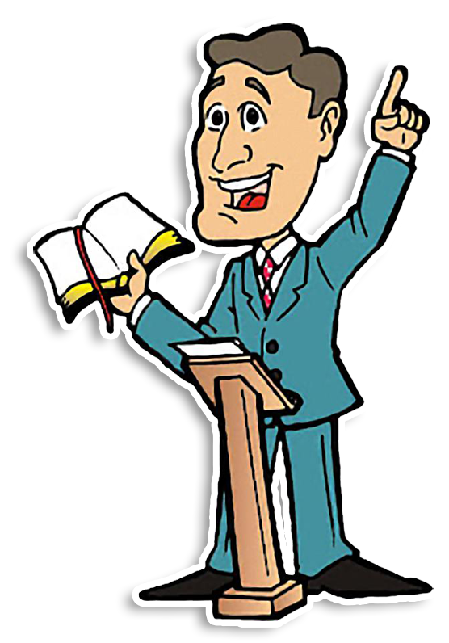
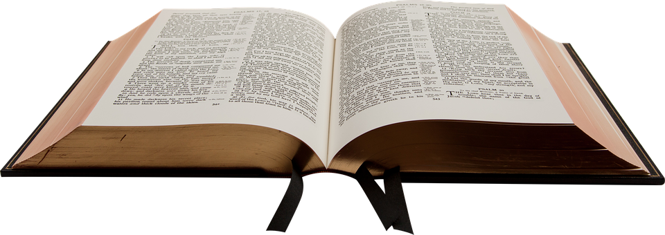
Sin Brings Judgment
How might God confront us today about a casual attitude you had toward sacred things?

Slide 19
Application
Check your ego.
  Examine to see if there are areas in which you have become over-confident in your own abilities and resources.
  Evaluate what’s led to this elevated sense of security. Pray that God will help you have a right attitude about depending on Him.

Slide 20
Application
Spend time alone with God.
  Set aside a couple of secluded hours, taking only a Bible, pen, and paper.
  Spend time in Scripture and prayer.
  Ask God to speak any messages He may have for you.
  Take time to listen silently; take notes on any impressions He gives.

Slide 21
Application
Focus on that which is sacred.
  Make a two-column list. Write “Sacred” as the heading of the column on the left; write “Cultural” as the heading of the column on the right.
  Under “Sacred,” list worship-related actions the Scriptures mandate.
  Under “Cultural,” list actions that may seem religious but are instead dictated by cultural expectations and traditions.
  Focus this week on what God calls sacred.

Slide 22
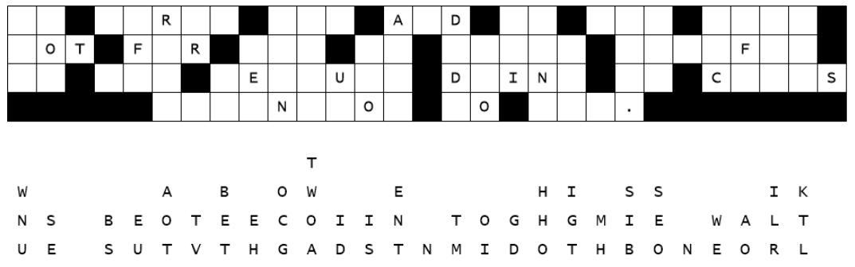

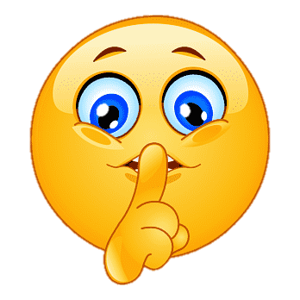
Family Activities
Whoa … the wrong glue again. A bunch of letters fell straight down. Spiros the Spy is upset big time. We need your help to put the message back together.
Find help and other cool, fun activities at https://tinyurl.com/3r2z3cvm

Slide 23
Speak Truth Boldly
September 17

