Slide 1
Showing Love
June 21

Slide 2

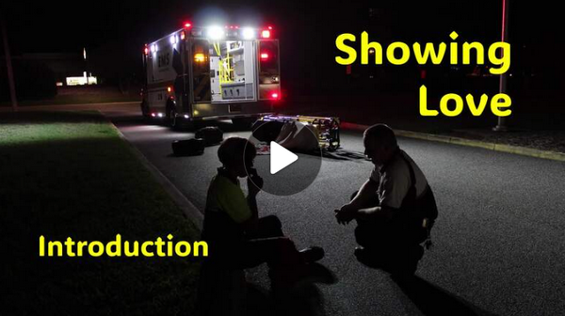
Video Introduction
View Video

Slide 3
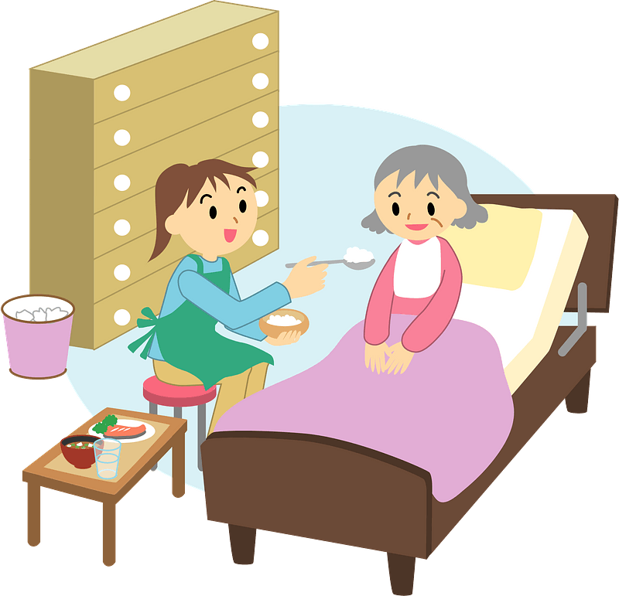
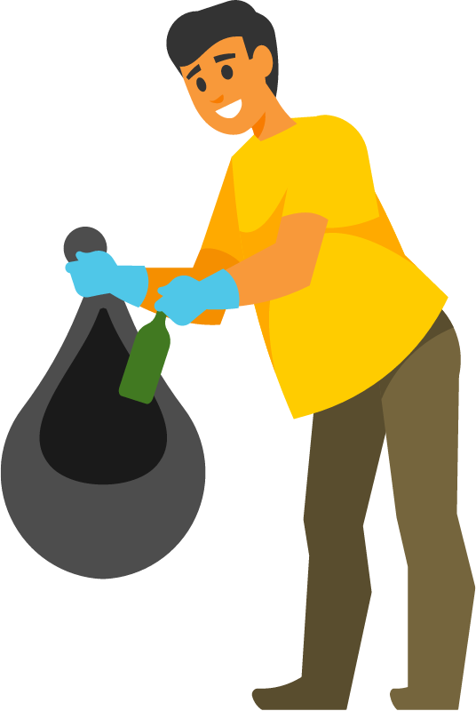
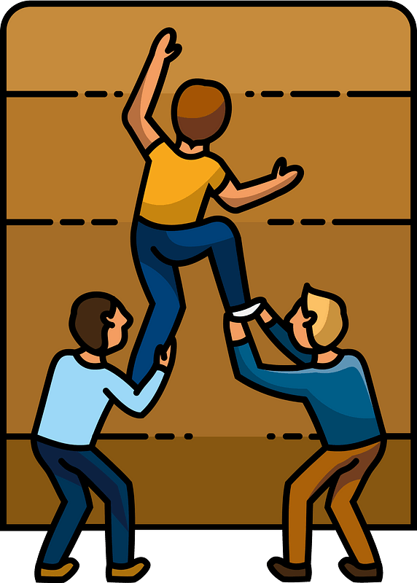
Remember?
When has someone gone out of his or her way to help you?

Slide 4
Remember?
When has someone gone out of his or her way to help you?
Helping one another is a way we show the love that Jesus spoke of
  Today we look at how loving God will be demonstrated in how we love others
  Sometimes that love will be costly

Slide 5
Listen for Jesus’ teaching style.
Luke 10:25-28 (NIV) On one occasion an expert in the law stood up to test Jesus. "Teacher," he asked, "what must I do to inherit eternal life?" 26 "What is written in the Law?" he replied. "How do you read it?" 27 He answered:

Slide 6
Listen for Jesus’ teaching style.
"'Love the Lord your God with all your heart and with all your soul and with all your strength and with all your mind'; and, 'Love your neighbor as yourself.'" 28 "You have answered correctly," Jesus replied. "Do this and you will live."

Slide 7
Loving God, Loving Others
What different motivations do people have for asking questions about God and of God?
Actually, this question is arguably the most important question any person can ask. Give your opinion why you think the lawyer was or was not sincere in asking it.
Sincere | Not Sincere

Slide 8
Loving God, Loving Others
If it was not a sincere question, but a test … what kind of test do you think this was?
Note that Jesus responds with a question of His own (a good teaching technique). What answer did the lawyer give about the requirements of the law?

Slide 9
Loving God, Loving Others
Loving God with all your heart, soul, strength, mind involves …
  Emotions
  Intellect
  Total focus
  God is the very center of every element of your life

Slide 10
Loving God, Loving Others
What does it mean to “love your neighbor as yourself”?
The man was said to be an “expert in the law.” How can spending too much time simply studying the Bible lead to an unbalanced spiritual life?
Why would knowledge with little or no works be a poor testimony for Christ?

Slide 11
Listen for how Jesus begins to define “neighbor.”
Luke 10:29-32 (NIV) But he wanted to justify himself, so he asked Jesus, "And who is my neighbor?" 30 In reply Jesus said: "A man was going down from Jerusalem to Jericho, when he fell into the hands of robbers. They stripped him of his clothes, beat

Slide 12
Listen for how Jesus begins to define “neighbor.”
him and went away, leaving him half dead. 31 A priest happened to be going down the same road, and when he saw the man, he passed by on the other side. 32 So too, a Levite, when he came to the place and saw him, passed by on the other side.

Slide 13
Looking Beyond Biases
When the lawyer asked, “who is my neighbor?” what do you think was behind his question ?
What natural inclinations make it easier for you to act like the priest and the Levite?
How do we overcome barriers like these?

Slide 14

Looking Beyond Biases
“You can never be too impulsive in acting on the motivation of love.”
Agree or disagree …
Disagree | Agree

Slide 15
Listen for a surprise hero.
Luke 10:33-37 (NIV) But a Samaritan, as he traveled, came where the man was; and when he saw him, he took pity on him. 34 He went to him and bandaged his wounds, pouring on oil and wine. Then he put the man on his own

Slide 16
Listen for a surprise hero.
donkey, took him to an inn and took care of him. 35 The next day he took out two silver coins and gave them to the innkeeper. 'Look after him,' he said, 'and when I return, I will reimburse you for any extra expense you may have.'

Slide 17
Listen for a surprise hero.
"Which of these three do you think was a neighbor to the man who fell into the hands of robbers?" 37 The expert in the law replied, "The one who had mercy on him." Jesus told him, "Go and do likewise."

Slide 18
Difficult and Inconvenient
Note what the traveling Samaritan did for the injured man.
  Bandaged his wounds, put medicine on them (oil and wine)
  Transported the man to an inn, took care of the man there personally
  Paid for additional days of stay in the inn

Slide 19
Difficult and Inconvenient
Why did the Samaritan do this? Why go to all this trouble?
What barriers did the Samaritan overcome to demonstrate compassion to the injured man?
What does it cost us to show compassion to people in need around us?

Slide 20
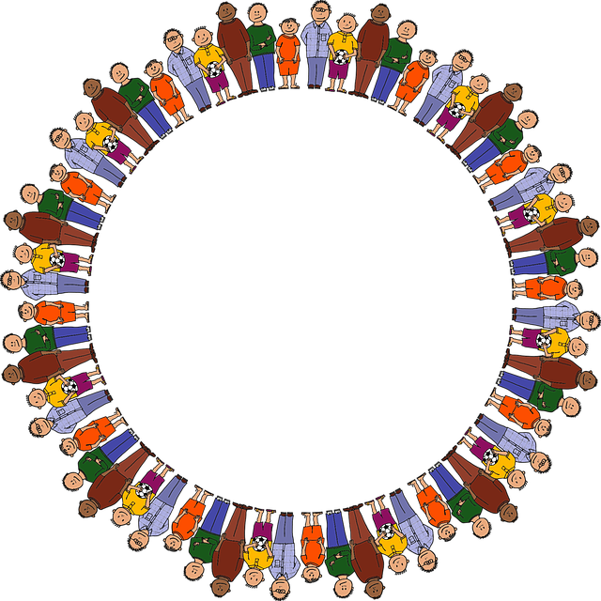
Difficult and Inconvenient
What can we do as individual
Christians or as a church to
help remove the barriers
that prevent God’s love and
message of compassion
from reaching all people?

Slide 21
Application
Confess.
  Has your life ever followed the pattern of the priest or Levite in the parable,
  Confess it to the Lord in prayer.
  Ask God to make you aware of the needs of others and to act with compassion toward them.

Slide 22
Application
Assess.
  Identify those you tend to avoid because of their spiritual lostness.
  Prayerfully examine your schedule and your attitudes.
  Determine what are the main obstacles for you to love others.
  Make the appropriate changes and look for someone who needs a neighbor.

Slide 23
Application
Express.
  Use creative ways to express your love for others.
  Send a card or a text.
  Invite an acquaintance to lunch.
  Just be a good neighbor!

Slide 24
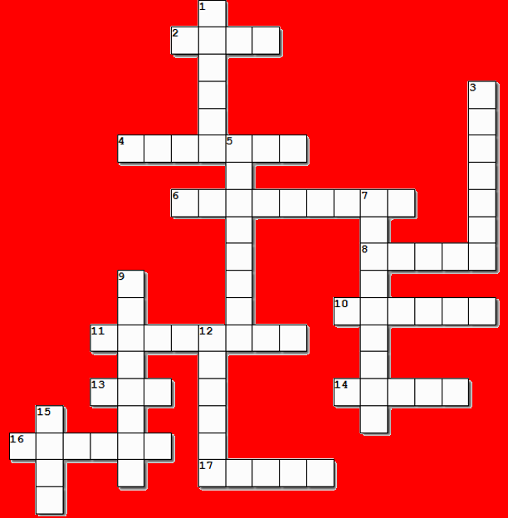

Family Activities
Well, I guess it’s time for the Crossword again. Some people want it every week. They need to know there is always a crossword posted (along with solutions). This week there’s also a Cryptogram. Find them at https://tinyurl.com/2utpkr8j

Slide 25
Showing Love
June 21

