Slide 1
Sharing Christ
April 21

Slide 2
Video Introduction
View Video

Slide 3
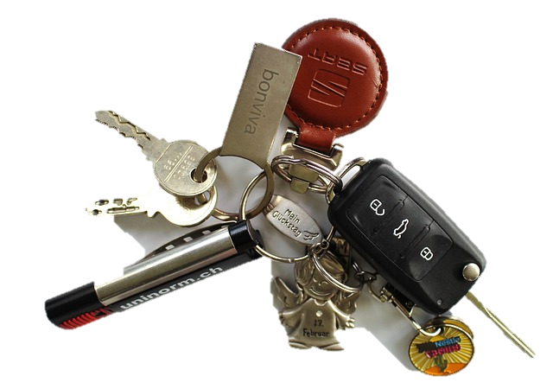
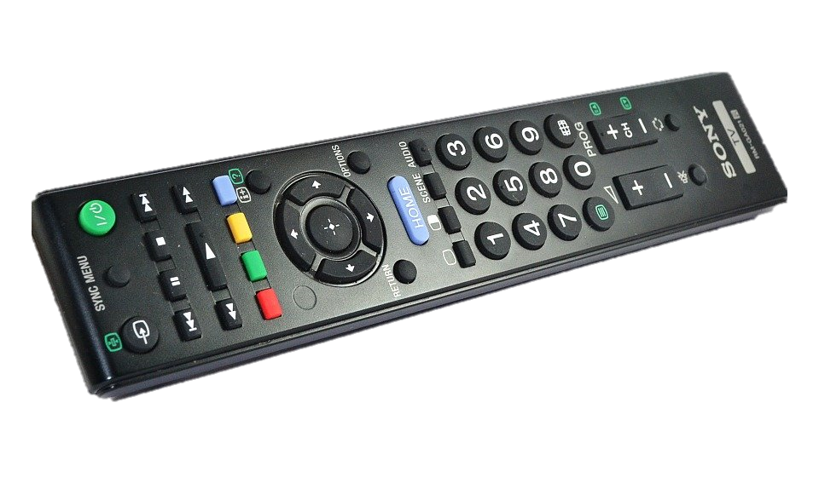
Admit it now …
When was the last time you felt like you were on a mission to find something?
God has sent us on a mission.
God sends us to tell others about Jesus.
We are on mission with Jesus to share Good News that changes lives.

Slide 4
Listen for a promise.
Matthew 28:18-20 (NIV) Then Jesus came to them and said, "All authority in heaven and on earth has been given to me. 19 Therefore go and make disciples of all nations, baptizing them in the name of the Father and of the Son and of the Holy Spirit, 20 and teaching them to obey everything I have commanded you. And surely I am with you always, to the very end of the age."

Slide 5
Make Disciples
What did Jesus say about Himself?
What does it mean to us that Jesus has “all authority”?
What activities were the disciples to be involved in?

Slide 6
Make Disciples
Note: The “go” is an imperatival participle in the original Greek.
As a participle it could be translated, “as you are going.”
As you go about life, remember your mission; remember your task
Because it is tied to the imperative, it is translated much stronger. We are commanded to “go” into all the world, every nation.

Slide 7
Make Disciples
How can knowing that Jesus is always with us make a difference “as we are going”?
To whom was Jesus speaking when He first spoke these words?
Why is the commission transferable to other believers through the ages?

Slide 8
Listen for how to share.
2 Corinthians 5:16-19 (NIV) So from now on we regard no one from a worldly point of view. Though we once regarded Christ in this way, we do so no longer. 17 Therefore, if anyone is in Christ, he is a new creation; the old has gone, the new has come!

Slide 9
Listen for how to share.
All this is from God, who reconciled us to himself through Christ and gave us the ministry of reconciliation: 19 that God was reconciling the world to himself in Christ, not counting men's sins against them. And he has committed to us the message of reconciliation.

Slide 10
Tell Others
What is the “worldly point of view” Paul mentions?
What did God do through Christ?
In what ways does God change our lives, make us a new “creation”?

Slide 11
Tell Others
To what responsibility have we been appointed on behalf of Christ?
How can you personally be involved in the ministry of reconciliation?

Slide 12
Listen for what is too good to keep to ourselves.
2 Corinthians 5:20-21 (NIV) We are therefore Christ's ambassadors, as though God were making his appeal through us. We implore you on Christ's behalf: Be reconciled to God. 21 God made him who had no sin to be sin for us, so that in him we might become the righteousness of God.

Slide 13
A Call to Be Reconciled
What appeal was part of Paul’s message to the Corinthians?
To what position have we been appointed in relation to sharing the message of reconciliation?

Slide 14
A Call to Be Reconciled
What are some ways we act as ambassadors for Christ? How is a Christian an ambassador?
Someone has said that believers are the only “Jesus” that some will ever see. What kinds of things in the life of a believer would keep others from seeing Jesus in their lives?

Slide 15
A Call to Be Reconciled
What kinds of things do we need to have changed in our lives so that Jesus can be seen more clearly, so that we will be more effective ambassadors?

Slide 16
Application
Study.
Read a book on how to share your faith.
Implement one suggestion from the book.

Slide 17
Application
Share.
Write your testimony (before I met Jesus; how I met Jesus; since I met Jesus).
Share it with someone you have never told.

Slide 18
Application
Support.
Volunteer to mentor a new Christian.
Meet with that person regularly to pray, study the Bible, and answer questions.

Slide 19
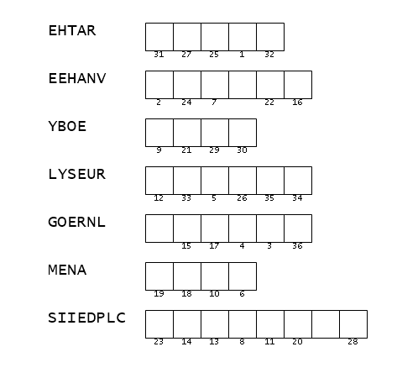
Family Activities
What is a “MENA”? That’s not going to help me figure out the quote. Oh yes … the words are from the Bible passage today. Help me out, please. You can find help and other cool stuff at https://tinyurl.com/23rv7xpw

Slide 20
Sharing Christ
April 21

