Slide 1
Share the Message
May 23

Slide 2

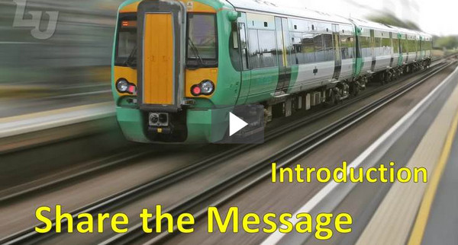
Video Introduction
View Video

Slide 3



Admit it, now …
What are some topics you are always ready to talk about?
Most people are ready to talk about something.
  These conversations can often be opportunities to share Christ.
  Today we look at how Paul did this when he visited Athens

Slide 4
Listen for where Paul speaks.
Acts 17:16-18 (NIV) While Paul was waiting for them in Athens, he was greatly distressed to see that the city was full of idols. 17 So he reasoned in the synagogue with the Jews and the God-fearing Greeks, as well as in the marketplace day by day with those who happened to be there.

Slide 5
Listen for where Paul speaks.
A group of Epicurean and Stoic philosophers began to dispute with him. Some of them asked, "What is this babbler trying to say?" Others remarked, "He seems to be advocating foreign gods." They said this because Paul was preaching the good news about Jesus and the resurrection.

Slide 6
Be Sensitive to Opportunities
What was it that distressed Paul? Why?
Why then did Paul go first to the Jewish synagogues?
Why do you think he also went to the marketplace?

Slide 7
Be Sensitive to Opportunities
Note the background of the two philosophical groups Paul interacted with …
  Epicureans – pursuit of pleasure and materialism
  Stoics – pursue human reason and self-sufficiency
What are examples of how these philosophies are present in today’s culture?
How are these worldviews in opposition to biblical values and the Gospel message?

Slide 8
Be Sensitive to Opportunities
Paul was not bashful about contacting people with the Good News … Why?
What are some reasons Christians might give for being unwilling to initiate contacts with lost people to tell them about Jesus?
⇨ Paul would have rejected all those reasons

Slide 9
Listen for Paul’s approach for witnessing.
Acts 17:22-23 (NIV) Paul then stood up in the meeting of the Areopagus and said: "Men of Athens! I see that in every way you are very religious. 23 For as I walked around and looked carefully at your objects of worship, I even found an

Slide 10
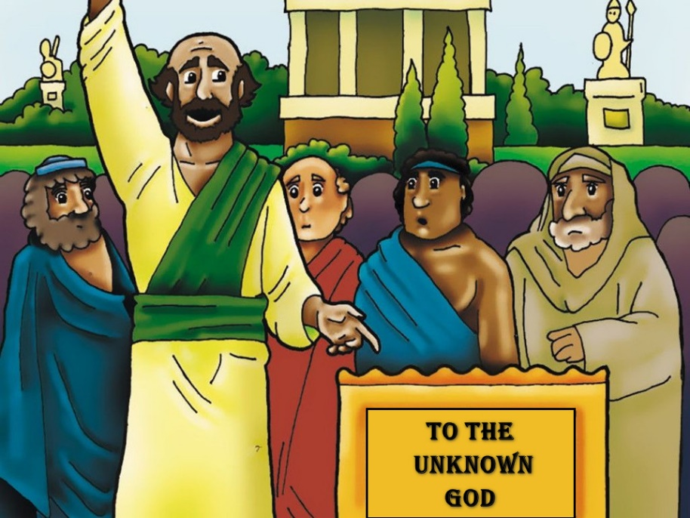
Listen for Paul’s approach for witnessing.
altar with this inscription: TO AN UNKNOWN GOD. Now what you worship as something unknown I am going to proclaim to you.

Slide 11
Find a Common Ground
What additional opportunity surfaced for Paul to share the gospel in a prominent setting?
What common religious and theological ground did he claim between himself and the people assembled on Mars’ hill?
Why would Paul tell us that Americans are very religious, but still lost?

Slide 12
Find a Common Ground
How can finding common ground with others lead to doors being opened to share the gospel?
What are some areas of commonality between religious and nonreligious people today?
What right do Christians have to claim they know the Truth about God?
In what ways does God prepare us to tell others what God has done in our lives?

Slide 13
Listen for points in Paul’s sermon.
Acts 17:30-31 (NIV) In the past God overlooked such ignorance, but now he commands all people everywhere to repent. 31 For he has set a day when he will judge the world with justice by the man he has appointed. He has given proof of this to all men by raising him from the dead."

Slide 14
Help Others Understand the Truth
What facts about repentance do you find in verse 30?
Through whom will God’s righteous judgment be administered?
By what act did God prove Jesus was worthy to be God’s agent of judgment?

Slide 15
Help Others Understand the Truth
What basic truths are essential when communicating the gospel?
Paul used Athenian culture and ideas to help them see Truth. What are some ways this could happen in our culture?

Slide 16
Application
Open your heart.
  Pray and ask God to make you aware of the opportunities around you to talk about your faith.
  Pray for a willingness to share Christ with others.

Slide 17
Application
Open your eyes.
  Make a list of areas of interest you share with other people.
  With the list, identify ways those areas of interest could be used to turn the conversation to the gospel.

Slide 18
Application
Open your mouth.
  Be diligent about maximizing your windows of opportunity to share Christ.
  Be intentional in making natural bridges between you and another person to talk about the gospel.

Slide 19
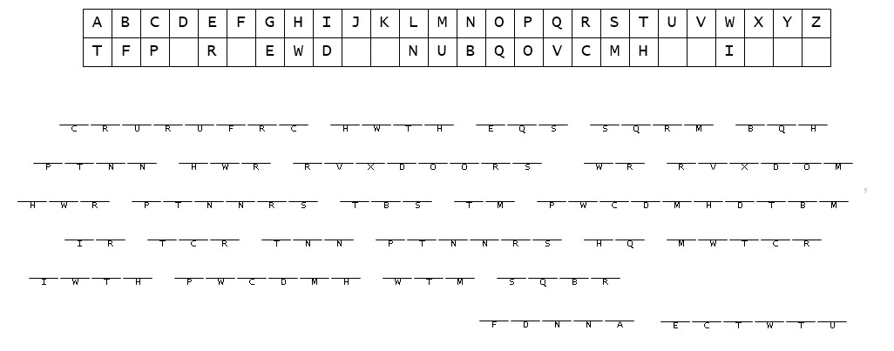
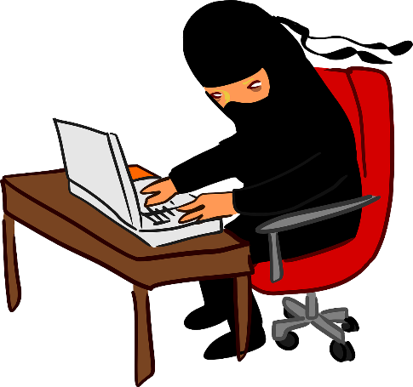
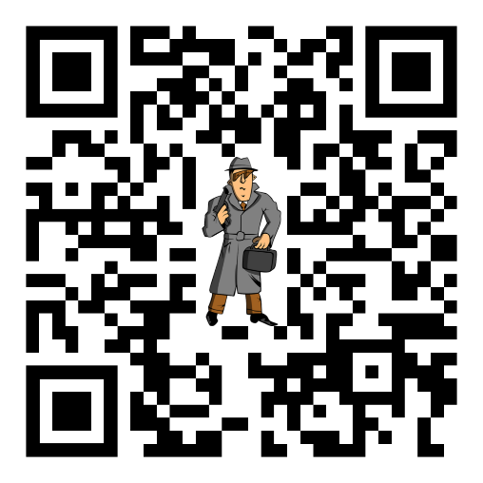
Family Activities
Spiros the Spy has forwarded to us this secret message and the key. We need your help to decode it and forward it to your evangelism committee. If you need help or additional Family Activities, access the QR code given here.

Slide 20
Share the Message
May 23

