Slide 1
Shaking Off Fear
December 13

Slide 2

Video Introduction
View Video

Slide 3

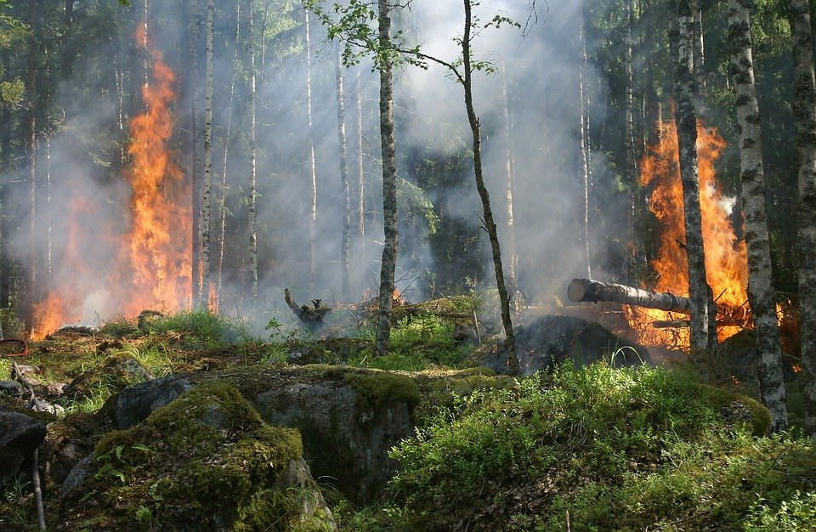
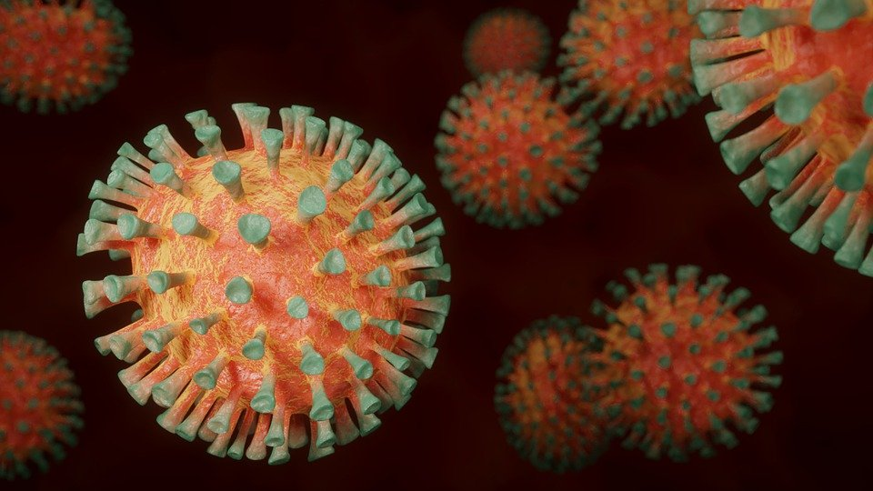
Think about it …
What endangers our health and safety in today’s world?
This has been an especially crazy year for such events.
  But we can rest assured God is our defender no matter what we face.

Slide 4
Listen for names of God.
Psalm 91:1-6 (NIV) He who dwells in the shelter of the Most High will rest in the shadow of the Almighty. 2 I will say of the LORD, "He is my refuge and my fortress, my God, in whom I trust." 3 Surely he will save you from the fowler's snare and from the deadly pestilence.

Slide 5
Listen for names of God.
He will cover you with his feathers, and under his wings you will find refuge; his faithfulness will be your shield and rampart. 5 You will not fear the terror of night, nor the arrow that flies by day, 6 nor the pestilence that stalks in the darkness, nor the plague that destroys at midday.

Slide 6
Trust God’s Power
What four names are used to refer to God? Consider the meaning or emphasis of each one.
Name | Meaning
The Most High | Supreme One, sovereignty, superiority
The Almighty | “El Shaddai”, powerful, omnipotent
LORD, Jehovah, Yahweh | Personal covenant name of God, The I AM
My God | “Elohim”, the One True God, note the “my”

Slide 7
Trust God’s Power
What are dangers from which God will protect or rescue those who trust in God?
What are images used in the passage to convey God’s protection over His loved ones?
How has God helped you through a time or season of fear?

Slide 8
Trust God’s Power
 Note
It is easy sitting in a Bible Study group to describe the calming presence and power of God.
It is much more of a struggle to apply these principles when everything around you is coming apart!
In what ways do you find that God calms your fears when circumstances around you could leave you frightened?
How should we respond when God delivers or protects us from danger?

Slide 9
Listen for God’s protection.
Psalm 91:9-13 (NIV) If you make the Most High your dwelling-- even the LORD, who is my refuge-- 10 then no harm will befall you, no disaster will come near your tent. 11 For he will command his angels concerning you to

Slide 10
Listen for God’s protection.
guard you in all your ways; 12 they will lift you up in their hands, so that you will not strike your foot against a stone. 13 You will tread upon the lion and the cobra; you will trample the great lion and the serpent.

Slide 11
Trust God’s Protection
What decision had the godly made that is affirmed by the psalmist?
What promise was extended to the godly?
What does it mean to make God our “dwelling place”?

Slide 12
Trust God’s Protection
Note the verses Satan misused in the New Testament? [11] For he will command his angels concerning you to guard you in all your ways; [12] they will lift you up in their hands, so that you will not strike your foot against a stone.
What are some ways to describe the difference between faith and presumption (which is what Satan was proposing)?
Faith | Presumption

Slide 13
Trust God’s Protection
How do we know God cares about us when we experience dangerous and difficult times?

Slide 14
Listen for God’s response to those who trust in Him.
Psalm 91:14-16 (NIV) "Because he loves me," says the LORD, "I will rescue him; I will protect him, for he acknowledges my name. 15 He will call upon me, and I will answer him; I will be with him in trouble, I will deliver him and honor him. 16 With long life will I satisfy him and show him my salvation."

Slide 15
Walk with God
What were the human actions God attributes to a human?
List the responses of God to these expressions of faith and trust.
What are some ways in which God has ministered to you in one of these ways recently?

Slide 16
Walk with God
What are some ways we can call out to God when we feel afraid?
Today …
  Be encouraged for your own needs by the reality of God at work in one another's lives
  Support one another in prayer for all these kinds of needs

Slide 17
Application
Make a list.
  Make a list of things that tend to cause you fear.
  Beside each of those fears, make a note of why trusting God will help you to overcome that fear.

Slide 18
Application
Get counsel.
  If you deal with a long-term deep-seated fear or phobia, talk to your pastor or a trusted counselor.
  Talking to a counselor can help get to the root of such fears and help you get to the place where you can trust God.

Slide 19
Application
Support.
  Walk alongside someone who might be prone to fear.
  Be an example and model of 2 Timothy 1:7: “For the Spirit God gave us does not make us timid, but gives us power, love and self-discipline.”

Slide 20
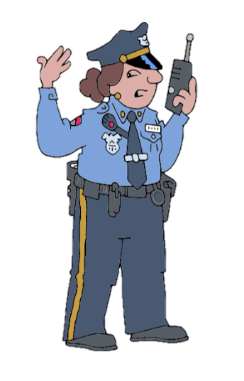
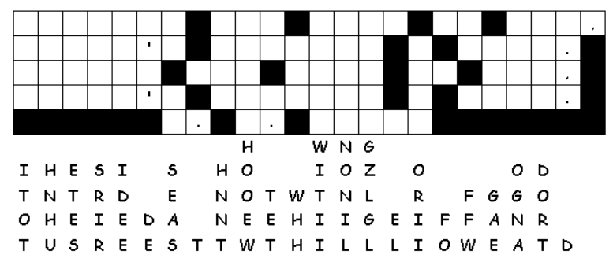

Family Activities
We have a report of letters down. People are paralyzed with fear. We need your help to get the message to them. Help and further resources can be found at https://tinyurl.com/y3chadje.

Slide 21
Shaking Off Fear
December 13

