Slide 1
Set Apart in the Way We Think
August 6

Slide 2

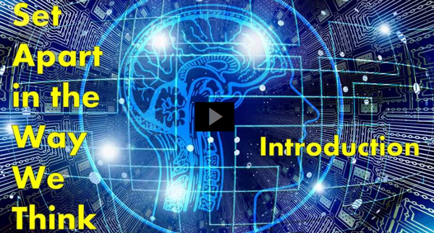
Video Introduction
View Video

Slide 3
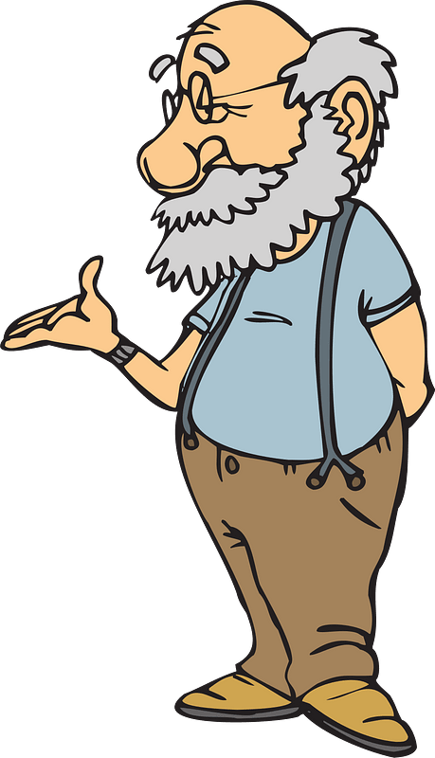


You changed your mind ???
What kinds of things could cause you to change your mind about something?
Maybe a change in your values has to do with a spiritual experience.
  Living for Christ changes the way we think.

Slide 4
Listen for an appeal.
Romans 11:33 (NIV) Oh, the depth of the riches of the wisdom and knowledge of God! How unsearchable his judgments, and his paths beyond tracing out! … [36]For from him and through him and to him are all things. To him be the glory forever! Amen. [12:1] Therefore, I urge you, brothers, in view of God's mercy, to offer your bodies as

Slide 5
Listen for an appeal.
living sacrifices, holy and pleasing to God--this is your spiritual act of worship. [2] Do not conform any longer to the pattern of this world, but be transformed by the renewing of your mind. Then you will be able to test and approve what God's will is--his good, pleasing and perfect will.

Slide 6
A Renewed Mind
The word therefore is a transition word … what follows is based on what has just been said. What do we learn about God prior to the “therefore”?
Based on the reality of who God is and what He is like, what are we urged to do?

Slide 7
A Renewed Mind
Sacrifices in Jewish worship were slain animals. Consider how this sheds meaning on giving your body as a living sacrifice.
  The owner was surrendering the value of the animal
  Killing it guaranteed a 100% surrender of the animal to God
  God wants 100% of what we are, who we are to belong to Him
  We surrender ownership and control of our lives to Him … as if we were dead

Slide 8
A Renewed Mind
What makes offering our bodies as living sacrifices an act of worship?
What would be the effect of a transformed way of thinking?
What are the patterns of the world that tempt us to conform?

Slide 9
A Renewed Mind
Surround by non-Christian worldview, how then can a Christian renew his or her mind?
How would these things help us discern the will of God?

Slide 10
Listen for how to think about yourself.
Romans 12:3-5 (NIV) For by the grace given me I say to every one of you: Do not think of yourself more highly than you ought, but rather think of yourself with sober judgment, in accordance with the measure of faith God has

Slide 11
Listen for how to think about yourself.
given you. 4 Just as each of us has one body with many members, and these members do not all have the same function, 5 so in Christ we who are many form one body, and each member belongs to all the others.

Slide 12
Thinking about Ourselves
What two-pronged challenge did he offer about the way believers are to think?
Why was a believer not to think of himself more highly than he ought to think?
How does the analogy of the human body help us better understand how the church should work?

Slide 13
Thinking about Ourselves
Agree or disagree ???
The point is, that both are equally important …
Paul is saying no one believer is more important than the other
All are equally important.
It’s more important to have an eye than an ear
Agree | Disagree

Slide 14
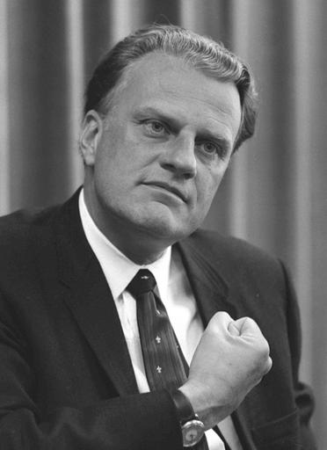
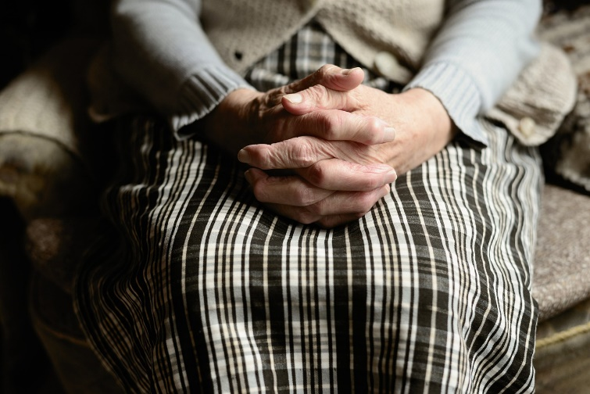
Thinking about Ourselves
In God’s economy, the little old ladies who pray are just as important as the evangelists who preach to millions

Slide 15
Listen for how to work with others.
Romans 12:9-13 (NIV) Love must be sincere. Hate what is evil; cling to what is good. 10 Be devoted to one another in brotherly love. Honor one another above yourselves. 11 Never be

Slide 16
Listen for how to work with others.
lacking in zeal, but keep your spiritual fervor, serving the Lord. 12 Be joyful in hope, patient in affliction, faithful in prayer. 13 Share with God's people who are in need. Practice hospitality.

Slide 17
Our Attitude toward Others
What are some ways Paul identified for how love will manifest itself in relationship to others?
What can we do to learn to hate evil?
How can one hate evil yet not hate the evildoer?

Slide 18
Our Attitude toward Others
How can a Christian learn to love others as God loves them?
Paul advises the Romans to be patient in affliction and to be faithful in prayer. How do you understand the relationship between patience in affliction and prayerfulness? How can prayer help us navigate challenging times?

Slide 19
Application
Recognize.
  Assess your self-image.
  Evaluate whether your view of yourself is consistent with how God sees you.
  If you identify spiritual pride, be quick to confess it and root it out wherever it can be found.

Slide 20
Application
Read.
  Spend some time working on the transforming of your mind.
  We know that this is God’s work, but God uses means.
  Consider reading a book such as The Mind of Christ by T. W. Hunt.

Slide 21
Application
Replicate.
  Connect with a Christian friend to share what you have learned.
  Set an appointment this week and encourage that friend to share principles from this session with another person the following week.

Slide 22
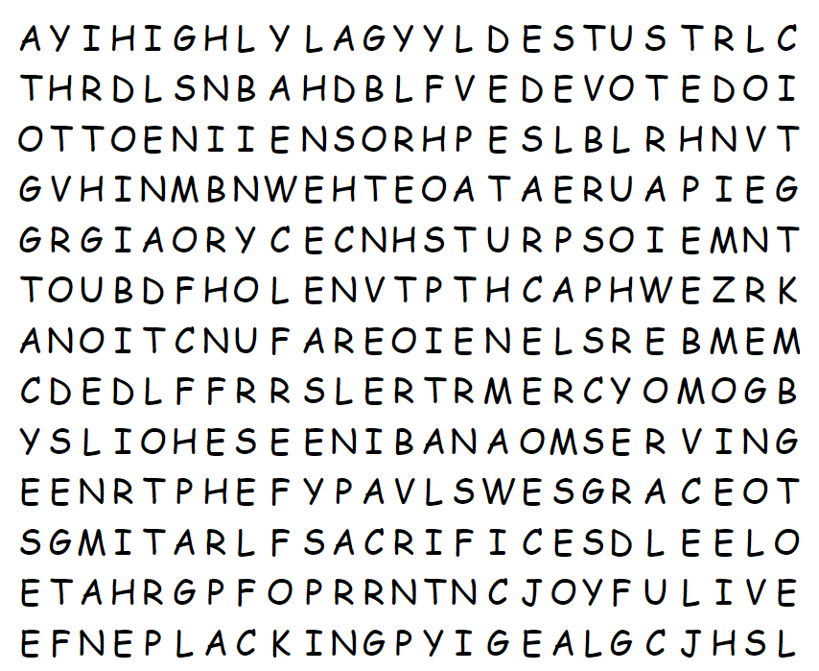
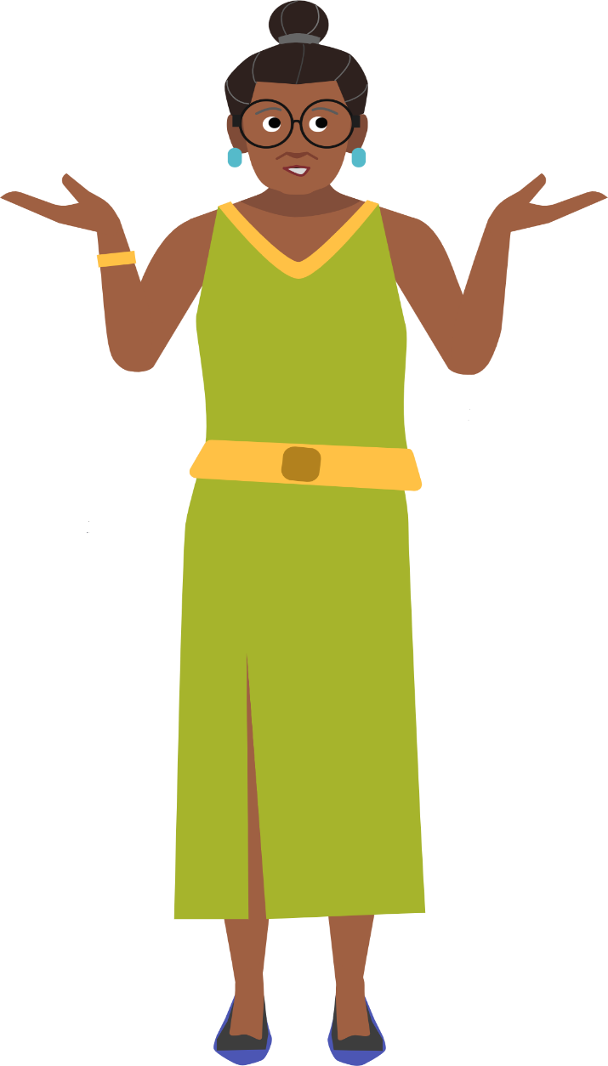
Family Activities
The Word Search Lady just said “Humph”. I hope you can find lots of the words. You know, they come from our Bible passage today. Don’t tell her, but there is a solution provided at https://tinyurl.com/mtdz8asu
And for that quiet crowd there in the back, the crossword is there also.

Slide 23
Set Apart in the Way We Think
August 6

