Slide 1
Set Apart in the Way We Live
August 13

Slide 2

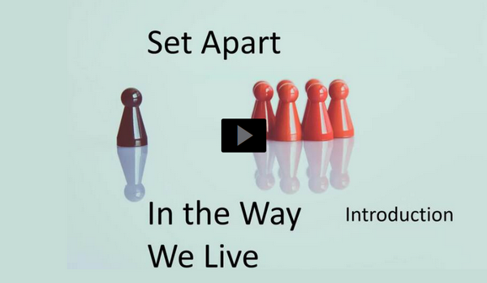
Video Introduction
View Video

Slide 3



It happens …
In what situations today do we see truth questioned?
God’s Truth is absolute.
  We grow in Christlikeness as we walk in truth and love
If I am elected …

Slide 4
Listen for repetitions of the word “truth”.
2 John 1:1-4 (NIV) The elder, To the chosen lady and her children, whom I love in the truth--and not I only, but also all who know the truth-- 2 because of the truth, which lives in us and will be with us forever: 3 Grace, mercy

Slide 5
Listen for repetitions of the word “truth”.
and peace from God the Father and from Jesus Christ, the Father's Son, will be with us in truth and love. 4 It has given me great joy to find some of your children walking in the truth, just as the Father commanded us.

Slide 6
Walk in Truth
Consider what we know of the writer of the letter and the recipients.
  The writer identifies himself as “the elder”
  Common opinion is that this is John, the disciple
  Addressed to “the chosen lady”
  Many Bible scholars believe this refers to a particular church congregation

Slide 7
Walk in Truth
According to the verses, why would the recipients of the letter be people easy to love?
How can the word “truth” be understood in these verses?
Over what did the writer rejoice?

Slide 8
Walk in Truth
How would you describe what it looks like to “walk in truth”?
How can we ensure our lifestyle is consistent with God’s truth?

Slide 9
Listen for John’s focus on love.
2 John 1:5-6 (NIV) And now, dear lady, I am not writing you a new command but one we have had from the beginning. I ask that we love one another. 6 And this is love: that we walk in obedience to his commands. As you have heard from the beginning, his command is that you walk in love.

Slide 10
Walk in Love
What is the urgent appeal John makes to the church to whom he wrote?
What might John have meant by referring to the commandment to love as something from the beginning?
John emphasizes the importance of truth and love. How do these two concepts intersect, and why are they crucial in the Christian faith?

Slide 11
Walk in Love
How would you describe what it looks like to walk in love?
What are some practical ways we can walk in love during a normal day?

Slide 12
Listen for a reminder to be alert.
2 John 1:7-9 (NIV) Many deceivers, who do not acknowledge Jesus Christ as coming in the flesh, have gone out into the world. Any such person is the deceiver and the antichrist. 8 Watch out that you do not lose what you have

Slide 13
Listen for a reminder to be alert.
worked for, but that you may be rewarded fully. 9 Anyone who runs ahead and does not continue in the teaching of Christ does not have God; whoever continues in the teaching has both the Father and the Son.

Slide 14
Walk in the Teachings of Christ
What did many false teachers of John’s day deny?
What does it mean not to welcome a person who does not share in the teaching of Christ?
How would welcoming someone without correct teaching about Christ be sharing in his or her wickedness?

Slide 15
Walk in the Teachings of Christ
How can we avoid false teachers without being cold or inhospitable?
What evidence in one’s life will indicate that he or she is striving to walk in truth?

Slide 16
Application
Read.
  Read a selection of Scripture each day this week.
  Why not start with the letters of the apostle John: 1, 2, and 3 John?
  These books have a total of seven chapters—just one per day! Then you will grow in truth.

Slide 17
Application
Reinforce.
  Consciously reinforce your love for others by either word or deed each day this week.
  Start with something small like a note or compliment.
  It will make a difference in your life and theirs.
  Then you will deepen your love.

Slide 18
Application
Reconcile.
  Identify someone you’ve had difficulty loving unconditionally.
  Pray for this person daily and ask God for an opportunity to either forgive or seek forgiveness this week.
  Then you will model obedience.

Slide 19


Family Activities
I hope you have a key for this secret message from Nango Puandbar. Spiros the Spy is counting on you to decode it. Help is available at https://tinyurl.com/yc7n42kh . For you gentlemen over on the right, the color page can be found there also.

Slide 20
Set Apart in the Way We Live
August 13

