Slide 1
Set Apart for the Journey
August 20

Slide 2
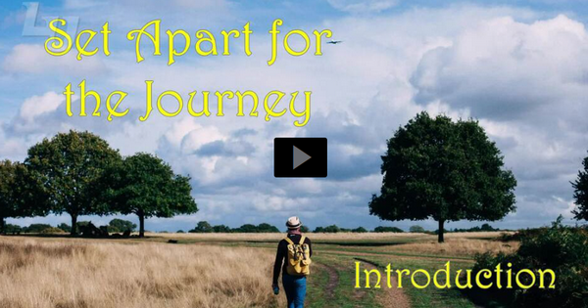
Video Introduction
View Video

Slide 3
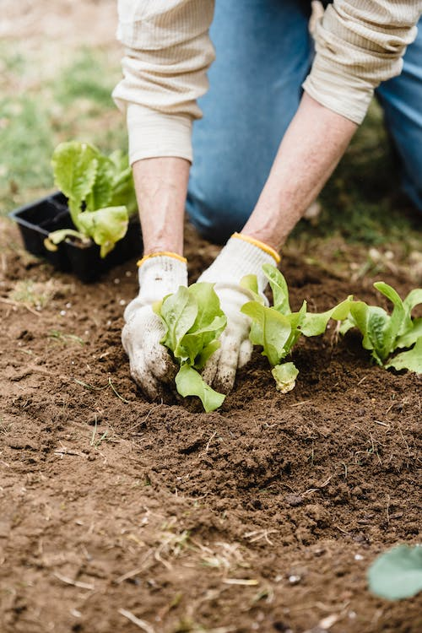
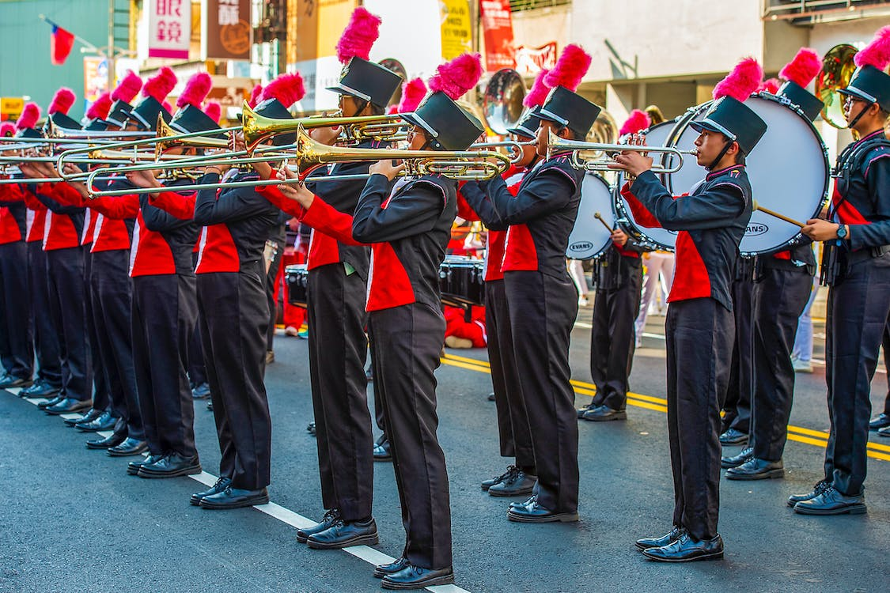
Remember that time …
When have you been thankful you didn’t quit?
Growing in Christ is a lifelong journey.
God wants us (and helps us) to keep at it – not to give up when things get difficult
Day by day, we can become more and more like Jesus.

Slide 4
Listen for Paul’s goal.
Philippians 3:12-14 (NIV) Not that I have already obtained all this, or have already been made perfect, but I press on to take hold of that for which Christ Jesus took hold of me. 13 Brothers, I do not consider myself yet

Slide 5
Listen for Paul’s goal.
to have taken hold of it. But one thing I do: Forgetting what is behind and straining toward what is ahead, 14 I press on toward the goal to win the prize for which God has called me heavenward in Christ Jesus.

Slide 6
A Continual Journey
What are the two actions he committed himself to in order to accomplish the one objective of becoming spiritually mature?
Paul says to forget the past. What in his past do you think Paul was trying to forget?
What are some things we need to forget as we grow and mature in our Christian faith?

Slide 7
A Continual Journey
Why can the past (good or bad) be a problem for a believer?
How do we put the past behind us, how do we get rid of these things which hinder us?
In what ways is the imagery of a race an appropriate one to describe what Paul urged his readers to strive for?

Slide 8
A Continual Journey
What is the prize that Christians are striving to obtain?
How can Christ help you stay on track and reach the goal?

Slide 9
Listen for an example to follow.
Philippians 3:15-19 (NIV) All of us who are mature should take such a view of things. And if on some point you think differently, that too God will make clear to you. 16 Only let us live up to what we have already attained. 17 Join with others in following my example, brothers, and take note

Slide 10
Listen for an example to follow.
of those who live according to the pattern we gave you. 18 For, as I have often told you before and now say again even with tears, many live as enemies of the cross of Christ. 19 Their destiny is destruction, their god is their stomach, and their glory is in their shame. Their mind is on earthly things.

Slide 11
The Example of Mature Believers
Paul warned against false teachers, “enemies of the cross” What are some words and phrases he used to describe them?
What positive examples does Paul suggest or imply?

Slide 12
The Example of Mature Believers
How can we intentionally position ourselves to benefit from the example of others?
How is salvation more than receiving “insurance” against eternal destruction (a fire escape from hell)?

Slide 13
Listen for where is our citizenship.
Philippians 3:20-21 (NIV) But our citizenship is in heaven. And we eagerly await a Savior from there, the Lord Jesus Christ, 21 who, by the power that enables him to bring everything under his control, will transform our lowly bodies so that they will be like his glorious body.

Slide 14
Glorious Transformation in Heaven
Consider the true community of believers and wherein is their true citizenship.
The Body of Christ … the Church
Citizenship is in heaven – that is where we belong
1 Peter 2:11 (NIV) “Dear friends, I urge you, as aliens and strangers in the world, to abstain from sinful desires, which war against your soul.”

Slide 15
Glorious Transformation in Heaven
What characterizes citizens of heaven?
What makes these verses challenging?
How can knowing that our citizenship is in heaven encourage us in this life?
How do we balance living as citizens of the particular nation we are from as well as being citizens of heaven?

Slide 16
Application
Identify.
Growing in Christ is a continual journey.
Identify a specific area of your Christian life where you have stopped growing spiritually.
Seek forgiveness and ask for grace to continue growing.

Slide 17
Application
Initiate.
We grow spiritually through the example of others.
Initiate an intentional relationship with a more mature believer who inspires you to grow in your walk with Christ.

Slide 18
Application
Invest.
Others grow spiritually through our example.
Pay it forward by inviting a less mature believer into an intentional relationship with you.
Help this person grow in his or her walk with Christ.

Slide 19
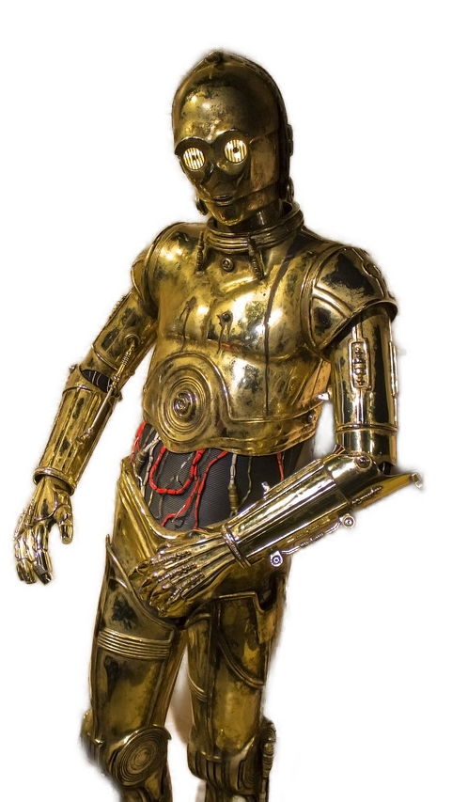
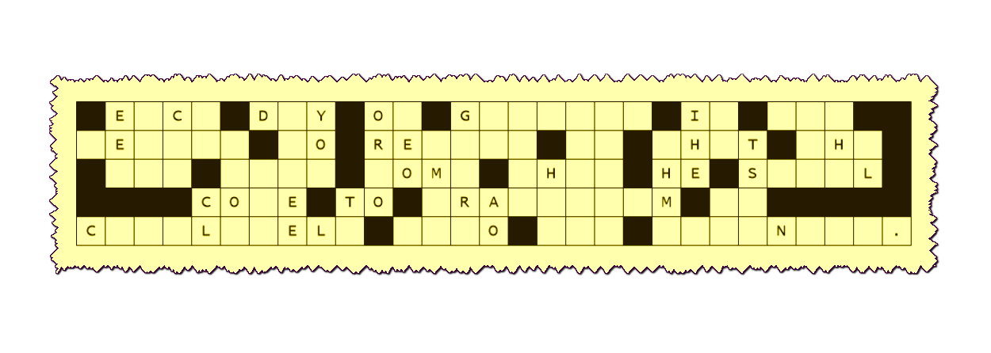
Family Activities
R2D2 suggests that you work quickly and accurately to rebuild the decoded message. You have been given the letters that fell straight down off the decoding form. Technical help is available at https://tinyurl.com/mrh62cfp And for you people in the front of class, the Crossword Puzzle is also available there.

Slide 20
Set Apart for the Journey
August 20

