Slide 1
Set Apart
But Not Alone
July 30

Slide 2


Video Introduction
View Video

Slide 3



What about you …
What are some different ways you access information for home, work, church, areas of curiosity?
This week we consider how the Spirit guides believers to live as wise, mature Christians
  The Holy Spirit helps us know how to live holy lives

Slide 4
Listen for comments on wisdom.
1 Corinthians 2:6-9 (NIV) We do, however, speak a message of wisdom among the mature, but not the wisdom of this age or of the rulers of this age, who are coming to nothing. 7 No, we speak of God's secret wisdom, a wisdom that has been hidden and that God destined for our glory

Slide 5

Listen for comments on wisdom.
before time began. 8 None of the rulers of this age understood it, for if they had, they would not have crucified the Lord of glory. 9 However, as it is written: "No eye has seen, no ear has heard, no mind has conceived what God has prepared for those who love him"--

Slide 6
God’s Wisdom Is Greater
How did Paul describe or define the substance of the message he and his coworkers preached in Corinth?
To what did he contrast his message?

Slide 7
God’s Wisdom Is Greater
Let’s contrast the two kinds of wisdom Paul speaks of. What characteristics of each does he state.
Wisdom of This Age | God’s Wisdom

Slide 8
God’s Wisdom Is Greater
Consider the fact that nowhere in this passage do the words “education” or “heritage” appear in relation to God's wisdom.
Because God’s Wisdom is not …
A matter of exposure to facts, knowledge
A collection of information to be passed down
⇨God’s wisdom has to do with knowing Christ personally

Slide 9
God’s Wisdom Is Greater
Spiritual Truth is known only to those who …
  Believe what God says and
  Receive it in faith

Slide 10
God’s Wisdom Is Greater
In what kinds of situations do we need wisdom in serving the Lord?
What advice in line with this scripture passage do you think Paul would give for these situations?

Slide 11


The Holy Spirit Gives Understanding
Why are you sometimes able to almost “read the mind” of your spouse or your best friend? You can often predict what they will say, or both say the same thing together.
Go see the new movie …

Slide 12
Listen for how you can know what God is thinking.
1 Corinthians 2:10-13 (NIV) but God has revealed it to us by his Spirit. The Spirit searches all things, even the deep things of God. 11 For who among men knows the thoughts of a man except the man's spirit within him? In the same way no one knows the thoughts of God except the Spirit of God.

Slide 13
Listen for how you can know what God is thinking.
We have not received the spirit of the world but the Spirit who is from God, that we may understand what God has freely given us. 13 This is what we speak, not in words taught us by human wisdom but in words taught by the Spirit, expressing spiritual truths in spiritual words.

Slide 14
The Holy Spirit Gives Understanding
Why is verse 10a essential to understanding Paul’s intent in verse 9?
⁹ However, as it is written: "No eye has seen, no ear has heard, no mind has conceived what God has prepared for those who love him"–
¹⁰ but God has revealed it to us by his Spirit..

Slide 15

The Holy Spirit Gives Understanding
How do we put ourselves in a position to receive God’s wisdom … to know His thoughts?
Why should we not assume that God gives us His wisdom automatically?
How does receiving God’s wisdom
relate to being filled by the Spirit?

Slide 16
Listen for limitations for unbelievers.
1 Corinthians 2:14-16 (NIV) The man without the Spirit does not accept the things that come from the Spirit of God, for they are foolishness to him, and he cannot understand them, because they are spiritually discerned. 15 The

Slide 17
Listen for limitations for unbelievers.
spiritual man makes judgments about all things, but he himself is not subject to any man's judgment: 16 "For who has known the mind of the Lord that he may instruct him?" But we have the mind of Christ.

Slide 18
A New Perspective
According to this passage, how are spiritual and unspiritual people different?
Spiritual People | Unspiritual People

Slide 19
A New Perspective
How then, can a believer differentiate between natural human wisdom and the spiritual wisdom that comes from God?
What are some Christian beliefs that nonbelievers (including those of other faiths) have a hard time understanding?

Slide 20
A New Perspective
According to this passage, how can we effectively explain these beliefs to nonbelievers?
What do you think it means to have “the mind of Christ?”

Slide 21

Application
List.
  Make a list of areas where
  you need wisdom.
  Take those things to God in
  prayer, asking for His
  Holy Spirit’s guidance.

Slide 22
Application
Refine.
  Conduct an inventory of the sources that help you make decisions in life.
  Ask God for greater discernment in discriminating between them.
  Classify these sources by subject area (such as finances) and their degree of reliability.
  Then eliminate resources that could betray your judgment or lead you astray.

Slide 23

Application
Partner.
  Look for a godly mentor in one or more of the areas listed above.
  Schedule regular time together to grow in wisdom with God’s help.

Slide 24
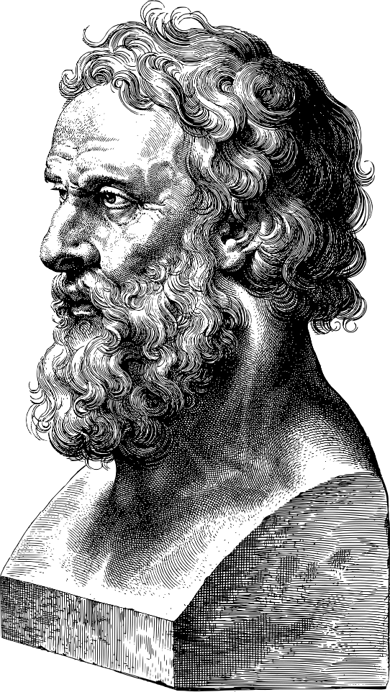
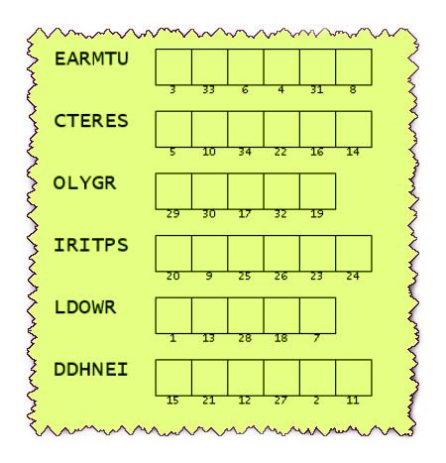
Family Activities
Looks like those are words from your Bible Study … just jumbled up. This must be the key to a coded message. If you get stuck, go to https://tinyurl.com/82nhrjvu for help. The ladies on the left will find the crossword there also.

Slide 25
Set Apart
But Not Alone
July 30

