Slide 1
Serving in Christ
May 12

Slide 2
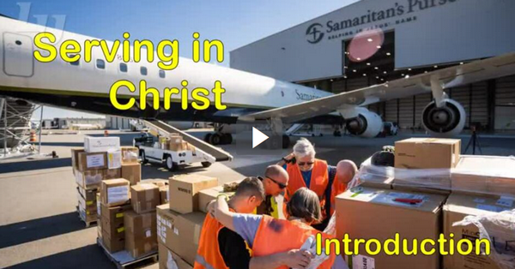
Video Introduction
View Video

Slide 3
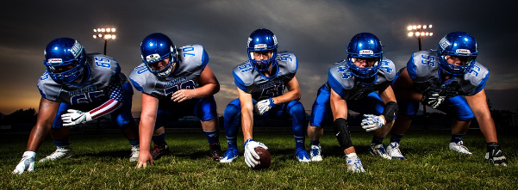
Remember that time?
When have you been in a situation where working together was a necessity, not an option?
Today we look at what keeps the church unified
We are diverse individuals
At the same time God calls us to unity … which takes work

Slide 4
Listen for use of the word “one”.
Ephesians 4:1-7 (NIV) As a prisoner for the Lord, then, I urge you to live a life worthy of the calling you have received. 2 Be completely humble and gentle; be patient, bearing with one another in love. 3 Make every effort to keep the unity of the Spirit through

Slide 5
Listen for use of the word “one”.
the bond of peace. 4 There is one body and one Spirit-- just as you were called to one hope when you were called-- 5 one Lord, one faith, one baptism; 6 one God and Father of all, who is over all and through all and in all. 7 But to each one of us grace has been given as Christ apportioned it.

Slide 6
One in the Spirit
According to this passage, what are actions and attitudes that show we walk worthy of our calling?
What kinds of habits or choices do believers sometimes make that shortchange God … times when we do not walk worthy of what He deserves?

Slide 7
One in the Spirit
Paul mentions unity. What keeps sports teams unified?
Since churches and their members are so diverse, what unifies us as the body of Christ?

Slide 8
One in the Spirit
Note the factors Paul enumerated that make for unity in the church. These are his uses of the word “one”.
One Body [the Body of Christ, the Church], one Spirit [the Holy Spirit], one hope, one Lord, one faith, one baptism, one God and Father of all, God’s grace

Slide 9
One in the Spirit
How does each contribute to the concept of unity among believers?
What attitudes and actions can we take that would build unity in our church?

Slide 10
Listen for what unity does not mean.
Ephesians 4:11-13 (NIV) It was he who gave some to be apostles, some to be prophets, some to be evangelists, and some to be pastors and teachers, 12 to prepare God's people for works of service, so that

Slide 11
Listen for what unity does not mean.
the body of Christ may be built up 13 until we all reach unity in the faith and in the knowledge of the Son of God and become mature, attaining to the whole measure of the fullness of Christ.

Slide 12
God Equips for Ministry
What specific skills do you see listed here that God gives?
What does Paul say is the purpose of these gifts?
The KJV uses the word “perfect” in verse 13 “Till we all come in the unity of the faith, and of the knowledge of the Son of God, unto a perfect man” What are some synonyms of this word?

Slide 13
God Equips for Ministry
So, what does it mean to be a “perfect” man or woman?
How have you seen church leaders equip the saints in a way that brought unity and growth towards perfection in the church? What are some ways you have been equipped by the church?

Slide 14
Listen for how God uses our gifts.
Ephesians 4:14-16 (NIV) Then we will no longer be infants, tossed back and forth by the waves, and blown here and there by every wind of teaching and by the cunning and craftiness of men in their deceitful scheming. 15 Instead, speaking

Slide 15
Listen for how God uses our gifts.
the truth in love, we will in all things grow up into him who is the Head, that is, Christ. 16 From him the whole body, joined and held together by every supporting ligament, grows and builds itself up in love, as each part does its work.

Slide 16
Ministering Alongside Others
How does Paul describe spiritual “infants”?
What are we supposed to be doing, according to verse 15?
What should be happening to a healthy body, according to verse 16?

Slide 17
Ministering Alongside Others
What imagery did Paul use to describe the relationship of Christ to the Church?
What advice would you give someone seeking to balance speaking truth and showing love?

Slide 18
Application
Cultivate unity.
Pray for unity in your church. Repent of actions and attitudes that destroy unity.
Confess these things to others if appropriate.

Slide 19
Application
Support church leaders.
Participate in an opportunity your church leaders provide for training and equipping members (Heb. 13:17).
Invite another group member to attend with you.

Slide 20
Application
Engage in ministry.
Assess your spiritual gifts. Commit to serve in a ministry role you have not served in before.
Ask God to help you find the place He has prepared for you.

Slide 21
Family Activities
My fellow operative in Qualdo Koeast works with Samaritan’s Purse. He brought this message to us from a local Baptist pastor, brother Leonidas. Use the key you have been given to help us with the decoding. Technical help and other Fun Family Activities are found at https://tinyurl.com/3erx6kmw

Slide 22
Serving in Christ
May 12

