Slide 1
Serve
May 17

Slide 2
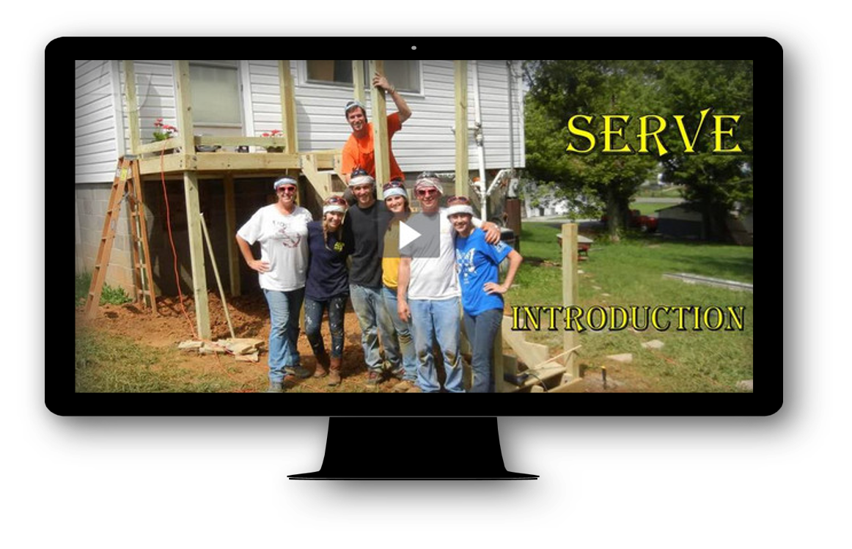
Video Introduction
View Video

Slide 3
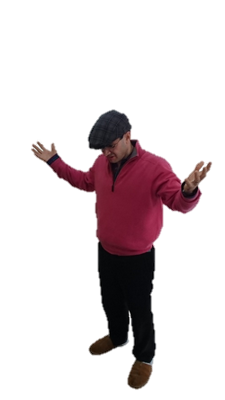

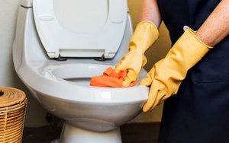
Think about it …
What’s hardest about serving others?
God calls us to seize the opportunity to serve.
  Paul takes different looks at why we serve
  He starts with how we are free to serve

Slide 4
Listen for why we have freedom.
Galatians 5:13-15 (NIV) You, my brothers, were called to be free. But do not use your freedom to indulge the sinful nature; rather, serve one another in love. 14 The entire law is summed up in a single command: "Love your neighbor as yourself." 15 If you keep on biting and devouring each other, watch out or you will be destroyed by each other.

Slide 5
Show Love by Serving
What are believers set free to do?
What is the connection between freedom in Christ and the command to serve?
What is an inappropriate use of the freedom believers have in Christ?
How can Paul say that the whole law is fulfilled by “loving your neighbor as yourself”?

Slide 6
Show Love by Serving
How do you think relationships can be strengthened through acts of service?
How might the command to “serve one another in love” affect the attitudes and actions of Christians seeking to resolve conflict situations?
How can serving others actually be very liberating?

Slide 7
Listen for an apparent contradiction.
Galatians 6:1-5 (NIV) Brothers, if someone is caught in a sin, you who are spiritual should restore him gently. But watch yourself, or you also may be tempted. 2 Carry each other's burdens, and in this way you will fulfill the law of Christ.

Slide 8
Listen for an apparent contradiction.
3 If anyone thinks he is something when he is nothing, he deceives himself. 4 Each one should test his own actions. Then he can take pride in himself, without comparing himself to somebody else, 5 for each one should carry his own load.

Slide 9
Serve by Helping to Carry Burdens
What is to be the response and goal of believers toward another believer who is guilty of wrongdoing? What actions will this involve?
What picture comes to mind when you hear the word “restore?”
What is the difference between restoring with a gentle spirit and correcting him/her harshly?
Correcting Harshly | Restoring Gently

Slide 10
Serve by Helping to Carry Burdens
In what sense does bearing “another’s burdens … fulfill the law of Christ”?
What caution did Paul offer believers?
What does this passage have to say about the temptation to feel superior to the erring brother or sister in Christ?

Slide 11
Serve by Helping to Carry Burdens
How do you explain the admonition to “bear one another’s burdens” with the admonition for every person to “bear his own burden”?
⇨ Here’s the apparent contradiction resolved
  Help your brother/sister with their struggles
  Don’t feel superior because of this … you’ve got your own issues to deal with

Slide 12
Listen for opportunities.
Galatians 6:10 (NIV) Therefore, as we have opportunity, let us do good to all people, especially to those who belong to the family of believers.

Slide 13
Seize Every Opportunity to Serve
What opportunity did Paul urge the believers to seize?
To whom should believers “especially … do good”? Why should that be true?
How can you help meet the needs of others outside the church?

Slide 14
Seize Every Opportunity to Serve
What opportunities does our group have to work for the good of others?
How can we structure our lives to be ready to serve others?

Slide 15
Application
Family.
  Be intentional about blessing your family members this week.
  Make an extra effort to serve the people you love the most.

Slide 16
Application
Church.
  Search for a specific way you can minister to your brothers and sisters in Christ.
  Start a service project or engage a long-term ministry.

Slide 17
Application
Community.
  Think through your gifts and resources.
  Then find a need in your neighborhood or community that corresponds with those gifts and resources.
  Take action.

Slide 18
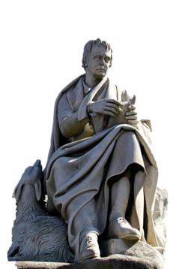
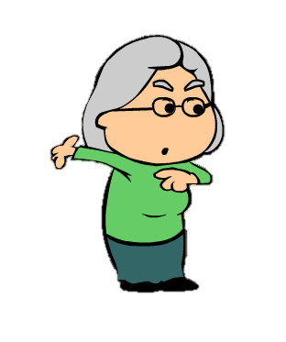
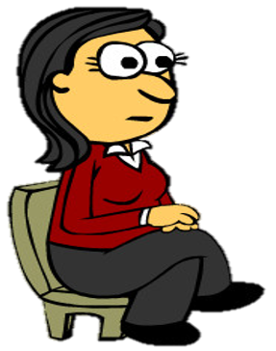
Family Activities
Nope, I don’t know who he is. But he introduces the Double Puzzle this week. He told me the solution is at https://tinyurl.com/yc9f87xd along with a bunch of other cool Family Friendly Activities!

Slide 19
Serve
May 17

