Slide 1
Serve with Courage
July 25

Slide 2


Video Introduction
View Video

Slide 3
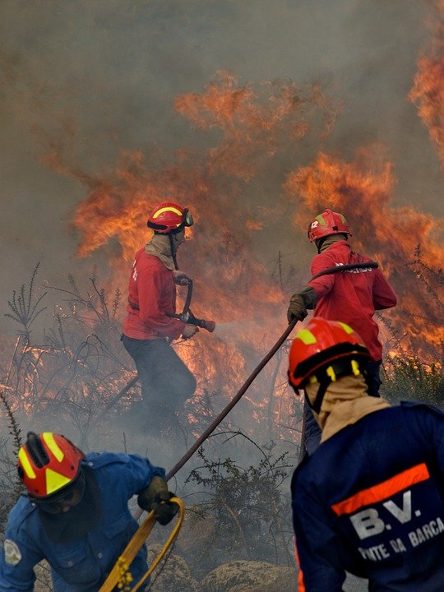
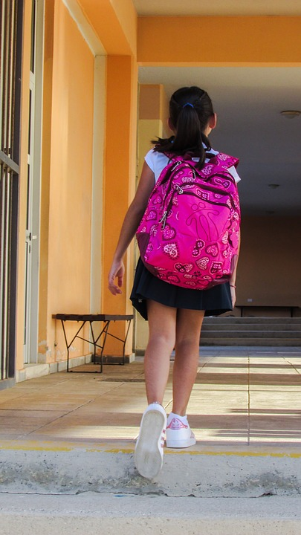
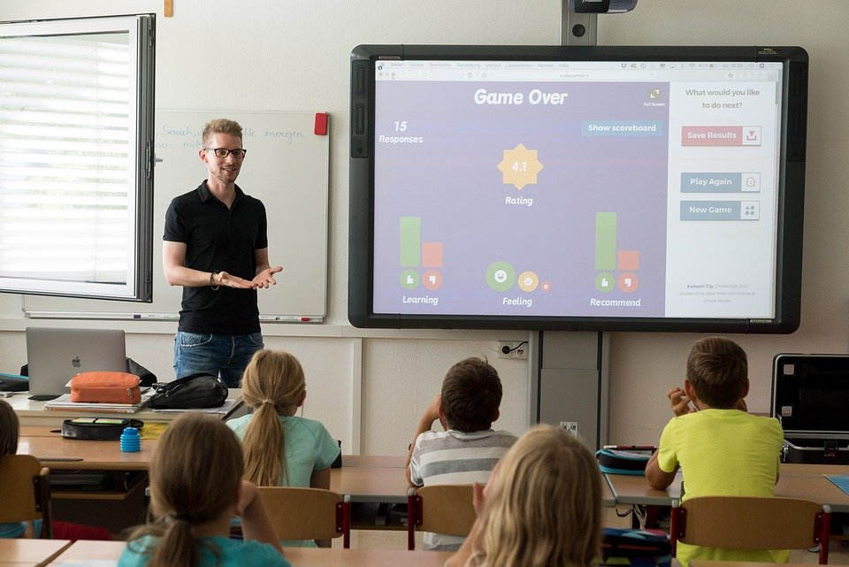
Remember that time …
What is an example of courage you have observed?
We have listed sports or job courage.
  It’s also true that serving God often calls for courage.
  Elijah demonstrated that kind of courage in the Bible passage we study today.

Slide 4
Listen for style of leadership.
1 Kings 16:29-33 (NIV) In the thirty-eighth year of Asa king of Judah, Ahab son of Omri became king of Israel, and he reigned in Samaria over Israel twenty-two years. 30 Ahab son of Omri did more evil in the eyes of the LORD than any of those before him. 31 He not only considered it trivial to commit the sins of Jeroboam son of Nebat,

Slide 5
Listen for style of leadership.
but he also married Jezebel daughter of Ethbaal king of the Sidonians, and began to serve Baal and worship him. 32 He set up an altar for Baal in the temple of Baal that he built in Samaria. 33 Ahab also made an Asherah pole and did more to provoke the LORD, the God of Israel, to anger than did all the kings of Israel before him.

Slide 6
Recognize Opposition
Who was Ahab? How did the writer assess his reign?
What things did he do that were acts of defiance or compromise toward the Lord?
Who was his wife and what information about her suggests that she would not be a positive influence on Ahab?

Slide 7
Recognize Opposition
Why would God be angered or provoked at what Ahab and Jezebel were promoting?
The passage speaks of pagan altars and Asherah poles where people worshiped false gods. What are some idols or false deities present in today’s culture?

Slide 8
Recognize Opposition
In what ways has the church mirrored Israel’s downward spiritual spiral?
Why does God take it so seriously when a person leads others into sin?

Slide 9
Listen for introduction of a prophet.
1 Kings 17:1 (NIV) Now Elijah the Tishbite, from Tishbe in Gilead, said to Ahab, "As the LORD, the God of Israel, lives, whom I serve, there will be neither dew nor rain in the next few years except at my word."

Slide 10
Take A Stand
What do we know about Elijah?
What declaration did he make to Ahab?
Note that a drought would be a significant element of judgment
  Baal is deity of rain, storms
  Jehovah actually in control – can stop or start rain as He pleases
  Baal proved to have no power

Slide 11
Take A Stand
What should the king and the people infer from Elijah’s message?
What kinds of issues influence us to be unwilling to confront or pronounce God’s judgment on evil we see?
How can we speak against the culture in ways that reflect Christ and glorify God?

Slide 12
Listen for a miracle of provision.
1 Kings 17:2-6 (NIV) Then the word of the LORD came to Elijah: 3 "Leave here, turn eastward and hide in the Kerith Ravine, east of the Jordan. 4 You will drink from the brook, and I have ordered the ravens to feed you there.”

Slide 13
Listen for a miracle of provision.
So he did what the LORD had told him. He went to the Kerith Ravine, east of the Jordan, and stayed there. 6 The ravens brought him bread and meat in the morning and bread and meat in the evening, and he drank from the brook.

Slide 14
Rely on God
What does the fact that the Lord had a word for Elijah suggest about his relationship with the Lord?
What mandate did the Lord give to Elijah?
What promise did He give? How did Elijah respond?

Slide 15
Rely on God
What is “just in time” inventory?
This is what God is doing for Elijah – “just in time” provisions. Why do you think God provides in this way?

Slide 16
Rely on God
What were some other situations in the Bible where God supplied what was needed just in time?
What are some situations when God provided for you … just in time?

Slide 17
Application
Look around.
  Approach your week with an eye to identify beliefs and practices around you that conflict with God’s authority.
  Pray, asking God to help you discern false beliefs and practices.

Slide 18
Application
Speak up.
  Take a stand against ideas that attack God’s authority.
  Speak up in a discussion or write a letter.
  Be a voice for God’s truth, but do so with grace and love.

Slide 19
Application
Sign up.
  Sign up for a mission trip to a place where God is not recognized as the One, true God.
  Represent Christ in a place that does not know Him.

Slide 20


Family Activities
Awwk! We provided Elijah with bread and meat. We’re providing you with a crossword puzzle! If you get stuck (or bored) go to https://tinyurl.com/yskhtj6d There’s cool stuff for the whole family.

Slide 21
Serve with Courage
July 25

