Slide 1
Sell Everything You Own
April 28

Slide 2
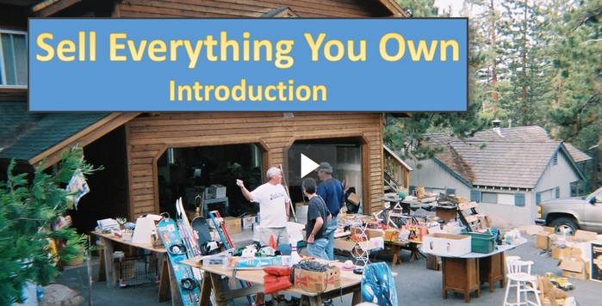
Introduction Video
View Video

Slide 3



Think about it …
What kinds of things do people have as priorities in their lives?
Today we look at a conversation Jesus had with a man who had misplaced priorities.
  Jesus teaches you must choose either Him or worldly wealth.
  You cannot live for both.

Slide 4
Listen for a claim and a question.
Matthew 19:16-20 (NIV) Now a man came up to Jesus and asked, "Teacher, what good thing must I do to get eternal life?" 17 "Why do you ask me about what is good?" Jesus replied. "There is only One who is good. If you want to enter life, obey the commandments."

Slide 5

Listen for a claim and a question.
"Which ones?" the man inquired. Jesus replied, "'Do not murder, do not commit adultery, do not steal, do not give false testimony, 19 honor your father and mother,' and 'love your neighbor as yourself.'" 20 "All these I have kept," the young man said. "What do I still lack?"

Slide 6
Outward Obedience Not Enough
What was the man seeking who came to Jesus?
Where is the flaw in his question?
On what basis did Jesus begin to establish an answer to the man’s question that was appropriate to him?
What astonishing claim did the young man make?

Slide 7
Outward Obedience Not Enough
Why do you think Jesus quizzed the man about his commitment to the commandments?
How would our culture respond to the young man’s question?
Why is keeping certain commands not enough to receive eternal life?

Slide 8
Listen for why the man is sad.
Matthew 19:21-22 (NIV) Jesus answered, "If you want to be perfect, go, sell your possessions and give to the poor, and you will have treasure in heaven. Then come, follow me." 22 When the young man heard this, he went away sad, because he had great wealth.

Slide 9
Internal Obedience to Christ
What further assignment did Jesus give the man who came to Him? What would the young man need to decide if he were to have eternal life?
What is at the heart of Jesus’ response to the young man? What point do you think Jesus was making with this rich man?

Slide 10

Internal Obedience to Christ
Seems to me that Jesus is stating here that you can earn your way to eternal life by giving all your money to God
???
How can you respond to this person’s comment?

Slide 11
Internal Obedience to Christ
How did the man react to Jesus’ demands?
Why do many poor people have a great love for God and many rich people have no interest in God?
Why is a willingness to surrender everything necessary to follow Jesus?

Slide 12
Listen for what seems impossible.
Matthew 19:23-26 (NIV) Then Jesus said to his disciples, "I tell you the truth, it is hard for a rich man to enter the kingdom of heaven. 24 Again I tell you, it is easier for a camel to go through the eye of a needle than for a rich man to enter the kingdom of God."

Slide 13
Listen for what seems impossible.
When the disciples heard this, they were greatly astonished and asked, "Who then can be saved?" 26 Jesus looked at them and said, "With man this is impossible, but with God all things are possible."

Slide 14
What Matters Is A Relationship with God
What astonishing statement did Jesus make about the rich and the kingdom of God?
What was the illustration He used to support His point?
What conclusion did they seem to draw?
How can a rich person—or any person—enter the kingdom?

Slide 15
What Matters Is A Relationship with God
In what ways can wealth and possessions get in the way of following Jesus?
What are some things other than wealth that can keep people from following Jesus?
How can we own possessions without possessions owning us?

Slide 16
Application
Trust.
  If you’ve been trying to be good and moral in order to gain a good standing with God, acknowledge the futility of it.
  Trust Christ and be obedient to His Word as a response to His grace in your life.

Slide 17
Application
Audit.
  Walk through your residence and look at the- things you own.
  Review each line of your financial statement.
  What do these possessions and purchases say about what’s important to you?
  Consider ways you can use what God has given you to honor Him and build up His kingdom.

Slide 18
Application
Sell.
  Sell what you don’t need or give it away.
  If you have possessions that consume your time in an unhealthy way or tempt you to focus on anything but Christ, sell it.

Slide 19

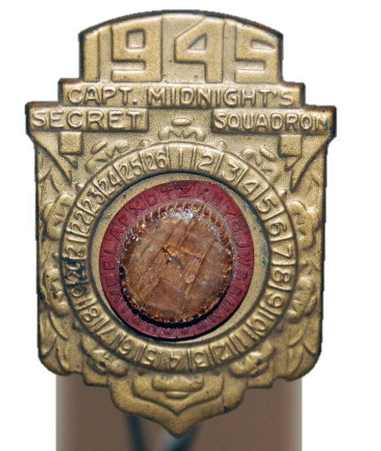
Family Activities
Here’s the secret message. Decode it, please. You won’t even need your magic decoder ring. The key is on your handout. Check out the other cool Family Activities at
https://tinyurl.com/yxfka55q

Slide 20
Sell Everything You Own
April 28

