Slide 1
Seeking Justice in an Unjust World
January 16

Slide 2

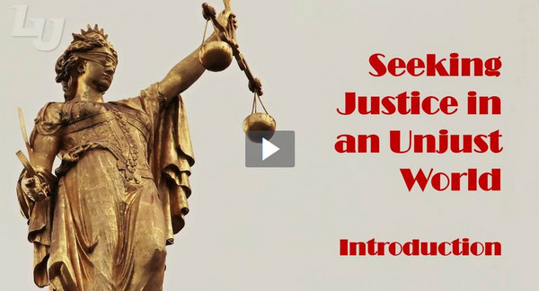
Video Introduction
View Video

Slide 3
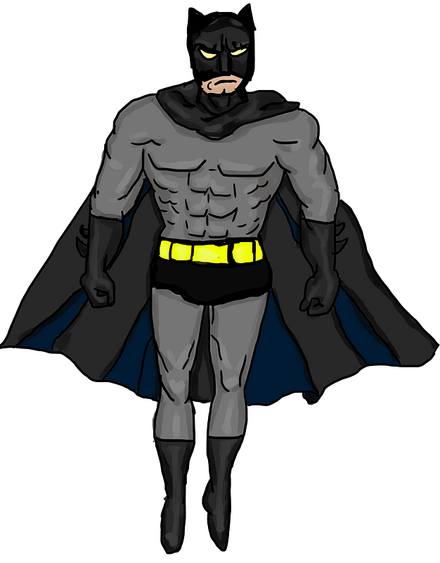
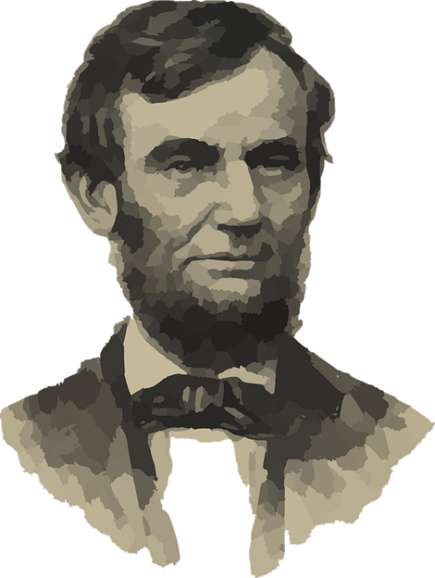
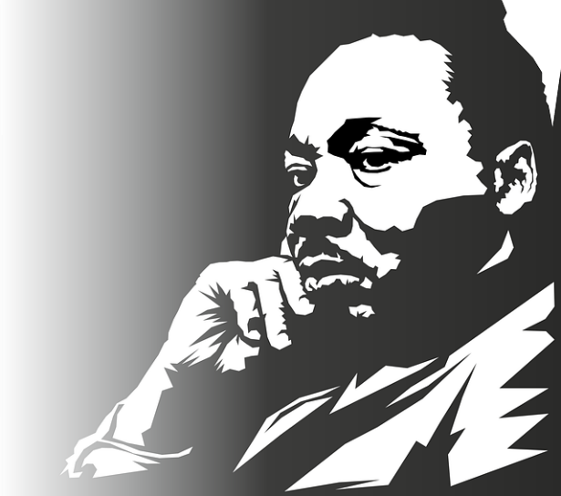
Remember these people?
Who are some heroes we admire because of their stand for justice and human rights?
Our God is a God of Justice
  Today we study the prophecies of Obadiah which speak to the issue of justice
  God calls us to join Him in pursuing justice in the face of indifference and oppression.

Slide 4
Listen for coming punishment.
Obadiah 1:1-4 (NIV) The vision of Obadiah. This is what the Sovereign LORD says about Edom-- We have heard a message from the LORD: An envoy was sent to the nations to say, "Rise, and let us go against her for battle"-- 2 "See, I will make you small among the nations; you will be utterly despised.

Slide 5

Listen for coming punishment.
The pride of your heart has deceived you, you who live in the clefts of the rocks and make your home on the heights, you who say to yourself, 'Who can bring me down to the ground?' 4 Though you soar like the eagle and make your nest among the stars, from there I will bring you down," declares the LORD.

Slide 6
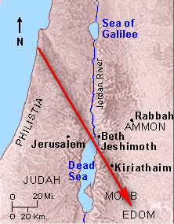
Dangers of Arrogance
What do we learn about the man Obadiah either directly or indirectly in these verses?
What is the Lord’s complaint
about Edom?

Slide 7
Dangers of Arrogance
The Edomites and the Israelites shared an old, negative family history.
  Jacob cheated Esau out of his heritage
  Jacob had to run away for many years
  Jacob feared his brother when he eventually returned with his family
  Edomites were the descendants of Esau

Slide 8
Dangers of Arrogance
How do longtime family problems affect the spiritual health of the Christian church?
How do churches sometimes show pride and arrogance with regard to other churches.
How do churches sometimes show pride and arrogance with regard to culture?
What can we do as individuals to avoid these kinds of arrogance?

Slide 9
Listen for the results of indifference.
Obadiah 1:10-14 (NIV) Because of the violence against your brother Jacob, you will be covered with shame; you will be destroyed forever. 11 On the day you stood aloof while strangers carried off his wealth and foreigners entered his gates and cast lots for Jerusalem, you were like one of them.

Slide 10
Listen for the results of indifference.
You should not look down on your brother in the day of his misfortune, nor rejoice over the people of Judah in the day of their destruction, nor boast so much in the day of their trouble. 13 You should not march through the gates of my people in the day of their disaster, nor look down on them in their calamity in the day of their

Slide 11
Listen for the results of indifference.
disaster, nor seize their wealth in the day of their disaster. 14 You should not wait at the crossroads to cut down their fugitives, nor hand over their survivors in the day of their trouble.

Slide 12
The Sin of Indifference
What other complaints does the Lord have against Edom?
List the “should nots” in this passage.
  You should not …
What are some obstacles to overcoming injustice in our culture?

Slide 13
The Sin of Indifference
The Edomites were indifferent to Judah’s plight. To what problems of our culture are we sometimes indifferent?
How can believers demonstrate value to lives that even believers sometimes devalue by this indifference?

Slide 14
Listen for God’s justice for the oppressed.
Obadiah 1:15-18, 21 (NIV) "The day of the LORD is near for all nations. As you have done, it will be done to you; your deeds will return upon your own head. 16 Just as you drank on my holy hill, so all the nations will drink continually; they will drink and drink and be as if they had never been. 17 But on Mount Zion will be deliverance; it will be holy, and the house of Jacob

Slide 15
Listen for God’s justice for the oppressed.
will possess its inheritance. 18 The house of Jacob will be a fire and the house of Joseph a flame; the house of Esau will be stubble, and they will set it on fire and consume it. There will be no survivors from the house of Esau." The Lord has spoken. … 21 Deliverers will go up on Mount Zion to govern the mountains of Esau. And the kingdom will be the Lord's.

Slide 16
Justice for the Oppressed
According to verses 15 and 16, how would God judge all rebellious nations? What does the day of the Lord hold for the unjust and unfaithful?
What is the meaning of the references to “drinking”?
How would Israel be delivered?

Slide 17
Justice for the Oppressed
What should these truths about God declare to people today … whether a victim or an arrogant rebel against God?
Suppose you take an active role in confronting injustice. Why is it important to have an ongoing close relationship with God?
Victim | Arrogant Rebel

Slide 18
Application
Move from self-preservation to sacrifice.
  Identify one area in your life where you are operating out of self-preservation instead of seeking the kingdom first.
  Assess how you spend your time, your talent, and your treasure.
  Choose one area to implement a change so that you are seeking God’s kingdom first and living sacrificially.

Slide 19
Application
Move from indifference to empathy.
  Take some time to journal and write out responses to the following questions.
  How do I struggle with indifference?
  How have I been passively disobedient?
  In what areas of my life do I live out of self-preservation instead of sacrificial service?

Slide 20
Application
Move from passivity to action.
  Somewhere in your community there is disparity.
  Identify one tangible area of injustice and bring two others alongside you to formulate a plan to fight for justice in that area.
  Make sure to bring others along who are different from you and can offer other perspectives on how to engage.

Slide 21
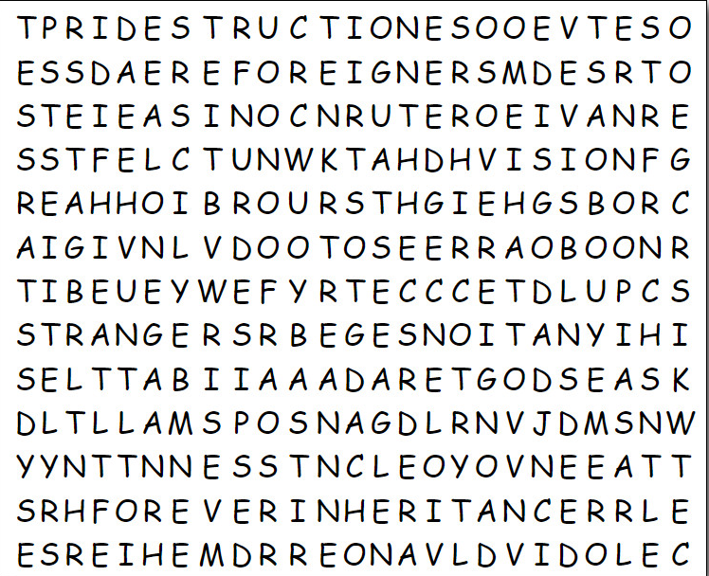

Family Activities
There may be a secret message somewhere in this grid of letters. The Word Search Lady might be hiding something. Report back to me what you find! Help is available at https://tinyurl.com/2p8bz6d5 Y You can also find other good stuff there.

Slide 22
Seeking Justice in an Unjust World
January 16

