Slide 1
Security in Place of Fear
December 11

Slide 2
Video Introduction
View Video

Slide 3
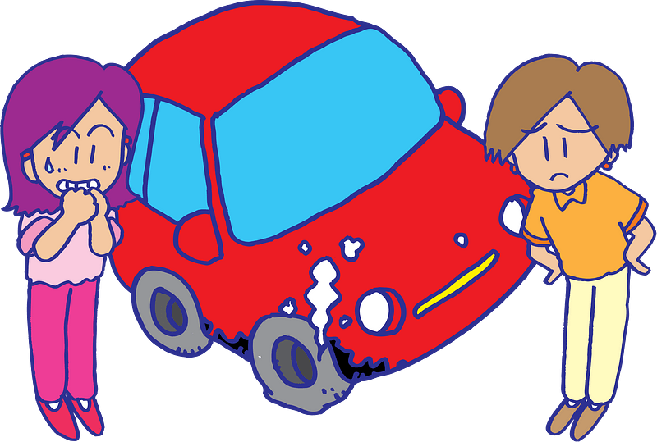
Admit it, now …
What are some fears you have outgrown?
Some people might somehow fear being separated from God’s loving care.
Today we will study what Paul said about this
Because of Christ, nothing will keep us from God and His work in our lives.

Slide 4
Listen for all God does for us.
Romans 8:28-30 (NIV) And we know that in all things God works for the good of those who love him, who have been called according to his purpose. 29 For those God foreknew he also predestined to be conformed to the

Slide 5
Listen for all God does for us.
likeness of his Son, that he might be the firstborn among many brothers. 30 And those he predestined, he also called; those he called, he also justified; those he justified, he also glorified.

Slide 6
God Works for Our Good
Sometimes the King James version of these verses are misquoted or misinterpreted.
“We know all things work together for good …”
Leaving off the qualifying phrase of who this is for.
The assurance is given to “those who love God,” those “Called according to His purpose”

Slide 7
God Works for Our Good
How has God been at work in the past (Bible history), the present, and the future on behalf of those who believe?
In your life, when has a God worked in a difficult situation and accomplished good?
Since God is working for our good, why do we still struggle when life is hard?

Slide 8
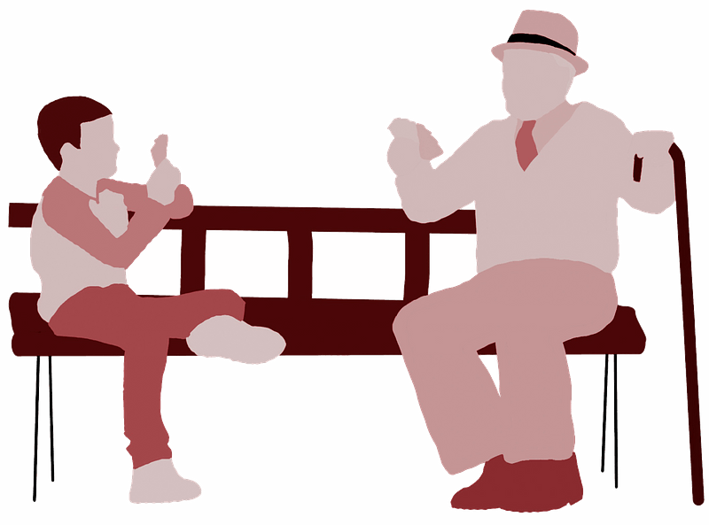
God Works for Our Good
How might you explain to a child or grandchild that can God produce good results out of bad situations?

Slide 9
Listen for how God is for us.
Romans 8:31-34 (NIV) What, then, shall we say in response to this? If God is for us, who can be against us? 32 He who did not spare his own Son, but gave him up for us all--how will he not also, along with him, graciously give us all things? 33 Who will bring any charge against those whom God has chosen?

Slide 10
Listen for how God is for us.
It is God who justifies. 34 Who is he that condemns? Christ Jesus, who died--more than that, who was raised to life--is at the right hand of God and is also interceding for us.

Slide 11
Not Condemned before God
Note the words and phrases which tell us what God continues to do for us?
Work in our behalf … He is “for us”
Graciously gives us all things
Declares us justified – “just as if we had never sinned”
Intercedes for us

Slide 12
Not Condemned before God
Look through the first verses of the chapter to see what Paul is referring to when he asks, “what do we say in response to this?”. What benefits do we receive because of Christ’s saving work for us?
Who might Paul mean when he mentions those who might be “against us”?

Slide 13
Not Condemned before God
When has it been obvious that God is for you?
Paul tells us where Jesus Christ is right now, and what He is doing.
Jesus is in heaven
He is at the right hand of God the Father
He is interceding for us

Slide 14
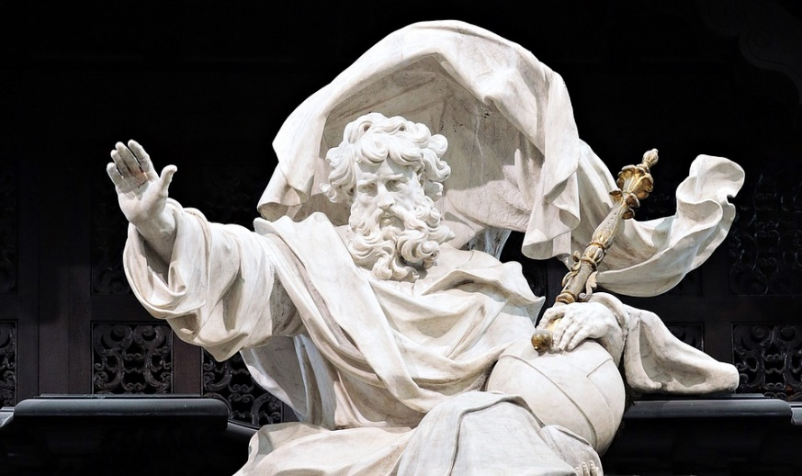
Not Condemned before God
How does it affect your walk with the Lord to know that Christ is interceding for you?

Slide 15
Listen for what cannot separate us from God’s love.
Romans 8:35-39 (NIV) Who shall separate us from the love of Christ? Shall trouble or hardship or persecution or famine or nakedness or danger or sword? 36 As it is written: "For your sake we face death all day long; we are considered as sheep to be slaughtered

Slide 16
Listen for what cannot separate us from God’s love.
37 No, in all these things we are more than conquerors through him who loved us. 38 For I am convinced that neither death nor life, neither angels nor demons, neither the present nor the

Slide 17
Listen for what cannot separate us from God’s love.
future, nor any powers, 39 neither height nor depth, nor anything else in all creation, will be able to separate us from the love of God that is in Christ Jesus our Lord.

Slide 18
Nothing Can Separate Us from God’s Love
Note the list of life-threatening experiences Paul mentions that we may think have potential to separate us from Christ’s love?

Slide 19
Nothing Can Separate Us from God’s Love
What might be examples of some of these things in today’s world, in our culture?
Troubles
Danger
Demons
Future
Sword
Famine, Nakedness

Slide 20
Nothing Can Separate Us from God’s Love
Why might these things tempt us to believe that we had been separated from Christ?
What do you think that means, to be “more than a conqueror?”
In light of these verses, how should we respond when we feel that God is not for us?

Slide 21
Application
Memorize.
Get your security in Christ ingrained in your mind.
Memorize Romans 8:37-39: “No, in all these things we are more than conquerors through him who loved us. For I am persuaded that neither death nor life, nor angels nor rulers, nor things present nor things to come, nor powers, nor height nor depth, nor any other created thing will be able to separate us from the love of God that is in Christ Jesus our Lord.”
Recite it daily.
Post it on your bathroom mirror.
Keep it before your eyes and fresh on your tongue.

Slide 22
Application
Encourage.
Write an encouraging note to someone who may be struggling with insecurity in their relationship with Christ.
Use what we’ve studied as a template to encourage this person.

Slide 23
Application
Minister.
You may be sensing God calling you to serve in some way, but a fear of failure makes you hesitant.
Rest on your foundation in Christ and step out in trustful obedience.
Trust Him to work in you and through you for your own good.

Slide 24
Family Activities
Ah HA! There you are. We need your help. There’s the key, you’ll have the encrypted message. Spiros the Spy has explained how it works. Secret Agent helps are at https://tinyurl.com/bdzjan37 And there’s more intrigue there as well.

Slide 25
Security in Place of Fear
December 11

