Slide 1
Sanctified
March 29

Slide 2

Introduction Video
View Introduction

Slide 3
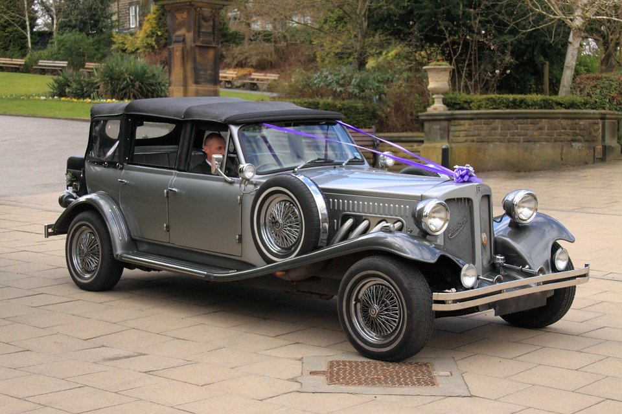

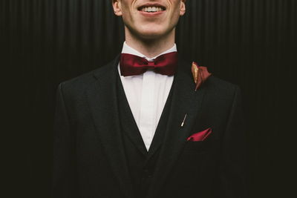
Think about it …
What is something about you that is unique?
We are all unique in many ways.
  Our God is unique, distinct, set apart … holy
  He calls us to be set apart in Christ, sanctified, to live holy lives.

Slide 4
Listen for lives changed
1 Corinthians 6:9-11 (NIV) Do you not know that the wicked will not inherit the kingdom of God? Do not be deceived: Neither the sexually immoral nor idolaters nor adulterers nor male prostitutes nor homosexual offenders 10 nor thieves nor the greedy nor drunkards nor slanderers

Slide 5
Listen for lives changed
nor swindlers will inherit the kingdom of God. 11 And that is what some of you were. But you were washed, you were sanctified, you were justified in the name of the Lord Jesus Christ and by the Spirit of our God.

Slide 6
Set Apart from Our Old Life
What does it mean to inherit the kingdom of God?
What were the behaviors listed in verse 9, then in verse 10.
Now what are the differences and similarities in the two lists
Verse 9 | Verse 10
Differences | Similarities

Slide 7
Set Apart from Our Old Life
So what had changed the Corinthians’ standing before God? What three terms did Paul use to describe the change that had taken place in them through Christ and the Spirit?
How does it make a person feel to know that they have been washed, set apart to be holy, and declared to be sinless before God the Father?

Slide 8
Set Apart from Our Old Life
How does this passage reflect the experience of a person with Christ in today’s culture? What difference should it make in a person’s life if they have been sanctified and justified by God’s Holy Spirit?

Slide 9
Listen for ethical implications.
1 Corinthians 6:12-17 (NIV) "Everything is permissible for me"--but not everything is beneficial. "Everything is permissible for me"--but I will not be mastered by anything. 13 "Food for the stomach and the stomach for food"--but God will destroy them both. The body is not meant for sexual immorality,

Slide 10
Listen for ethical implications.
but for the Lord, and the Lord for the body. 14 By his power God raised the Lord from the dead, and he will raise us also. 15 Do you not know that your bodies are members of Christ himself? Shall I then take the members of Christ

Slide 11
Listen for ethical implications.
and unite them with a prostitute? Never! 16 Do you not know that he who unites himself with a prostitute is one with her in body? For it is said, "The two will become one flesh." 17 But he who unites himself with the Lord is one with him in spirit.

Slide 12
Set Apart to Be One with Christ
What false and destructive belief about freedom in Christ had some of the Corinthian believers adopted?
How did Paul challenge the statement of some that all things are lawful?
By what act and promise of God are we made one with Christ?

Slide 13
Set Apart to Be One with Christ
In what way did Paul argue that sexually immoral behavior dishonors the body of Christ?
What did Paul mean by saying, "I will not be mastered by anything"?
Since all things are permissible, how do we evaluate what is beneficial?

Slide 14
Listen for what is God’s temple.
1 Corinthians 6:18-20 (NIV) Flee from sexual immorality. All other sins a man commits are outside his body, but he who sins sexually sins against his own body. 19 Do you not know that your body is a temple of the Holy Spirit, who is in you, whom you have received from God? You are not your own; 20 you were bought at a price. Therefore honor God with your body.

Slide 15
Set Apart to Glorify God
How did Paul advise his readers to deal with the potential of sexual sin?
According to verse19, what makes our bodies special? What does it mean to call our bodies the temple of the Holy Spirit?
According to this passage, how will sexual misbehavior affect people?

Slide 16
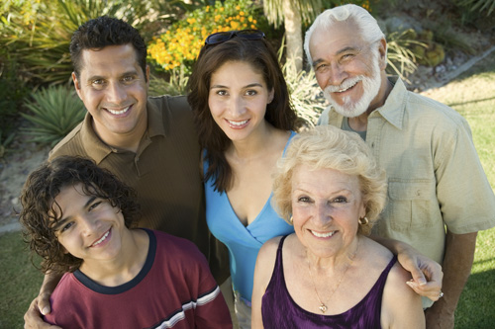
Set Apart to Glorify God
What are other specific ways Christians can live set apart for God in today’s culture?
How can we motivate children and grandchildren to remain sexually pure?

Slide 17
Application
Offer thanks.
  Reflect on how your life has changed because of Christ.
  Thank Him for setting you free from the former way of life.
  Pray for the Lord to continue His good work.

Slide 18
Application
Memorize.
  Memorize 1 Corinthians 6:19-20 and repeat it to yourself when you need to flee from temptation.
  “Don’t you know that your body is a temple of the Holy Spirit who is in you, whom you have from God? You are not your own, for you were bought at a price. So glorify God with your body.”

Slide 19
Application
Walk alongside others.
  Making the daily choice to live a holy life is much easier when you walk alongside other believers.
  Surround yourself with others who also choose to live their lives for Christ. Your Bible study group is a good place to start.

Slide 20


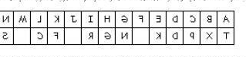
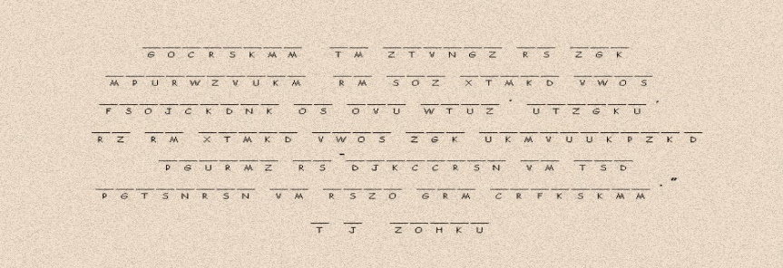
Family Activities
I’m pretty busy with an old book report I have to write. Could you decrypt this message? I have the key right here, somewhere. If you need help or want a different family activity, go to https://tinyurl.com/uvkl9wf
Humph!

Slide 21
Sanctified
March 29

