Slide 1
The Samaritan Woman: Faith Worth Sharing
July 7

Slide 2
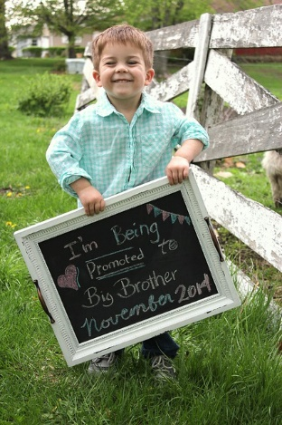
Think about it …
What are some unique ways people share exciting personal announcements?

Slide 3
Today …
Today we study a woman who was confronted by Christ personally.
Jesus modeled good ways to engage with others
We also see how the woman was quick to tell others what had happened.
Likewise, your life-changing encounter with Christ should be shared with others.

Slide 4
Listen for how Jesus grabs attention.
John 4:9-14 (NIV) The Samaritan woman said to him, "You are a Jew and I am a Samaritan woman. How can you ask me for a drink?" (For Jews do not associate with Samaritans.) 10 Jesus answered her, "If you knew the gift of God and who it is that asks you for a drink, you would have asked him and he would have given you living water." 11 "Sir," the woman said, "you have nothing to draw with and the well

Slide 5
Listen for how Jesus grabs attention.
is deep. Where can you get this living water? 12 Are you greater than our father Jacob, who gave us the well and drank from it himself, as did also his sons and his flocks and herds?" 13 Jesus answered, "Everyone who drinks this water will be thirsty again, 14 but whoever drinks the water I give him will never thirst. Indeed, the water I give him will become in him a spring of water welling up to eternal life."

Slide 6
See Your Need
How would you describe the Samaritan woman’s initial attitude upon meeting Jesus at the well?
How can prejudice affect a Christian’s witness? How can social differences keep us from engaging with others in order to share the gospel?
How did Jesus answer the Samaritan woman’s question?

Slide 7
See Your Need
How is the world’s need for salvation and eternal life like thirst?
What did the Samaritan woman think Jesus was talking about?
How can confusion about spiritual things open the door for more discussion?
Note Jesus’ use of water as a metaphor to teach about salvation. He also used bread, light, and breath. ⇨ Jesus provides all that is needed to sustain (spiritual) life.

Slide 8
See Your Need
Think about some everyday objects – how might we use these to communicate a truth or confront people with a need in their lives?
Every Day Object | Jesus meets a need
Car Garden Road Detour Fishing Rod Food

Slide 9
Listen for the response to Jesus knowledge about her.
John 4:15-18 (NIV) The woman said to him, "Sir, give me this water so that I won't get thirsty and have to keep coming here to draw water." 16 He told her, "Go, call your husband and come back." 17 "I have no husband," she

Slide 10
Listen for the response to Jesus knowledge about her.
replied. Jesus said to her, "You are right when you say you have no husband. 18 The fact is, you have had five husbands, and the man you now have is not your husband. What you have just said is quite true."

Slide 11
Confront Your Sin
What indicates the woman still did not have a spiritual understanding of what Jesus was saying to her?
Why do you think Jesus asked her to call her husband?
Why is it difficult to confront people about sin in their lives?

Slide 12
Confront Your Sin
Certainly Jesus has the right to go directly to our sore spots, but how are we to follow His example when we witness or counsel?
What are some “wells” that people “drink” from in efforts to satisfy their “thirst”?
Why would sharing your own testimony of how Jesus forgave your sins ease the transition into confronting sin?

Slide 13
Listen for a sudden realization.
John 4:28-30 (NIV) Then, leaving her water jar, the woman went back to the town and said to the people, 29 "Come, see a man who told me everything I ever did. Could this be the Christ?" 30 They came out of the town and made their way toward him.

Slide 14
Share Christ
What conclusion did the woman apparently come to because of her conversation with Jesus?
What did she do with what she believed to be true?
What was her testimony?

Slide 15
Share Christ
What barriers keep us from talking to other people about Christ?
How does spending time talking to Jesus affect your life?

Slide 16
Top Ten Pointers
10. Go where lost people are.
9. Create interest by what you are saying.
8. Meet lost people at their immediate point of need.
7. Ignore barriers to talking with them.
6. Use a different approach if the first one doesn’t work well.

Slide 17
Top Ten Pointers
5. Refuse to be side-tracked in religious arguments
4. Keep your focus on who Jesus is and what He has done.
3. Encourage new believers to share their faith with others.
2. Disciple new believers by spending time with them.
1. Look for more lost people.

Slide 18
Application Video
View the Video

Slide 19
Application
Write.
Contemplate your personal faith story.
Write it down and pray for the Lord to open the door for you to share it with someone this week.
Post your written testimony online.

Slide 20
Application
Pray.
Begin a list of people you know who need to accept Christ as their personal Savior.
As a group, begin consistently praying for them.
Consider prayerwalking as a group in an area close to your church or in your neighborhood.

Slide 21
Application
Share.
Learn a simple evangelistic presentation, or review tools that you have learned in the past that you can use when you begin gospel conversations.
Incorporate this presentation with your own personal testimony of a changed life in Christ.

Slide 22
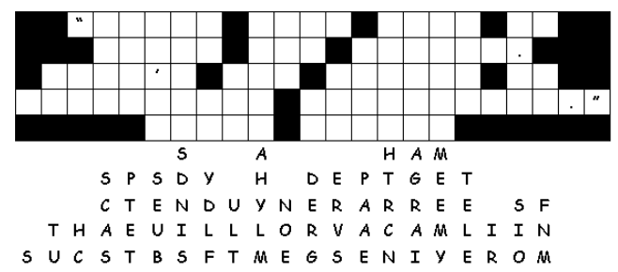
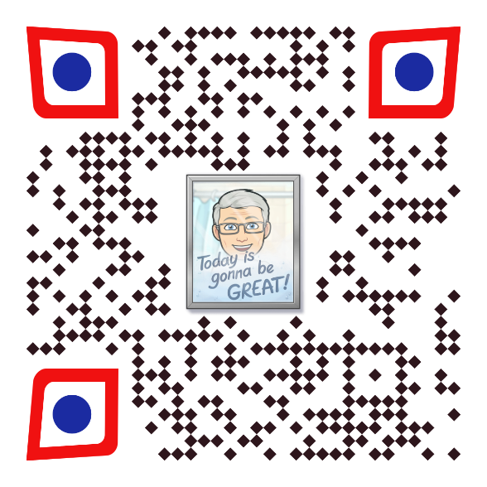
Family Activities
It’s fun! It’s cool! It’ll involve your family in what we studied. Get everyone to help. Grab the QR code so you know where to go.

Slide 23
The Samaritan Woman: Faith Worth Sharing
July 7

