Slide 1
Redirecting Anger
December 27

Slide 2
Introduction Video
View Video

Slide 3
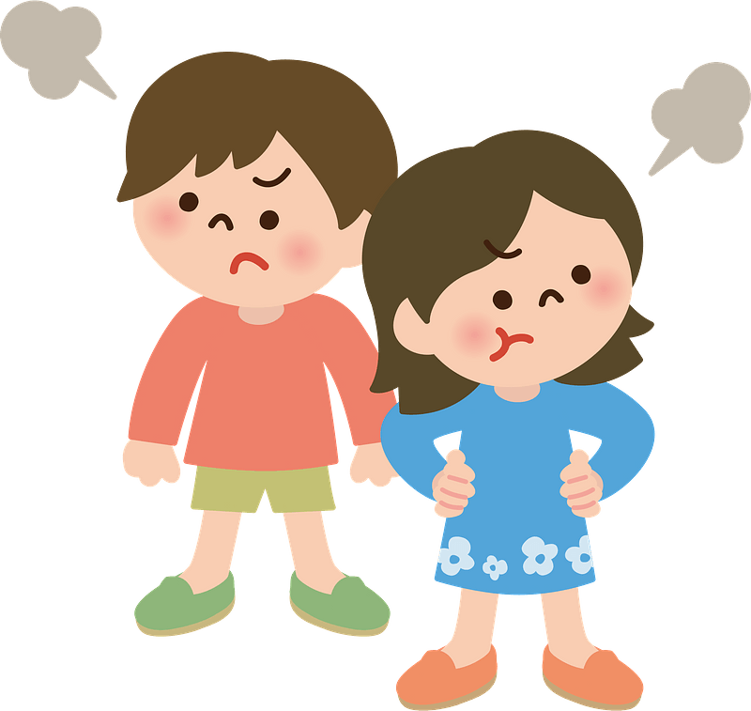
Admit it, now …
When you were a kid, what would make you really angry?
Anger can get us in trouble if we get out of control.
It’s better to take your anger to God and leave matters in His hands.

Slide 4
Listen for military references.
Psalm 35:1-3 (NIV) Contend, O LORD, with those who contend with me; fight against those who fight against me. 2 Take up shield and buckler; arise and come to my aid. 3 Brandish spear and javelin against those who pursue me. Say to my soul, "I am your salvation."

Slide 5
Admit Your Anger to God
What did the psalmist pray for the Lord to do for him?
How does the imagery employed indicate that he wanted the Lord to defend him as well as take the fight to the enemy? Note the military references.
What assuring words did the poet want to hear?
What’s your gut reaction to these verses? Why?

Slide 6
Admit Your Anger to God
What might keep us from being honest with God about our anger?
What might you tell God when you are facing conflict with people opposing you?
How can you continue on believing God is your salvation from those who would seek to bring shame and dishonor upon you unjustly?

Slide 7
Listen for a betrayal.
Yet when they were ill, I put on sackcloth and humbled myself with fasting. When my prayers returned to me unanswered, 14 I went about mourning as though for my friend or brother. I bowed my head in grief as though weeping for my mother.

Slide 8
Listen for a betrayal.
15 But when I stumbled, they gathered in glee; attackers gathered against me when I was unaware. They slandered me without ceasing. 16 Like the ungodly they maliciously mocked; they gnashed their teeth at me.

Slide 9
Respond with Love and Grace
In contrast to the way the poet was treated by those who opposed him, how did he say he responded to them during a time of need?
How does he say his opponents reacted to his acts of kindness?
What are some emotions when you are falsely accused or treated maliciously by others?

Slide 10
Respond with Love and Grace
What are some natural reactions when people try to hurt us?
Why can retaliation not accomplish what we might want?
How should we pray when we are falsely accused or slandered?

Slide 11
Listen for David’s response to God.
Psalm 35:17-18 (NIV) O Lord, how long will you look on? Rescue my life from their ravages, my precious life from these lions. 18 I will give you thanks in the great assembly; among throngs of people I will praise you.

Slide 12
Leave Matters in God’s Hands
What emotions or suspicions thoughts might be behind the question the psalmist raised in verse 17?
How did the psalmist restate his plea?
What response did the psalmist pledge to give when the Lord answered?

Slide 13
Leave Matters in God’s Hands
What makes leaving matters in God’s hands so challenging?
What are some ways we can help our children and grandchildren respond to difficult situations by trusting God?

Slide 14
Application
Vent—to God.
Before talking to others about what has upset you, talk to God.
Be honest with God about why you’re angry.
Ask Him for the strength to refrain from anger and the will to trust Him with the situation.

Slide 15
Application
Seek resolution—not retaliation.
If possible, find a way to resolve the relationship or situation that has angered you.
At the very least, pray for the well-being of the other person.
As you genuinely pray for another person, God will also work on your heart.

Slide 16
Application
Love—no matter what.
Find specific, concrete ways you can show the love of Christ to those who’ve hurt you or made you angry.
Don’t take any action to look self-righteous and better than the other person.
Show love in order to honor the One who loves you.

Slide 17
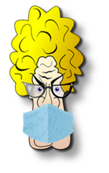
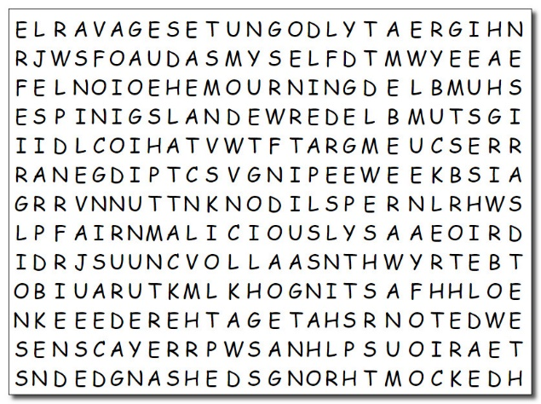
Family Activities
Well, humph … the letters didn’t fall down this time. They got scrambled around. It’s crazy, they still form words … which you have to find. No pressure, humph, your end of year evaluation depends on it. You can earn some extra credit, however by checking out the Family Activities at https://tinyurl.com/y4rmwvpb

Slide 18
Redirecting Anger
December 27

