Slide 1
Recovering from a Fall into Temptation
May 14

Slide 2

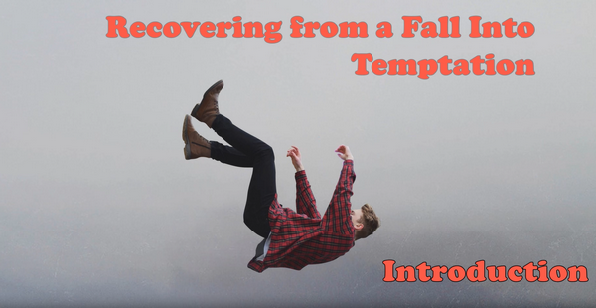
Video Introduction
View Video

Slide 3

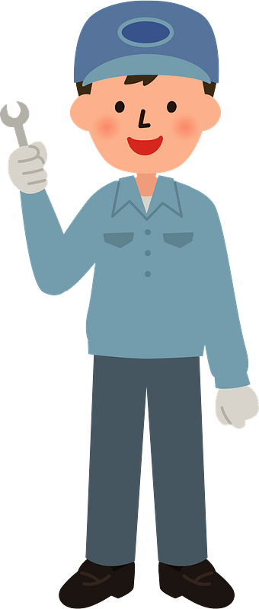

Think about this …
When has a fresh set of eyes really changed your perspective?
The God we perceive in our minds and what God is really like can differ.
  Especially when we deal with how we have mishandled a temptation.
  Return to God for forgiveness and restoration.
A classic import !
Lots of miles and hard to find parts !

Slide 4
Listen for words which have to do with sin.
Psalm 32:1-2 (NIV) Blessed is he whose transgressions are forgiven, whose sins are covered. 2 Blessed is the man whose sin the LORD does not count against him and in whose spirit is no deceit.

Slide 5
Joy and Blessing from God’s Forgiveness
Who are the blessed?
What “sin” words do you find in this passage? Note the meanings of each.
  Transgressions – defiant rebellion, God’s standard
  Sin – missing the mark, not meeting God’s standard
  Deceit (iniquity) – twisted inner character

Slide 6
Joy and Blessing from God’s Forgiveness
What are the words and phrases used in the passage to talk about forgiveness? Note the meanings.
  Forgiven – lifting up and removing the barrier
  Covered – permanently hidden from God’s sight
  The Lord does not count against
  – God declares us “not guilty”

Slide 7
Joy and Blessing from God’s Forgiveness
Why do people initially feel it is fun to get away with doing wrong?
Why do you think that wrong ultimately brings such weight upon a person?

Slide 8
Joy and Blessing from God’s Forgiveness
David rejoiced because God covered his sin. What is the difference between our trying to cover up sin and God covering it?
When I try to cover my sin. | When God covers my sin.

Slide 9
Joy and Blessing from God’s Forgiveness
Consider how forgiveness is like a debt being erased.
  Sin demands God’s judgment – think of it as a debt owed
  With forgiveness the offended party (God) says, “I will not require payback for the offense”
  The effect is that the debt of judgment (punishment) is not held against you
  The debt of your sin is erased

Slide 10
Joy and Blessing from God’s Forgiveness
Note that David begins the psalm with praise and thanksgiving to God … not by dwelling on his sin. Why is focusing on God more important than continually recalling our sins?

Slide 11
Listen for the effect of unconfessed sin.
Psalm 32:3-5 (NIV) When I kept silent, my bones wasted away through my groaning all day long. 4 For day and night your hand was heavy upon me; my strength was sapped as in the heat of summer.

Slide 12
Listen for the effect of unconfessed sin.
Selah. Then I acknowledged my sin to you and did not cover up my iniquity. I said, "I will confess my transgressions to the LORD"-- and you forgave the guilt of my sin. Selah

Slide 13
Forgiveness Requires Confession
What words or phrases express David’s feelings when he had unconfessed sin in his life? How did David’s struggle with his sin affect him?
What did David decide to do about his sin?

Slide 14
Forgiveness Requires Confession
Confession means to agree with God that what you have done is sin …
  You refuse to rename wrong as right
  You call it what it is … hurtful actions against God and people
  You begin to trust God rather than your own perception of right and wrong

Slide 15
Forgiveness Requires Confession
What kinds of things prevent us from confessing known sin in our lives? Why do you think we are sometimes hesitant to repent of sin, even when we know God will forgive us?
Why is it important that David (and we) blame no one else for personal sin?

Slide 16
Listen for benefits of timely repentance.
Psalm 32:6-7 (NIV) Therefore let everyone who is godly pray to you while you may be found; surely when the mighty waters rise, they will not reach him. 7 You are my hiding place; you will protect me from trouble and surround me with songs of deliverance. Selah

Slide 17
Avoiding Future Sin
What is the recommendation David issued to others?
What can the one who comes seeking the Lord in times of trouble expect?
What caused David to feel he was surrounded by songs of deliverance?

Slide 18
Avoiding Future Sin
What about forgiving ourselves? How could it be that not forgiving myself affects my spiritual growth?
How much better to experience what David says
  You are my hiding place
  You will protect me from trouble, surround me with songs of deliverance

Slide 19
Application
Confess.
  If you are still groaning under the weight of your sin, make Psalm 32:5 your prayer.
  Confess your sin to God and embrace His forgiveness.

Slide 20
Application
Rejoice.
  Write a note or prayer, rejoicing in God’s forgiveness.
  Consider God’s goodness and mercy.
  Express to Him your thankfulness.

Slide 21
Application
Talk.
  If you struggle with continuing pangs of guilt, talk to your pastor or a trusted Christian friend.
  Seek support and assurance in discovering this truth and reality …
  When God says He forgives, He forgives completely.

Slide 22
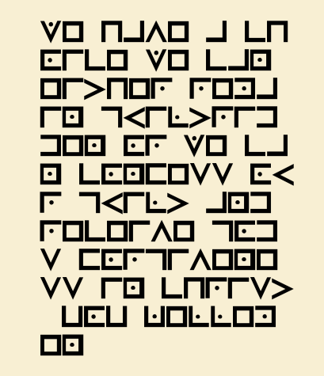
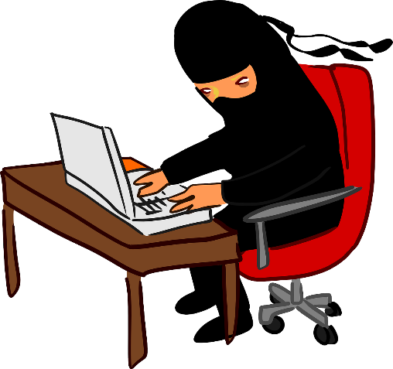

Family Activities
Spiros the Spy says he needs this decrypted. Each symbol stands for a letter of the alphabet. Use the key on your handout. This is an important spiritual truth from our Cristian brothers inYefri Dormicape . If you get stuck, go to https://tinyurl.com/2ptb935c Check out all the Family Activities

Slide 23
Recovering from a Fall into Temptation
May 14

