Slide 1
Purpose Restored
September 15

Slide 2


Video Introduction
View Video

Slide 3
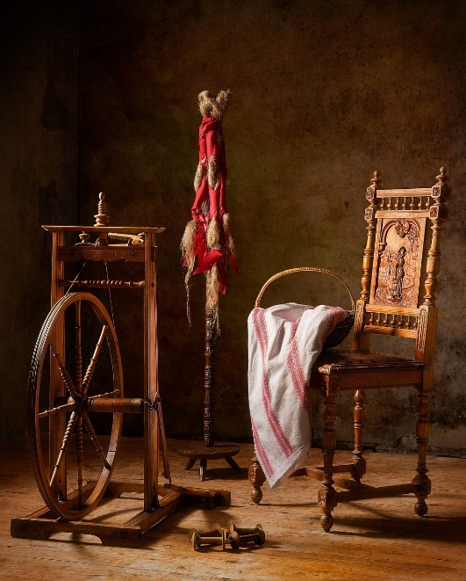


It looks great …
What is something you own that has been refurbished or restored?
Actually our lives sometimes need to be restored – physically or even spiritually.
  Through Jesus WE can be forgiven and restored to the purpose for which God created us.

Slide 4
Listen for an accusation.
Acts 3:14-18 (NIV) You disowned the Holy and Righteous One and asked that a murderer be released to you. 15 You killed the author of life, but God raised him from the dead. We are witnesses of this. 16 By faith in the name of Jesus, this man whom you see and know was made strong. It is Jesus' name and

Slide 5
Listen for an accusation.
the faith that comes through him that has given this complete healing to him, as you can all see. 17 "Now, brothers, I know that you acted in ignorance, as did your leaders. 18 But this is how God fulfilled what he had foretold through all the prophets, saying that his Christ would suffer.

Slide 6
Restoration Comes through Jesus
What is the significance of Peter referring to Jesus as the “Holy and Righteous One”?
How does the title of “Holy and Righteous One” contrast with the way the people treated Him? What indictment did Peter bring against the people?
What proves that what they did, heinous as it was, was not the end?

Slide 7
Restoration Comes through Jesus
To what and whom did Peter attribute the healing of the lame beggar?
According to Peter, why did the people act as they did? Why was ignorance not an excuse?
Where do you see evidence in our culture that people need restoration?

Slide 8



Restoration Comes through Jesus
Besides physical issues, in what other ways do individuals need healing and restoration?

Slide 9

Why?
Why do men (not women) tend not to look at a map or ask someone who might know the way?
Listen for how Peter’s preaching can act as a life road map.

Slide 10
Listen for how Peter’s preaching can act as a life road map.
Acts 3:19-21 (NIV) Repent, then, and turn to God, so that your sins may be wiped out, that times of refreshing may come from the Lord, 20 and that he may send the Christ,

Slide 11
Listen for how Peter’s preaching can act as a life road map.
who has been appointed for you--even Jesus. 21 He must remain in heaven until the time comes for God to restore everything, as he promised long ago through his holy prophets.

Slide 12
Repentance Leads to Forgiveness
Peter previously noted how the people acted in ignorance. How are these remarks like a spiritual roadmap?
What kinds of inadequate ways do people in our culture try to find direction for life?
What is the result of repenting according to this passage?

Slide 13
Repentance Leads to Forgiveness
How is having sins forgiven like “seasons/times of refreshing?”
How would you counsel a person who wants forgiveness?

Slide 14
Listen for a warning.
Acts 3:22-26 (NIV) For Moses said, 'The Lord your God will raise up for you a prophet like me from among your own people; you must listen to everything he tells you. 23 Anyone who does not listen to him will be completely cut off from among his people.' 24 "Indeed, all the prophets from Samuel on, as many as have

Slide 15
Listen for a warning.
spoken, have foretold these days. 25 And you are heirs of the prophets and of the covenant God made with your fathers. He said to Abraham, 'Through your offspring all peoples on earth will be blessed.' 26 When God raised up his servant, he sent him first to you to bless you by turning each of you from your wicked ways."

Slide 16
Victory over Evil through Jesus
What is the consequence of refusing to be attentive to the message of the Christ?
What suggests that the word from God is constant and consistent?
What does God desire His people to be and do?

Slide 17
Victory over Evil through Jesus
What are two ways the word “raised” in verses 22 and 26 can be understood?
Why are both crucial to the redemptive plan of God to restore sinners to wholeness?

Slide 18
Application
Repent.
  Restoration begins by coming to Christ in repentance and faith.
  If you’ve never made a commitment of your life to Christ, you can do so now.
  Talk to someone in your Bible study group about your desire to follow Christ.

Slide 19
Application
Refresh.
  Even as a Christian, life can be challenging.
  Thankfully, you’re not alone.
  Spend some focused and unhurried time with Jesus by praying and reading His Word.
  Let His Spirit wash over you to keep you strong.

Slide 20
Application
Restore.
  Let others see Jesus in you as you live out a renewed and restored purpose.
  You can’t restore others to their purpose in Christ, but you can be a testimony to them of how Christ restores.
  Be ready to tell your story to all who are willing to hear.

Slide 21



Family Activities
Oh yes … and the words and clues come from our Bible passage. Help (and other fun things) are found at https://tinyurl.com/4khry2j7
Goodness … I hope there are clues!

Slide 22
Purpose Restored
September 15

