Slide 1
Purpose Questioned
September 1

Slide 2
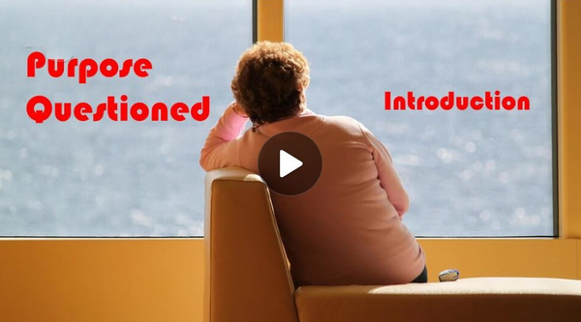
Video Introduction
View Video

Slide 3
It’s such a pain …
What is something you get tired of doing over and over again?
All those things take up a big chunk of our lives.
Apart from God, life is meaningless

Slide 4
Listen for dissatisfaction.
Ecclesiastes 1:2-7 (NIV) "Meaningless! Meaningless!" says the Teacher. "Utterly meaningless! Everything is meaningless." 3 What does man gain from all his labor at which he toils under the sun? 4 Generations come and generations go, but the earth remains forever. 5 The sun

Slide 5
Listen for dissatisfaction.
rises and the sun sets, and hurries back to where it rises. 6 The wind blows to the south and turns to the north; round and round it goes, ever returning on its course. 7 All streams flow into the sea, yet the sea is never full. To the place the streams come from, there they return again.

Slide 6
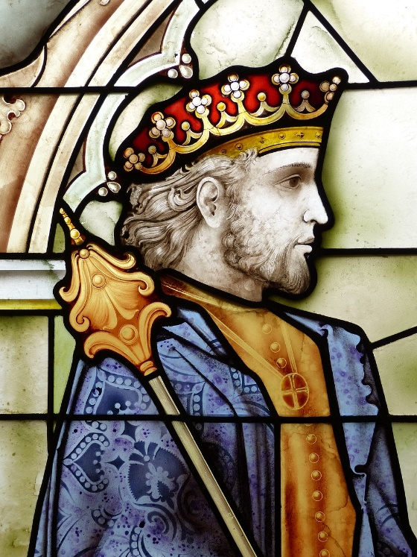
There Is No Purpose
The author of Ecclesiastes
Refers to himself as “The Teacher”
Note in further verses that he is “king over Israel in Jerusalem”
Generally believed to be Solomon

Slide 7
There Is No Purpose
What evidence did the Preacher cite for the validity of his thesis that life is vanity or “meaningless”?
“Vanity” or “meaningless” portrays the concept of something that exists for a moment, then vanishes – like a vapor or a soap bubble. What are things people pursue that can disappear like a vapor or soap bubble?

Slide 8
There Is No Purpose
To what sort of meaningless activities do people often commit their lives?
Why would he imply that we gain little or nothing for all our labor “under the sun”? How is it still true in the 21st century?

Slide 9
There Is No Purpose
What are the pitfalls of pursuing what we’re most passionate about?
How can you cope when you start to think that your life is meaningless?

Slide 10
Listen for lack of purpose.
Ecclesiastes 1:8-10 (NIV) All things are wearisome, more than one can say. The eye never has enough of seeing, nor the ear its fill of hearing. 9 What has been will be again, what

Slide 11
Listen for lack of purpose.
has been done will be done again; there is nothing new under the sun. 10 Is there anything of which one can say, "Look! This is something new"? It was here already, long ago; it was here before our time.

Slide 12
No Meaning, No Satisfaction
What three efforts did the Preacher identify that humankind may depend on to develop an understanding of the meaning of life?
How did the Preacher connect the past with the future? What did he conclude about the “new”?
Where do you see evidence that people are experiencing weariness in our culture?

Slide 13
No Meaning, No Satisfaction
What are some experiences in life that have caused you to say, “there is nothing new under the sun”?
When have you found the pursuit of knowledge to be burdensome?

Slide 14
Listen for a search.
Ecclesiastes 1:11-14 (NIV) There is no remembrance of men of old, and even those who are yet to come will not be remembered by those who follow. 12 I, the Teacher, was king over Israel in Jerusalem. 13 I devoted myself to

Slide 15
Listen for a search.
study and to explore by wisdom all that is done under heaven. What a heavy burden God has laid on men! 14 I have seen all the things that are done under the sun; all of them are meaningless, a chasing after the wind.

Slide 16
Looking for Purpose, Finding Futility
What does the Preacher say is the eventual reality about the things and people in our past?
Why did the Preacher describe the search for significance as sore travail?

Slide 17
Looking for Purpose, Finding Futility
In your opinion, what are some key ingredients of a meaningful life? How can you keep from becoming discouraged or disillusioned by life.
How does it change our perspective when we “seek first the kingdom of God and His righteousness”?

Slide 18
Application
Read further.
Block out some time to carefully read the rest of Ecclesiastes.
As you meditate on Solomon’s words, consider what the Lord is teaching you.

Slide 19
Application
Search your heart.
Take some quiet time away from the rush of life.
Ask the Holy Spirit to search your heart with the question: What am I looking to apart from God for meaning in my life?

Slide 20
Application
Share the gospel.
We are surrounded by people with no purpose.
Point them to Christ, the One who gives purpose to our lives.

Slide 21
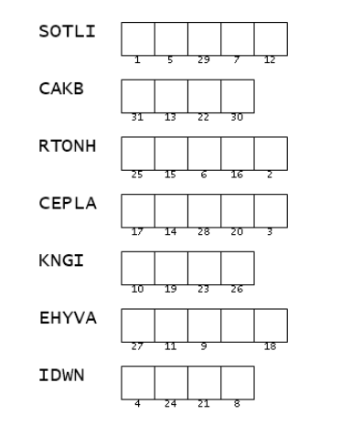
Family Activities
What happened to the spell checker? “SOTLI”? “CAKB”?
You need to correct these spellings!
Ah … use the numbers then to complete the message. I’ll bet there’s help at https://tinyurl.com/3c2d2m87 And you men in the back row will find the color page there also.

Slide 22
Purpose Questioned
September 1

