Slide 1
Purpose Expressed
September 29

Slide 2
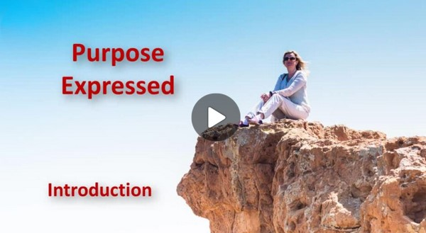
Video Introduction
View Video

Slide 3
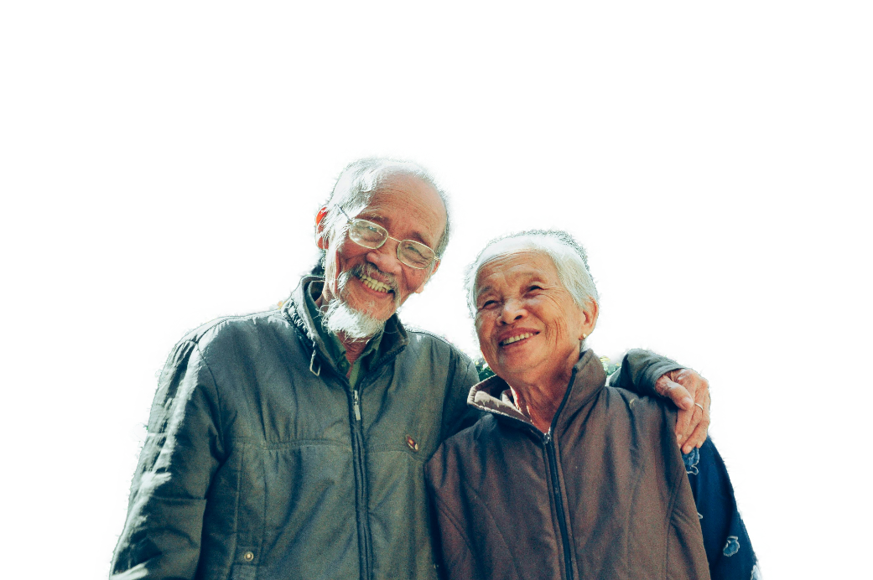
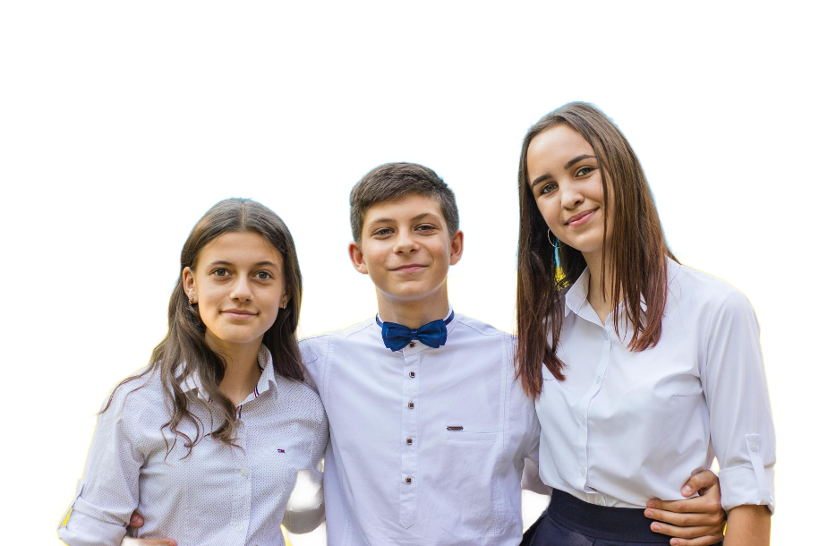
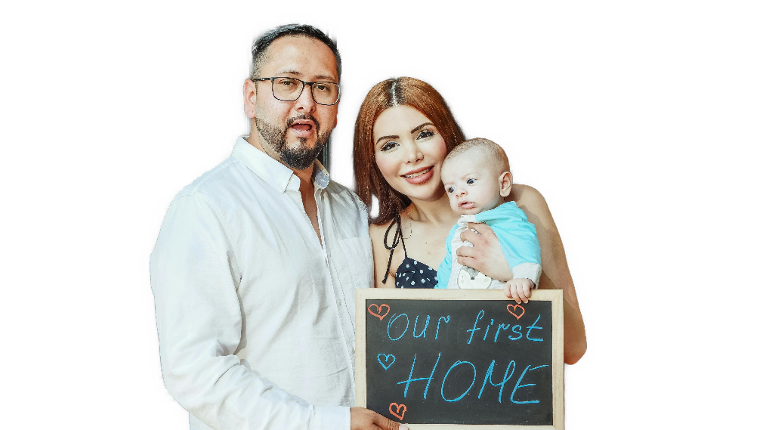
What impresses you?
What do you appreciate about the different generations?
The shift in society towards self-centeredness is evident.
Believers must guard against this self-centeredness.
We fulfill God’s purpose for us as we serve others in love.

Slide 4
Listen for an apparent contradiction.
Galatians 6:1-5 (NIV) Brothers, if someone is caught in a sin, you who are spiritual should restore him gently. But watch yourself, or you also may be tempted. 2 Carry each other's burdens, and in this way you will fulfill the law of Christ. 3 If anyone

Slide 5
Listen for an apparent contradiction.
thinks he is something when he is nothing, he deceives himself. 4 Each one should test his own actions. Then he can take pride in himself, without comparing himself to somebody else, 5 for each one should carry his own load.

Slide 6
Restore Others
What does Paul say should be done when someone is caught in sin?
What picture comes to mind when you hear the word “restore?”

Slide 7
Restore Others
What is the difference between restoring with a gentle spirit and correcting him/her harshly?
How does carrying an erring believer’s burden help to restore that person?
In what sense does bearing “another’s burdens … fulfill the law of Christ”?
Correcting Harshly | Restoring Gently

Slide 8
Restore Others
What caution did Paul offer believers?
What does this passage have to say about the temptation to feel superior to the erring brother or sister in Christ?
How do you explain the admonition to “bear one another’s burdens” with the admonition for every person to “bear his own burden”?

Slide 9
Listen for a farming principle
Galatians 6:6-8 (NIV) Anyone who receives instruction in the word must share all good things with his instructor. 7 Do not be deceived: God cannot be mocked. A man reaps what he sows. 8 The one who sows to please his sinful nature, from that nature will reap destruction; the one who sows to please the Spirit, from the Spirit will reap eternal life.

Slide 10
Benefits of Doing Good
What did Paul urge the Christians to do in relationship to those who provided instruction in the word?
What different kinds of things does Paul say that people sow? And what are the results?
What is sowed? | What is reaped?

Slide 11
Benefits of Doing Good
What would be some examples in our culture of mocking God and sowing to please one’s sinful nature?
In what ways are these things mocking God?
So what would be examples of sowing to please the Spirit?

Slide 12
Listen for an opportunity
Galatians 6:9-10 (NIV) Let us not become weary in doing good, for at the proper time we will reap a harvest if we do not give up. 10 Therefore, as we have opportunity, let us do good to all people, especially to those who belong to the family of believers.

Slide 13
Seize Every Opportunity
What did Paul say about a Christian’s social responsibility?
To whom should believers “especially … do good”? Why should that be true?
What opportunities does our group have to work for the good of others?
How can we structure our lives to be ready to serve?

Slide 14
Seize Every Opportunity
Consider the book by Richard Swenson, Margin.
“Margin” is the space that once existed between ourselves and our limits.
Today we use margin just to get by.
This book is for anyone who yearns for relief from the pressure of overload.

Slide 15
Seize Every Opportunity
Dealing with overload.
Reevaluate your priorities,
Determine the value of rest and simplicity in your life, and
See where your identity really comes from.
Available on Amazon at https://tinyurl.com/yc67swfy

Slide 16
Application
Encourage.
Think of those who played a key role in teaching, discipling, or mentoring you.
Find a tangible way to express thanks and “share all his good things” (Gal. 6:6) with one or more of them.

Slide 17
Application
Seize.
Ask God to make you aware of any opportunity during the day to serve someone else.
Seize that opportunity and serve as a way to honor God.

Slide 18
Application
Restore.
If you’re aware of another follower of Christ who is struggling with sin, come alongside that person.
Without arrogance or condemnation, offer a gentle reminder of God’s call to repent and to live an obedient life for Him.

Slide 19
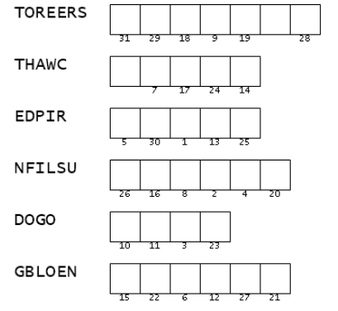
Family Activities
This is the first part of a message from a believer in Bazueavaslands. It is the key to the second portion. Unscramble the words (which are found in your Bible Study passage). Then use the numbers to fill in the message. Help is available at https://tinyurl.com/rp75yn63 . You ladies over on the left can also download the crossword.

Slide 20
Purpose Expressed
September 29

