Slide 1
Purpose Exemplified
October 6

Slide 2
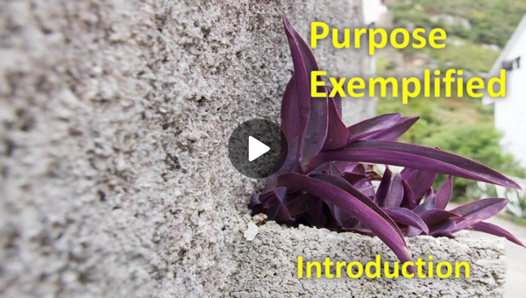
Video Introduction
View Video

Slide 3
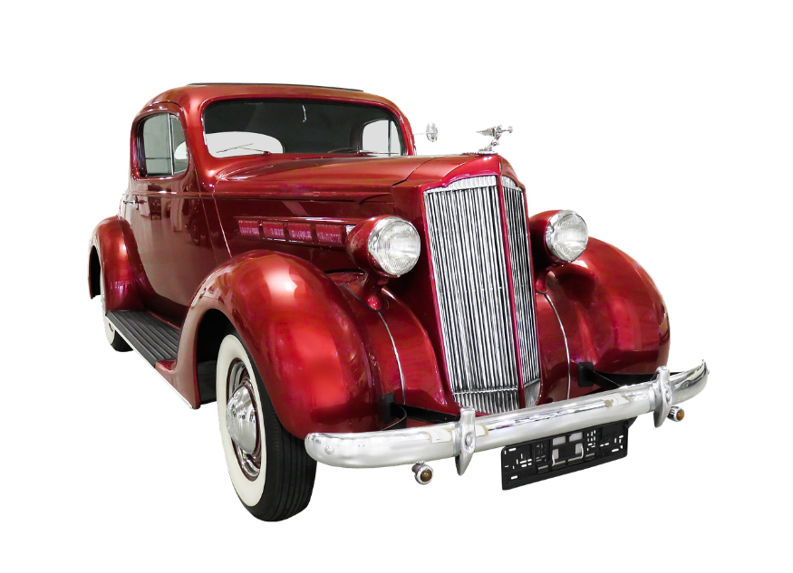
Admit it … OK?
What is the closest you’ve come to creating a masterpiece?
You might not have been commissioned to create a piece of art, but each believer does have a commission … the Great Commission
We are to put on display the beautiful work of Christ in our lives
God is glorified when we live with Christ-centered purpose.

Slide 4
Listen for thankfulness.
Philippians 1:1-5 (NIV) Paul and Timothy, servants of Christ Jesus, To all the saints in Christ Jesus at Philippi, together with the overseers and deacons: Grace and peace to you from God our Father and

Slide 5
Listen for thankfulness.
the Lord Jesus Christ. 3 I thank my God every time I remember you. 4 In all my prayers for all of you, I always pray with joy 5 because of your partnership in the gospel from the first day until now,

Slide 6
Thank God
What blessing does Paul extend to the recipients?
Why would it be a good practice to begin a letter with a Christian blessing?

Slide 7
Thank God
What do Paul’s remembrances of the Philippian church generate for him?
How does remembering God’s past action make a difference in our lives today?
What steps can we take to build thanksgiving more deeply into our prayer life?

Slide 8
Thank God
What godly encouragement can you offer other Christians?
Paul did not give thanks for things; he gave thanks for people. Why is that important?

Slide 9
Listen for confidence.
Philippians 1:6-8 (NIV) being confident of this, that he who began a good work in you will carry it on to completion until the day of Christ Jesus. 7 It is right for me to feel this way about all of you, since

Slide 10
Listen for confidence.
I have you in my heart; for whether I am in chains or defending and confirming the gospel, all of you share in God's grace with me. 8 God can testify how I long for all of you with the affection of Christ Jesus.

Slide 11
Praise God
What are some words and phrases Paul used to describe his relationship with the church at Philippi?
What was Paul confident about?
How did Paul feel about the Philippian church?

Slide 12
Praise God
Paul says he is confident that God, who began a good work in the Philippians, will carry it on to completion. How does this verse encourage us in our spiritual growth?
What “good work” has God begun in your life, and how does this verse challenge or comfort you regarding its completion?

Slide 13
Listen for Paul’s prayer request.
Philippians 1:9-11 (NIV) And this is my prayer: that your love may abound more and more in knowledge and depth of insight, 10 so that you may be able to discern what is best and may be pure and blameless until the day of Christ, 11 filled with the fruit of righteousness that comes through Jesus Christ--to the glory and praise of God.

Slide 14
Glorify God
What did Paul report that he prayed for?
How is Paul’s prayer for the Philippians a good prayer for you to copy?
In what ways does our ongoing spiritual growth glorify the Lord?

Slide 15
Glorify God
Why is glorifying God the believer’s highest priority?
Paul mentions "discernment" in verse 10. Why is discernment important in living out a life of love and righteousness?

Slide 16
Application
Cultivate a grateful life.
If you’re a Christian, realize you’re more blessed than you deserve.
Regardless of your circumstances, remind yourself daily of all that’s yours in Christ Jesus.
Remind yourself daily of the gospel and live out of the overflow of a heart enthralled with the Savior.
As you pray and thank God for all He’s done for you, let His joy fill your heart and be seen as you serve others.

Slide 17
Application
Memorize Philippians 1:6.
Memorize this passage as a reminder that God is at work, even when we don’t yet see the result:
“I am sure of this, that he who started a good work in you will carry it on to completion until the day of Christ Jesus.”

Slide 18
Application
Partner with others in the gospel.
Invest your life in encouraging and supporting others with their particular ministry.
Such a partnership should include prayer, and it might even include financial support.
Look for other ways to partner with them in the gospel.

Slide 19
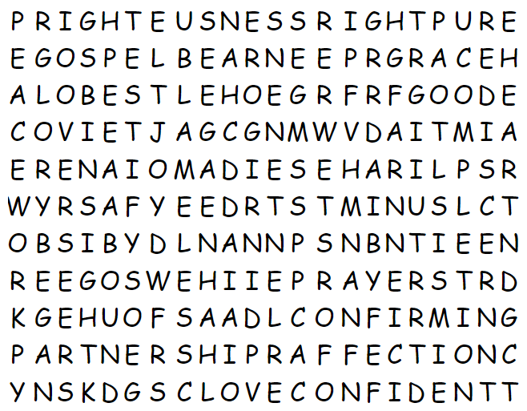
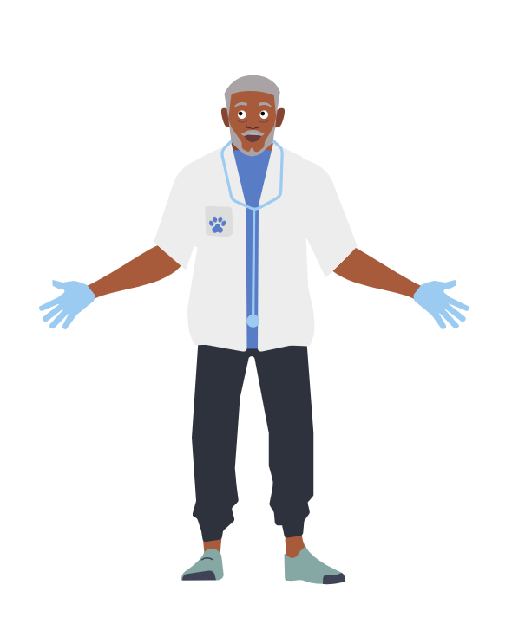
Family Activities
What is a “COVIET”? And “EGO” is not a word in the Bible Study. Please help find the right words. Help and other cool Family Activities are found at https://tinyurl.com/5n8hwwnw The Word Search Lady says, “That other class can find more words than you guys.” I say “Humph”!

Slide 20
Purpose Exemplified
October 6

