Slide 1
Purpose Abandoned
September 8

Slide 2
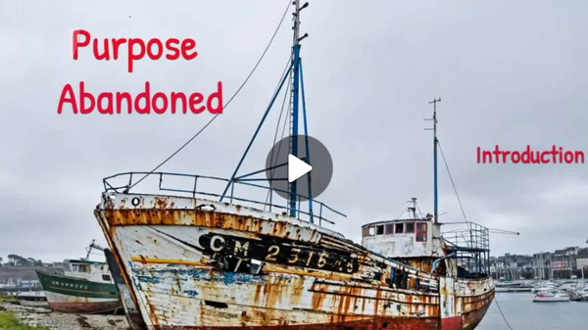
Video Introduction
View Video

Slide 3
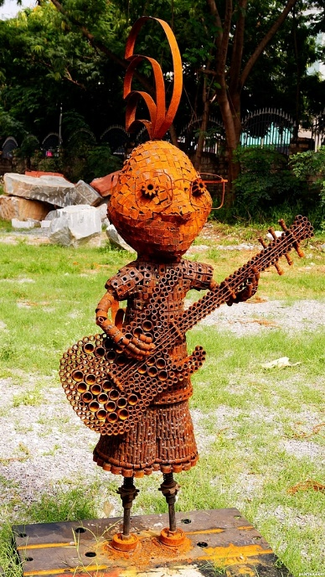
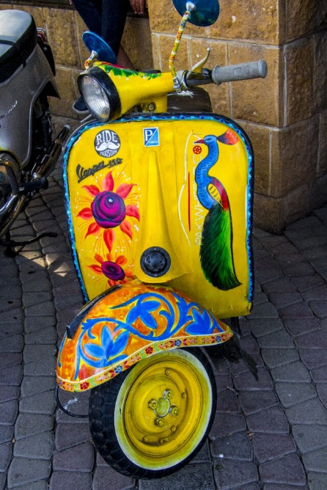
It was so clever …
What are some items you have seen where the item was changed to be able to do something entirely different from its original purpose?
God has created each of us with a specific purpose.
Our sin can keep us from living out that purpose
We seek both to know our purpose and to experience God’s restoration.

Slide 4
Listen for descriptions of God.
Psalm 8:1-6 (NIV) O LORD, our Lord, how majestic is your name in all the earth! You have set your glory above the heavens. 2 From the lips of children and infants you have ordained praise because of your enemies, to silence the foe and the avenger. 3 When I consider your heavens, the work of your fingers, the moon and

Slide 5
Listen for descriptions of God.
the stars, which you have set in place, 4 what is man that you are mindful of him, the son of man that you care for him? 5 You made him a little lower than the heavenly beings and crowned him with glory and honor. 6 You made him ruler over the works of your hands; you put everything under his feet:

Slide 6
Look What Good God Did
What are words and phrases David uses in this passage to describe God?
Why is “Lord” used two times in the declaration of praise in verse 1?
What do you find most amazing about God’s creation?

Slide 7
Look What Good God Did
What can we learn from David about the attitude we should have about ourselves?
With what value did God create people?
How are you a “little less than God” (or “heavenly beings”)?

Slide 8
Listen for how mankind failed.
Psalm 14:1-3 (NIV) The fool says in his heart, "There is no God." They are corrupt, their deeds are vile; there is no one who does good. 2 The LORD looks down from heaven on the sons of men to

Slide 9
Listen for how mankind failed.
see if there are any who understand, any who seek God. 3 All have turned aside, they have together become corrupt; there is no one who does good, not even one.

Slide 10
Look How We Messed Up
Verse 1 starts with “The fool says in his heart, ‘There is no God.’” How does this declaration reflect the psalmist’s view of human wisdom and foolishness?
What does this say about the nature of belief or unbelief with regards to God?
How does the Lord assess those who live as if He does not exist. List the words and phrases.

Slide 11
Look How We Messed Up
What are some examples of people expressing "there is no God" by how they live?
How pervasive is the sin that characterizes humankind?
In a world that constantly seeks to turn us away from God, what practices can anchor us to Him?

Slide 12
Listen for God’s solution.
Psalm 14:4-7 (NIV) Will evildoers never learn-- those who devour my people as men eat bread and who do not call on the LORD? 5 There they are, overwhelmed with dread, for God is present in the company of the righteous.

Slide 13
Listen for God’s solution.
You evildoers frustrate the plans of the poor, but the LORD is their refuge. 7 Oh, that salvation for Israel would come out of Zion! When the LORD restores the fortunes of his people, let Jacob rejoice and Israel be glad!

Slide 14
Look at the Fix God Offers
In verses 6-7, the psalmist expresses hope for salvation and deliverance. How do these verses contribute to the overall message of the psalm regarding hope and redemption?
What does this imply about the role of divine intervention in human history?

Slide 15
Look at the Fix God Offers
When has the Lord been a refuge for you during a difficult time?
Why are we reluctant to turn to God after we’ve sinned?

Slide 16
Applications
Reflect.
Take time to reflect on the fact that God has created you for His glory.
Are you living your life for His glory or your own?
Make any changes necessary to give Him all the praise.

Slide 17
Applications
Confess.
What is a part of your life God is revealing that you may be living apart from His purposes for you?
Confess that to Him, repent, and thank Him for His forgiveness.

Slide 18
Applications
Forgive.
A sign of maturity is sharing God’s forgiveness with others.
Is there someone who has hurt you?
Ask God for the grace to forgive, even as He has forgiven you.

Slide 19
Family Activities
This is the key to an important message out of Yepurocnalia. You must use it to decode the message. Our sports attaché there wants this to be translated for church sports directors everywhere. Help and access to the Crossword puzzle is available at https://tinyurl.com/56nemx5d

Slide 20
Purpose Abandoned
September 8

