Slide 1
Prepare for Battle
Oct. 8

Slide 2

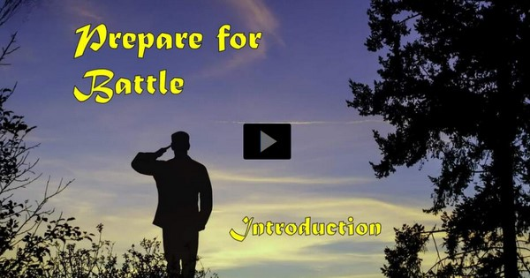
Video Introduction
View Video

Slide 3


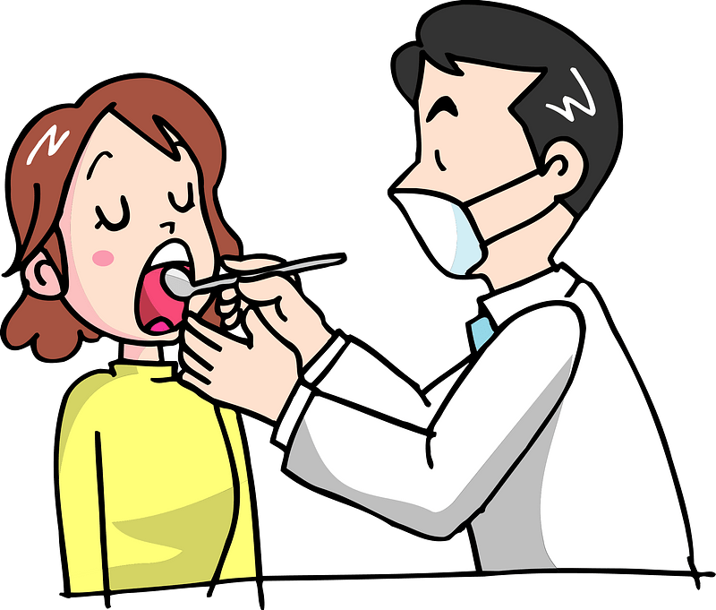
Go ahead … admit it …
When have you been intimidated or frightened by an encounter with another person?
Today we study Daniel’s meeting with a real angel.
  The angel tells him of a coming major conflict
  God strengthened Daniel and will strengthen us as we pray and engage in spiritual battle.
Test today

Slide 4
Listen for Daniel’s response to a message.
Daniel 10:1-3 (NIV) In the third year of Cyrus king of Persia, a revelation was given to Daniel (who was called Belteshazzar). Its message was true and it concerned a great war. The understanding of the message

Slide 5
Listen for Daniel’s response to a message.
came to him in a vision. 2 At that time I, Daniel, mourned for three weeks. 3 I ate no choice food; no meat or wine touched my lips; and I used no lotions at all until the three weeks were over.

Slide 6
Prepare to Hear from God
What do we learn about the historical context of these verses?
What words and phrases describe the revealed word given to Daniel?
How do we typically respond to bad news?
What is your understanding of spiritual warfare?

Slide 7
Prepare to Hear from God
What is the significance of the three-week period of fasting and mourning that Daniel observes at the beginning of chapter 10? How does this reflect his character and devotion to God?
The passage emphasizes the power of prayer and the importance of seeking understanding and insight from God. How can we apply this lesson to our own prayer lives and our pursuit of spiritual wisdom?

Slide 8
Listen for a physical touch.
Daniel 10:10-13 (NIV) A hand touched me and set me trembling on my hands and knees. 11 He said, "Daniel, you who are highly esteemed, consider carefully the words I am about to speak to you, and stand up, for I have now been sent to you." And when he said this to me, I stood up trembling. 12 Then he continued, "Do not be afraid, Daniel.

Slide 9
Listen for a physical touch.
Since the first day that you set your mind to gain understanding and to humble yourself before your God, your words were heard, and I have come in response to them. 13 But the prince of the Persian kingdom resisted me twenty-one days. Then Michael, one of the chief princes, came to help me, because I was detained there with the king of Persia.

Slide 10
Prayer, An Element of Spiritual Warfare
What acts and words of assurance did the heavenly visitor provide Daniel to help him overcome his fear and to stand ready to receive the message being delivered to him?
The angelic messenger explains being delayed by a spiritual battle in the heavenly realm. What does this reveal about the unseen spiritual warfare that may be taking place around us? How might this influence our understanding of prayer and spiritual warfare?

Slide 11
Prayer, An Element of Spiritual Warfare
When have events led you to an extended ongoing season of prayer?
What can we learn about the role of angels in God's plans from this passage?

Slide 12
Listen for how Daniel was encouraged.
Daniel 10:16-19 (NIV) Then one who looked like a man touched my lips, and I opened my mouth and began to speak. I said to the one standing before me, "I am overcome with anguish because of the vision, my lord, and I am

Slide 13
Listen for how Daniel was encouraged.
helpless. 17 How can I, your servant, talk with you, my lord? My strength is gone and I can hardly breathe." 18 Again the one who looked like a man touched me and gave me strength.

Slide 14
Listen for how Daniel was encouraged.
"Do not be afraid, O man highly esteemed," he said. "Peace! Be strong now; be strong." When he spoke to me, I was strengthened and said, "Speak, my lord, since you have given me strength."

Slide 15
Stand Strong in the Lord
What action by the angelic being seemed to make a difference in Daniel’s ability to speak and stand strong?
What was Daniel’s plea and confession to the angelic being and why is it significant?

Slide 16
Stand Strong in the Lord
How does the angel respond to Daniel’s confession?
What are some ways the Lord strengthens us for spiritual battle?

Slide 17
Application
Recall.
  The time to prepare for warfare is before we are attacked.
  Make a list of Scriptures that offer you encouragement and assurance for troubling times.
  Keep those nearby and pull them out when needed.

Slide 18
Application
Resist.
  Jesus quoted Scripture when He was tempted.
  Memorize some of the Scriptures in your list so you can be ready to quote them when you feel attacked spiritually.

Slide 19
Application
Read.
  Find a good book on spiritual warfare that is written by a solid Christian author. Consider “God’s Smuggler” by Brother Andrew
  Ask the Lord to speak to you through this book and to strengthen you spiritually.

Slide 20
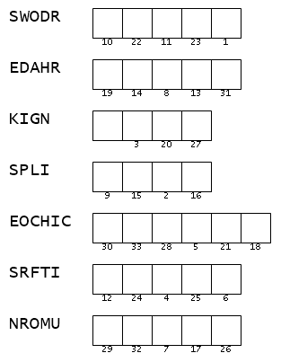
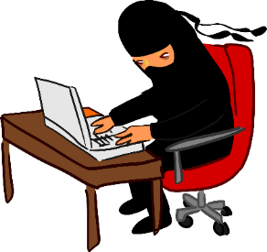
Family Activities
Fellow Word Ninjas … this is a task for YOU! Unscramble these clue words. Then you can use the numbers to decode the message. Remember, these words must be found in our Bible passage. Help (and the Crossword) can be found at https://tinyurl.com/mu4htccb

Slide 21
Prepare for Battle
Oct. 8

