Slide 1
Praying for Ourselves
November 11

Slide 2
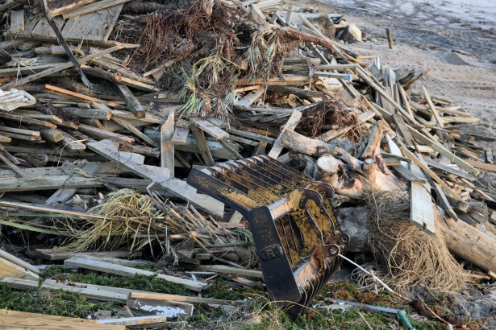
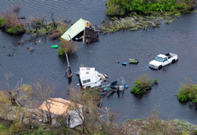
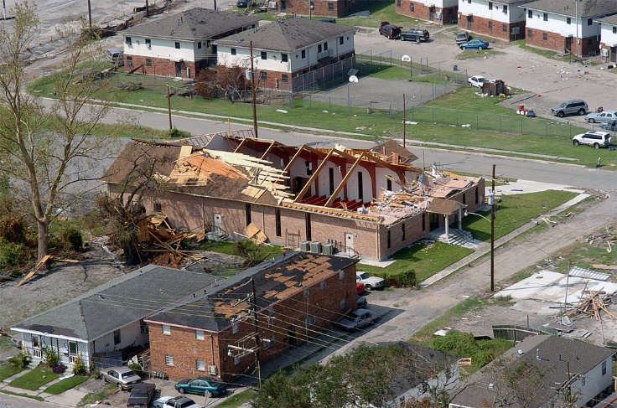
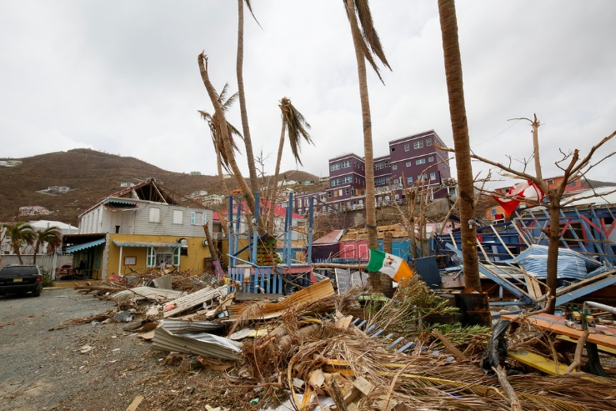
Think about it …
For the people who went through the devastation of recent hurricanes, what are some of the most basic needs they have encountered?
Jesus taught us to pray for our “daily bread”
  Daily needs include more than just bread
  Today we consider taking all your needs to God daily and trusting Him to answer.

Slide 3
Listen for a response to bad news.
Matthew 6:11 (NIV) Give us today our daily bread. Isaiah 38:1-3 In those days Hezekiah became ill and was at the point of death. The prophet Isaiah son of Amoz went to him and said, "This is what the LORD says: Put your house in order, because you are going to die; you will not recover."

Slide 4
Listen for a response to bad news.
Hezekiah turned his face to the wall and prayed to the LORD, 3 "Remember, O LORD, how I have walked before you faithfully and with wholehearted devotion and have done what is good in your eyes." And Hezekiah wept bitterly.

Slide 5
Take Your Needs to God
What message did God send via Isaiah to the good king Hezekiah when he became gravely ill?
What was Hezekiah’s reaction to the prophecy about his imminent death?
What other Bible characters (beside Jesus) do we know who faced death? How did they handle that possibility?

Slide 6
Take Your Needs to God
How else might Hezekiah have reacted when Isaiah told him he would die from his current illness?
What do we sometimes do first instead of going to God with our needs?
Why pray, since God already knows what you need?
How is the petition in Matthew 6:11 also an expression of trust?

Slide 7
Listen for good news.
Isaiah 38:4-6 (NIV) Then the word of the LORD came to Isaiah: 5 "Go and tell Hezekiah, 'This is what the LORD, the God of your father David, says: I have heard your prayer and seen your tears; I will add fifteen years to your life. 6 And I will deliver you and this city from the hand of the king of Assyria. I will defend this city.

Slide 8
God Graciously Answers
How did the Lord respond to Hezekiah’s plea?
Why might the Lord have identified Himself as the God of David thy father?
What positive events resulted from the potential tragedy of Hezekiah?
Why is, or is not, death the worst thing that can happen to us?
The worst thing … | NOT the worst thing …

Slide 9
God Graciously Answers
How can we respond when we don’t see God granting our requests?
What are some ways God might answer your prayer in a way that is evident it could only be from the Lord?

Slide 10
Listen for Hezekiah’s praise.
Isaiah 38:15-17 (NIV) But what can I say? He has spoken to me, and he himself has done this. I will walk humbly all my years because of this anguish of my soul. 16 Lord, by such things men live; and my spirit finds life in them too..

Slide 11
Listen for Hezekiah’s praise.
You restored me to health and let me live. 17 Surely it was for my benefit that I suffered such anguish. In your love you kept me from the pit of destruction; you have put all my sins behind your back

Slide 12
God’s Answer Benefits and Strengthens
How did Hezekiah acknowledge God as the source of his healing?
How did Hezekiah view his physical and mental suffering after he was delivered?
What are some of the lessons Hezekiah seemed to have learned from his experience of facing death?

Slide 13
God’s Answer Benefits and Strengthens
How can answered prayer change your perspective toward life?
How does God use our prayer life to get us to where He wants us to be?

Slide 14
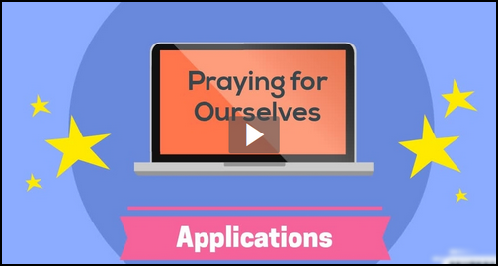
Application
View the Video

Slide 15
Application
List your requests.
  Make a list of your needs—both daily and long-term.
  Pray through that list and trust God to answer

Slide 16
Application
Evaluate your requests.
  In light of God’s honor, will, and kingdom, evaluate your list of prayer requests
  As needed, modify what you’re asking or how you’re asking to ensure your requests honor Christ.

Slide 17
Application
Share God’s answers.
  Share with someone the specific ways God has answered your prayers.

Slide 18
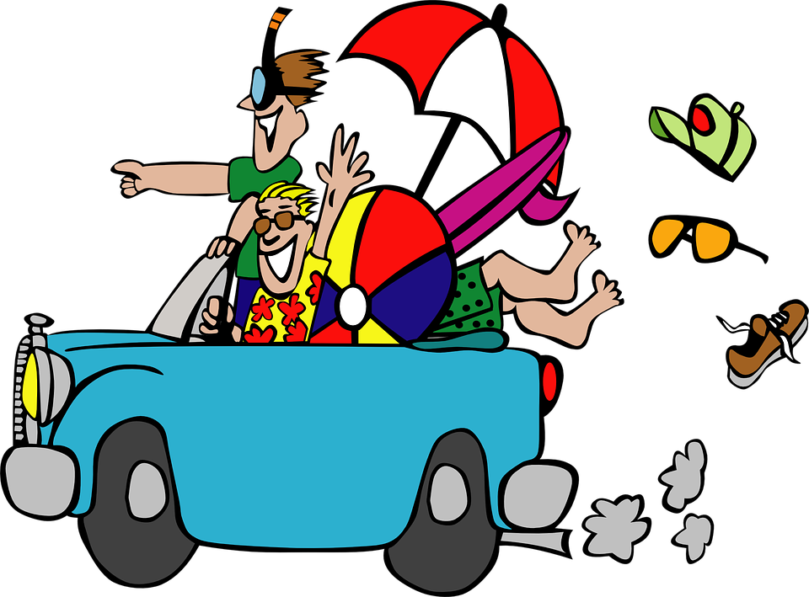
Family Activities
Summer’s over …
Everyone’s now home
And there’s nothing on 500 channels of TV
For some cool family activities check out
https://tinyurl.com/ycqnmr49

Slide 19
Praying for Ourselves
November 11

