Slide 1
Praying for Our Nation
June 30

Slide 2
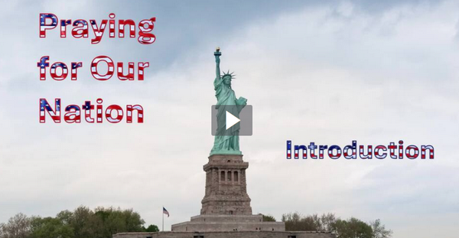
Video Introduction
View Video

Slide 3
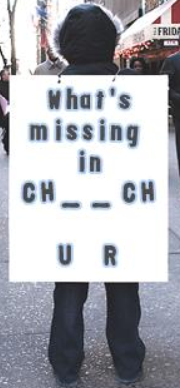
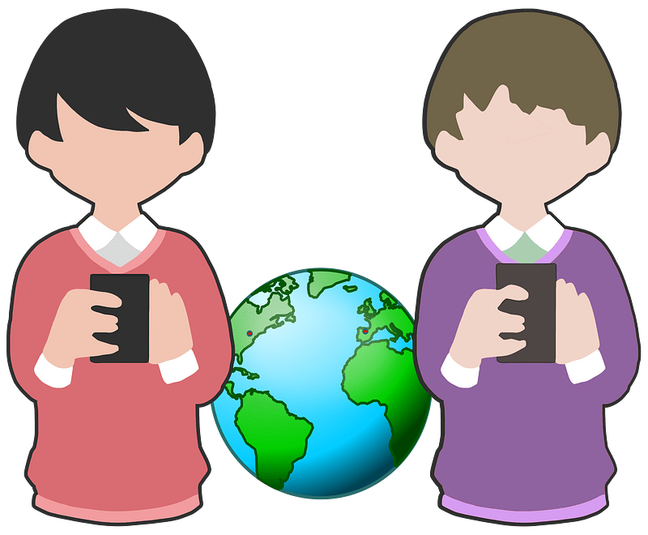
Think about it …
In what ways have you observed a rapid shift in culture?
Culture may change, but God does not.
God blesses those who humbly look to Him.
This is true for us as individuals and as a nation.

Slide 4
Listen for results of God’s presence.
2 Chronicles 7:1-3 (NIV) When Solomon finished praying, fire came down from heaven and consumed the burnt offering and the sacrifices, and the glory of the LORD filled the temple. 2 The priests could not enter the temple of the LORD because the glory of the LORD filled it.

Slide 5
Listen for results of God’s presence.
When all the Israelites saw the fire coming down and the glory of the LORD above the temple, they knelt on the pavement with their faces to the ground, and they worshiped and gave thanks to the LORD, saying, "He is good; his love endures forever."

Slide 6
God’s Glory, Our Humility
What manifestations of the Lord came at the conclusion of Solomon’s dedicatory prayer?
Note their significance:
Fire can be considered a personal encounter with God in a way that can be observed
Glory denotes the manifestation of the presence of the Lord with power

Slide 7
God’s Glory, Our Humility
What affect did they have on the people?
What questions might you like to ask about God’s glory filling the temple?
How is their response different from the way we enter our church sanctuary for a Sunday service?
When have you been moved to worship because of something God has done?

Slide 8
Listen for God’s revelation to Solomon.
2 Chronicles 7:12-16 (NIV) the LORD appeared to him at night and said: "I have heard your prayer and have chosen this place for myself as a temple for sacrifices. 13 "When I shut up the heavens so that there is no rain, or command locusts

Slide 9
Listen for God’s revelation to Solomon.
to devour the land or send a plague among my people, 14 if my people, who are called by my name, will humble themselves and pray and seek my face and turn from their wicked ways, then will I hear from heaven and will forgive their sin and will

Slide 10
Listen for God’s revelation to Solomon.
heal their land. 15 Now my eyes will be open and my ears attentive to the prayers offered in this place. 16 I have chosen and consecrated this temple so that my Name may be there forever. My eyes and my heart will always be there.

Slide 11
God’s Promises, Our Repentance
God answers prayer in His time and now we see on His terms, His conditions … what are the four conditions?
What is required to “humble” oneself?
What do you think it means to “seek God's face”?
What are the results when we meet God's conditions?

Slide 12
God’s Promises, Our Repentance
When God “hears” it means more than sound vibrating someone’s eardrums
It implies that God is acting upon our prayers
God is doing something

Slide 13
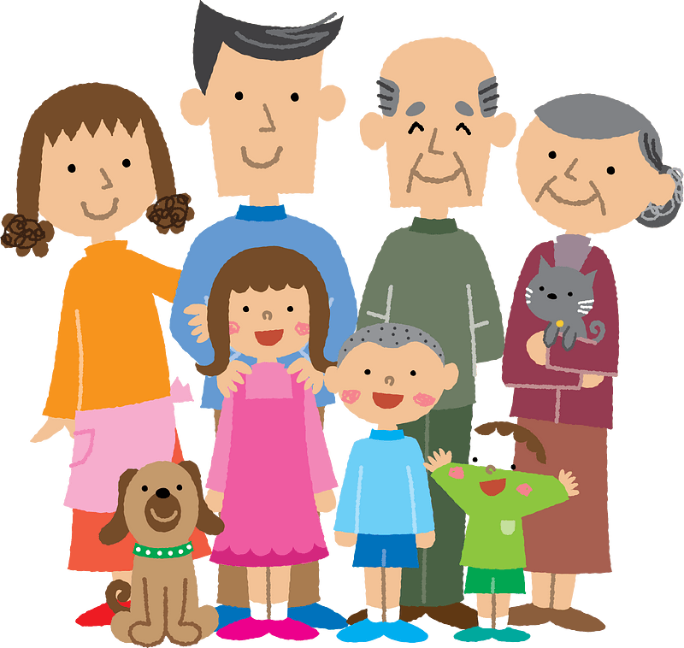
God’s Promises, Our Repentance
How might this affect people at a family level if they met the conditions listed previously?
How might this affect people within a local church body if the met the four conditions?

Slide 14
Listen for God’s commands to Solomon.
2 Chronicles 7:17-20 (NIV) "As for you, if you walk before me as David your father did, and do all I command, and observe my decrees and laws, 18 I will establish your royal throne, as I covenanted with David your father when I said, 'You shall never fail to have a man to rule over Israel.' 19 "But if you turn

Slide 15
Listen for God’s commands to Solomon.
away and forsake the decrees and commands I have given you and go off to serve other gods and worship them, 20 then I will uproot Israel from my land, which I have given them, and will reject this temple I have consecrated for my Name. I will make it a byword and an object of ridicule among all peoples.

Slide 16
God’s Blessing, Our Obedience
What condition did the Lord establish for Solomon and his descendants?
What are some "gods" people serve today rather than following the one true God?

Slide 17
God’s Blessing, Our Obedience
Note the results if Solomon was faithful and obedient.
Establish his throne, his rule, his authority
The line of David’s kingship would be intact

Slide 18
God’s Blessing, Our Obedience
What would happen if he and his descendants were not faithful and obedient?
How do these promises and warnings compel us to pray for our church and our nation?

Slide 19
Application
Be humble.
Embrace a posture of humility in your relationship with God.
Recognize your own imperfections and acknowledge your dependence on Him.

Slide 20
Application
Pray.
Make prayer a priority in your daily life.
Seek God’s presence, guidance, and will for your life in every situation.

Slide 21
Application
Invite.
Encourage others to join you on this journey.
Reach out to offer encouragement for keeping the faith.
Together, seek to experience the transformative power of humble prayer and sincere devotion to God.

Slide 22
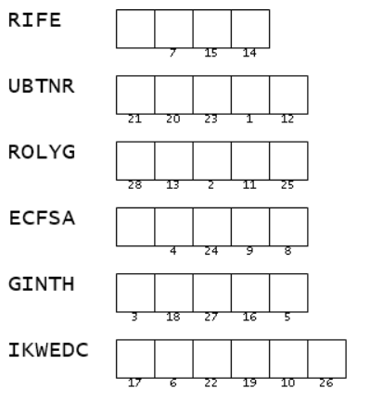
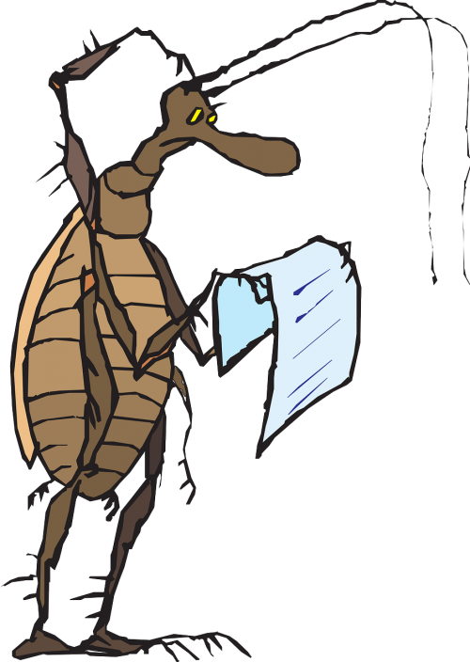
Family Activities
What is a “ROLYG”? Who is “GINTH”? Looks like the letters are out of order. Can you fix the words? Spiros the Spy says it’s part of a secret message from the Interpol office in Sima Zamsaintras. You might want to go to https://tinyurl.com/5a67rhuf for technical help … or for the Crossword

Slide 23
Praying for Our Nation
June 30

