Slide 1
Praying for Others
November 11

Slide 2

Introduction
View the video

Slide 3

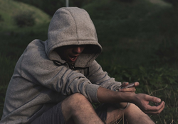
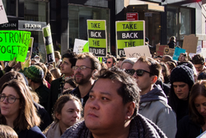
Think about it …
What do you think is most challenging for a Christian living in today’s society?
We all struggle with these issues along with the normal problems of life.
  We need the prayer support of fellow believers … and they need our prayers
  Today we look at going to God on the behalf of others.

Slide 4
Listen for Jesus’ petitions.
Matthew 6:11 (NIV) Give us today our daily bread. John 17:11-16 I will remain in the world no longer, but they are still in the world, and I am coming to you. Holy Father, protect them by the power of your name--the name you gave me--so that they may be one as we are one. 12 While I was with them, I protected them and kept them safe by that

Slide 5
Listen for Jesus’ petitions.
name you gave me. None has been lost except the one doomed to destruction so that Scripture would be fulfilled. 13 "I am coming to you now, but I say these things while I am still in the world, so that they may have the full measure of my joy within them. 14 I have given them your word

Slide 6
Listen for Jesus’ petitions.
and the world has hated them, for they are not of the world any more than I am of the world. 15 My prayer is not that you take them out of the world but that you protect them from the evil one. 16 They are not of the world, even as I am not of it.

Slide 7
Praying for Protection
What did Jesus ask His Father to do for His disciples?
Why did Jesus say these things while He was still in the world?
Why would the world hate Jesus’ disciples?
Why can believers today expect the world to hate them?

Slide 8
Praying for Protection
What does your life-style as a believer indicate about your relationship to the world?
Why is it so easy for us to become closely involved in the world?
Jesus specifically did not pray that we be removed from the world. Why do you think believers are still in the world?
⇨ Pray for one another that we will be both protected from the world’s influence but at the same time be an influence on the world.

Slide 9
Listen for our mission.
John 17:17-19 (NIV) Sanctify them by the truth; your word is truth. 18 As you sent me into the world, I have sent them into the world. 19 For them I sanctify myself, that they too may be truly sanctified.

Slide 10
Praying for Spiritual Growth
What does it mean when Jesus prays, “Sanctify them by the truth”?
How does God’s truth sanctify us or make us holy?
In what ways are we as believers set apart, separated from the world’s values, for God’s use?

Slide 11
Praying for Spiritual Growth
In what ways does sanctification reflect a process, and, as Jesus used the term, how can a person be set aside more than once?
What are some obstacles to spiritual growth that we need prayer to overcome?

Slide 12
Praying for Spiritual Growth
We often request prayer for one another’s physical needs. Why are we reluctant to request prayer for our spiritual needs … for God’s sanctifying process to take place in our lives?
⇨ Pray for one another’s spiritual needs as well as physical needs.

Slide 13

Consider …
What happens when musicians are not in tune with each other
Listen for a reason for the need of unity – being in tune with one another.

Slide 14
Listen for a reason for the need of unity – being in tune with one another.
John 17:20-23 (NIV) "My prayer is not for them alone. I pray also for those who will believe in me through their message, 21 that all of them may be one, Father, just as you are in me and I am in you. May they also be in us so that the world may believe that you have sent me.

Slide 15
Listen for a reason for the need of unity – being in tune with one another.
I have given them the glory that you gave me, that they may be one as we are one: 23 I in them and you in me. May they be brought to complete unity to let the world know that you sent me and have loved them even as you have loved me.

Slide 16
Praying for Unity
For whom did Jesus pray?
In what ways are all Christians one, united?
How are Christians today divided? Why?

Slide 17
Praying for Unity
Jesus prayed for unity, not uniformity. What’s the difference? Why is the distinction important in thinking of Jesus’ prayer?
What are some ways we can pray for others (even if we don’t totally agree with them) as Jesus prayed in these verses?

Slide 18
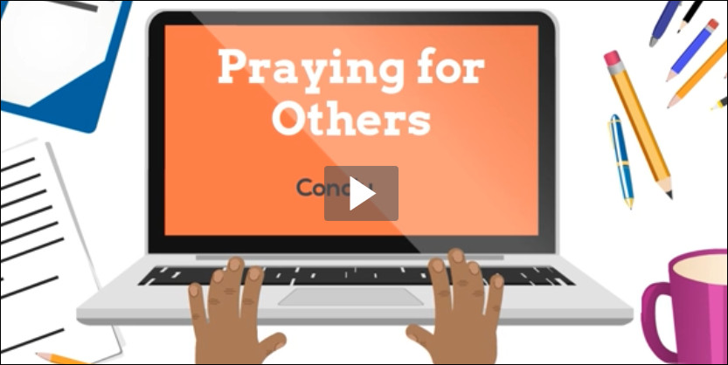
Application Video
View the Video

Slide 19
Application
Categorize your requests.
  Create a prayer list under three columns: PROTECTION, SPIRITUAL GROWTH, and UNITY.
  Under each column, list individuals or groups for whom you can pray.

Slide 20
Application
Ask others.
  Contact friends and family by phone, email, or text.
  Ask them how you can be praying specifically for them.

Slide 21
Application
Pray together.
  Meet with others in your group for a season of prayer.
  Pray together for unity among believers and churches in your community.

Slide 22
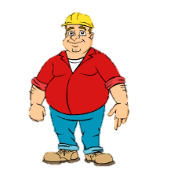
Family Activities
OK, so you’ve got your favorite this week on the handout … the crossword puzzle. But let me tell you, there’s other good stuff also, even an online jigsaw puzzle where Billy Graham reveals secrets about his golf game! Look it up at
https://tinyurl.com/yd2lkyx2

Slide 23
Praying for Others
November 11

