Slide 1
Praying Faith
February 11

Slide 2

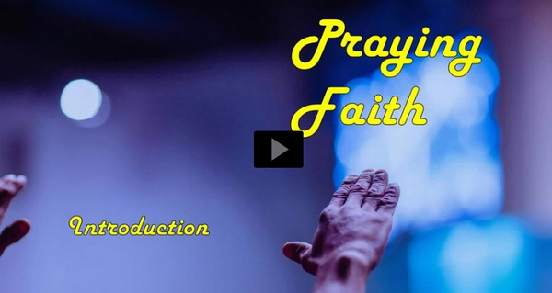
Video Introduction
View Video

Slide 3

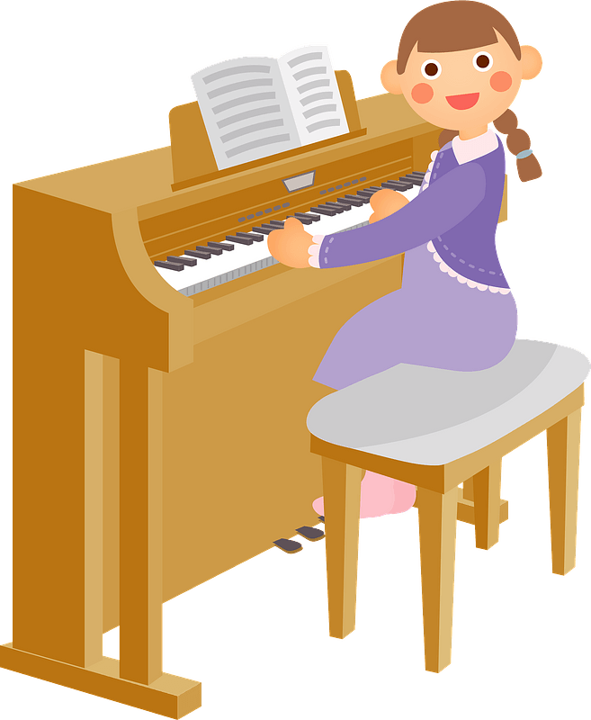
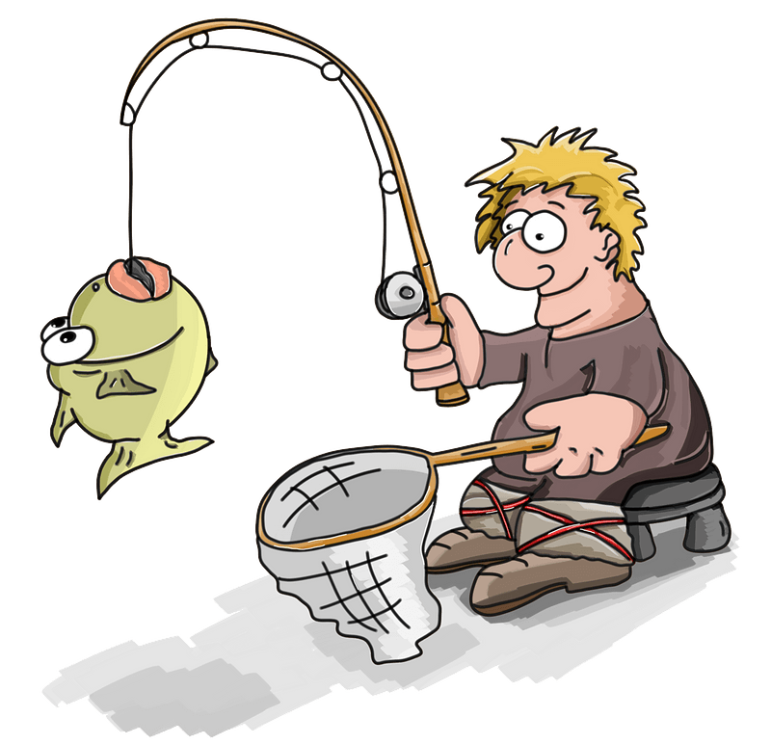
You learned this lesson …
When have you found it pays to be persistent?
Prayer is something in which we can and should persevere
  Jesus taught us to persevere in prayer.
  Faith looks to God to provide what we need.

Slide 4
Listen for elements of a prayer.
Luke 11:1-4 (NIV) One day Jesus was praying in a certain place. When he finished, one of his disciples said to him, "Lord, teach us to pray, just as John taught his disciples." 2 He said to them, "When you pray, say:

Slide 5
Listen for elements of a prayer.
"'Father, hallowed be your name, your kingdom come. 3 Give us each day our daily bread. 4 Forgive us our sins, for we also forgive everyone who sins against us. And lead us not into temptation.'"

Slide 6
Instructions for Praying Faith
Why did the disciples need to be taught how to pray?
Why do we need to learn how to pray?
Note, Jesus was praying “in a certain place.” How important is the place where we pray?

Slide 7
Instructions for Praying Faith
What specific elements should be in our prayers, according to the passage? Note that this is the direct answer to the disciples’ original question.
What are some good ways to prepare for personal prayer time?

Slide 8

Instructions for Praying Faith
Evaluate what kinds of concerns occupy most of your prayer time …
  Praise
  Confession
  Thanksgiving
  Petition
    Physical Needs
    Spiritual Needs
    Material needs
Do my prayers fit the pattern Jesus is outlining here?

Slide 9
Listen for an example of persistence.
Luke 11:5-10 (NIV) Then he said to them, "Suppose one of you has a friend, and he goes to him at midnight and says, 'Friend, lend me three loaves of bread, 6 because a friend of mine on a journey has come to me, and I have nothing to set before him.' 7 "Then the one

Slide 10
Listen for an example of persistence.
inside answers, 'Don't bother me. The door is already locked, and my children are with me in bed. I can't get up and give you anything.' 8 I tell you, though he will not get up and give him the bread because he is his friend, yet because of the man's boldness he will get up and give

Slide 11
Listen for an example of persistence.
him as much as he needs. 9 "So I say to you: Ask and it will be given to you; seek and you will find; knock and the door will be opened to you. 10 For everyone who asks receives; he who seeks finds; and to him who knocks, the door will be opened.

Slide 12
Keep On Praying with Faith
Why was the man in this passage so persistent?
Note the parallels between this man’s persistence and why we should be persistent
  Our needs are often desperate
  We know that God wants us to come to him
  We know that God has what we need

Slide 13
Keep On Praying with Faith
Note the contrast between God and the neighbor
  The man was reluctant but gave in
  God wants us to come to Him with our needs – He wants our trust
What kinds of things keep us from being persistent in our prayers?

Slide 14
Keep On Praying with Faith
Consider the promise attached to the exhortation to ask, seek, and knock.
  Remember that Hebrew writing and oration often use repeated statements
  Note the parallel and contrasting statements in the Psalms (see Psalm 119)
  The repetition emphasized the perseverance Jesus was stressing
  Keep asking, keep seeking, keep knocking – keep TRUSTING

Slide 15



Keep On Praying with Faith
What kinds of strategies might we have to develop persistence in prayer?

Slide 16



What about it?
What kinds of gifts have people given that appeared to be good but turned out to bring harm to the recipient?

Slide 17
Listen for examples of good and bad gifts.
Luke 11:11-13 (NIV) "Which of you fathers, if your son asks for a fish, will give him a snake instead? 12 Or if he asks for an egg, will give him a scorpion? 13 If you then, though you are evil, know how to give good gifts to your children, how much more will your Father in heaven give the Holy Spirit to those who ask him!"

Slide 18
Accept the Answer with Faith
Note the requests of the son and what is not given by the father?
What descriptive words or phrases are given about human fathers?
How is this contrasted with God?
How might consistently praying with God’s goodness in mind impact a believers’ faith?
Request | NOT Given
Fish Egg | Snake Scorpion

Slide 19
Application
Meditate.
  Pick a psalm and use it as a guide to worship God.
  Allow a phrase from the psalm to carry you through the week ahead.

Slide 20
Application
Write.
  Pen a prayer card to a friend.
  Let that person know that you are praying and share with them a specific prayer that you are praying.

Slide 21
Application
Practice.
  In the Garden of Gethsemane, Jesus asked his disciples, “Couldn’t you stay awake with me one hour?”
  Consider taking time one day this week and pray for one hour.
  Map out a plan and strategy for that hour that will guide the time.
  With a plan, you’ll be amazed how quickly the hour will pass.

Slide 22



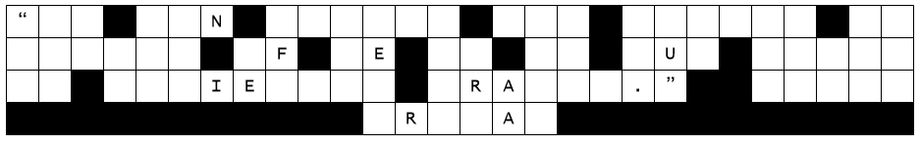
Family Activities
Yikes, that alien zapped the letters on the billboard with anti-gravity particles. They’re floating directly above the columns on your paper. Help us fix it. Find help at http://tinyurl.com/bdfn8fu6
Also, if you feel more secure with a crossword puzzle, that’s where it is.

Slide 23
Praying Faith
February 11

