Slide 1
Pray for Your Neighbor
August 7

Slide 2
Video Introduction
View Video

Slide 3
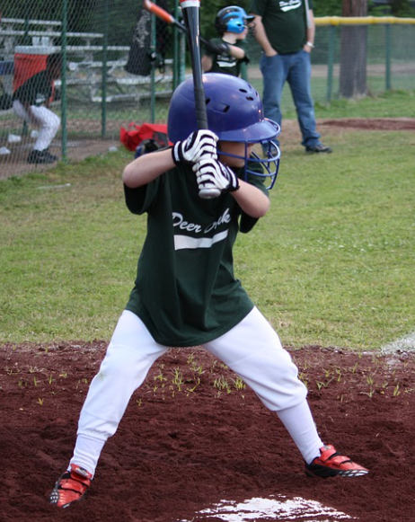
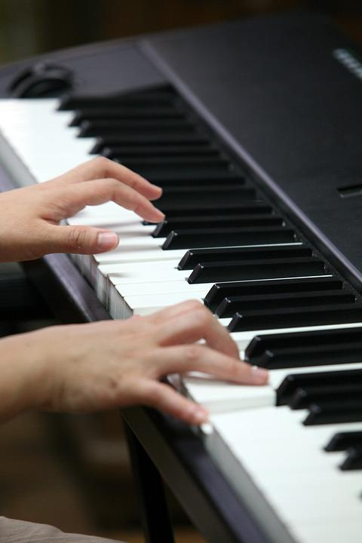
What do you remember …
When have you seen hours of training and hard work pay off?
Consider the daily practice of intercessory prayer.
We can demonstrate love our neighbors by taking their needs to God in prayer.

Slide 4
Listen for whom to pray.
1 Timothy 2:1-4 (NIV) I urge, then, first of all, that requests, prayers, intercession and thanksgiving be made for everyone-- 2 for kings and all those in authority, that we may live peaceful and quiet lives in all godliness and holiness. 3 This is good, and pleases God our Savior, 4 who wants all men to be saved and to come to a knowledge of the truth.

Slide 5
Pray for Your Neighbor
Why kind of praying did Paul urge Timothy to do? What are different synonyms for prayer used in various translations you have?
For whom was he to pray?
Consider your neighbors, how can you pray for them?

Slide 6
Pray for Your Neighbor
What often gets in the way of regular prayer in our lives?
What sort of prayers should we make on behalf of our leaders?
How would Timothy (and we) benefit from praying for those in authority?

Slide 7
Pray for Your Neighbor
Why do you think the greater majority of our public prayer requests have to do with physical needs … instead of spiritual needs?
It’s not always best to divulge embarrassing personal struggles to a group.
Seeking prayer support privately from an accountability partner is a much better practice

Slide 8
Listen for another reason to pray.
1 Timothy 2:5-6 (NIV) For there is one God and one mediator between God and men, the man Christ Jesus, 6 who gave himself as a ransom for all men--the testimony given in its proper time.

Slide 9
Pray for Spiritual Needs
Why should Timothy focus his attention on the Lord God?
Not the use of the term mediator applied to Jesus. How do we use mediators in our society?
Who are the disputants and how does Jesus facilitate the reconciliation?

Slide 10
Pray for Spiritual Needs
Based on this passage, what advice would you give to a Christian who insists he/she cannot pray for the salvation of a person who has hurt him/her?
Paul says here that God wants all men to be saved and come to know Truth. What are some reasons this has not happened?
Jesus gave us the Great Commission
It is our responsibility to be praying, giving, and challenging young people to go as He calls them.

Slide 11
Listen for Paul’s primary purpose in life.
1 Timothy 2:7-8 (NIV) And for this purpose I was appointed a herald and an apostle--I am telling the truth, I am not lying--and a teacher of the true faith to the Gentiles. 8 I want men everywhere to lift up holy hands in prayer, without anger or disputing.

Slide 12
Pray with the Right Attitude
What three terms did Paul use to describe his functional role as a follower of Christ?
Why is prayer an important step in preaching and teaching the gospel?
How can our group pray together for the salvation of others?

Slide 13
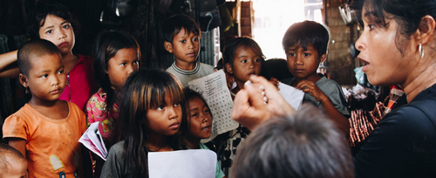
Pray with the Right Attitude
How can we pray for those who take the Gospel where we cannot go?

Slide 14
Application
Write.
Write down the four types of prayers Paul listed in verse 1—petitions, prayers, intercessions, and thanksgivings.
Write at least one name beside each category.

Slide 15
Application
Contact.
Contact a person for whom you been praying and tell them you prayed for them.
You can send a text, write a note, or just tell them in person.

Slide 16
Application
Reconcile.
If you are aware of an unresolved conflict with another believer, go to that person in humility and seek reconciliation.
Read Matthew 5:21-24; 18:15-19 for Jesus’s specific instructions on how to resolve conflict.

Slide 17
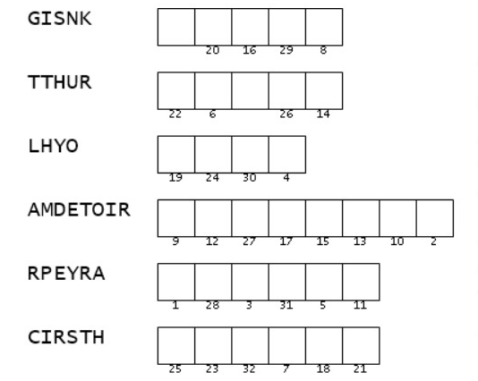
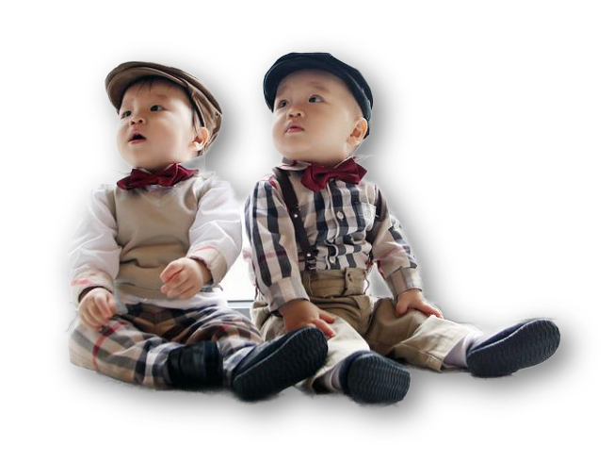
Family Activities
Yep, but if you can figure them out, you can use them to decode the message. I’m going to get help at https://tinyurl.com/3dsbssa7 I might also try the Crossword.
Those words are all out of order!

Slide 18
Pray for Your Neighbor
August 7

