Slide 1
Place God First
September 6

Slide 2
Video Introduction
View Video

Slide 3
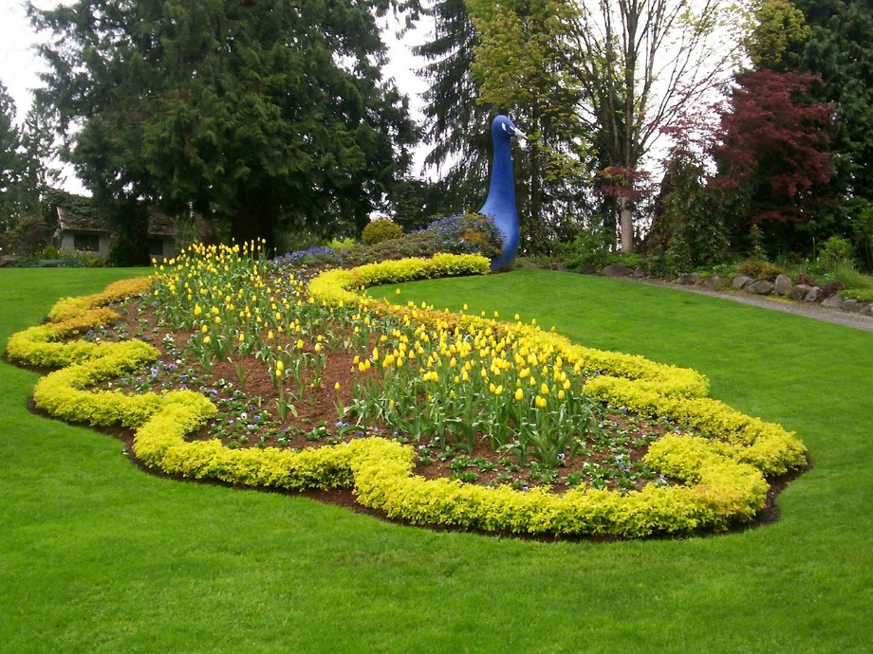
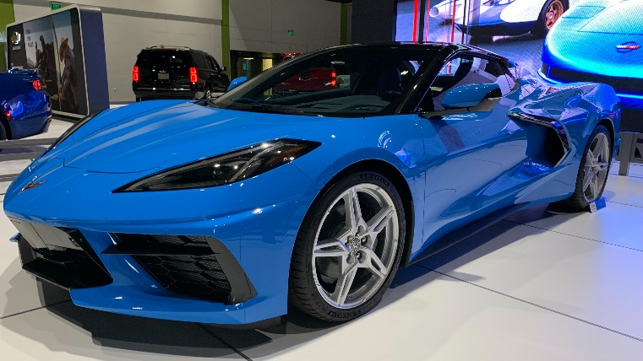
Think about it …
What are things our society tends to worship?
Many people or places or things can be the most important element in our lives.
By definition, that makes them idols – more important than God
As believers, God should have first place in every aspect of life.

Slide 4
Listen for why to devote yourself to God.
Exodus 20:1-6 (NIV) And God spoke all these words: 2 "I am the LORD your God, who brought you out of Egypt, out of the land of slavery. 3 "You shall have no other gods before me. 4 "You shall not make for yourself an idol in the form of anything in heaven above or on the earth beneath or in the waters below.

Slide 5
Listen for why to devote yourself to God.
You shall not bow down to them or worship them; for I, the LORD your God, am a jealous God, punishing the children for the sin of the fathers to the third and fourth generation of those who hate me, 6 but showing love to a thousand [generations] of those who love me and keep my commandments.

Slide 6
He Alone Is God
Why do you think God prefaced the Ten Commandments by announcing who He is?
Because that is true, what are they (we) commanded to avoid?
So, with the first commandment “no other gods before me,” how do Christians violate this commandment?

Slide 7
He Alone Is God
How is this first concept (no other gods) really different from the second commandment which speaks of actual physical objects which someone might bow down to?
Why would God not want any physical representations of Himself to be used in worship?
How does God respond to those who sin against Him?

Slide 8
He Alone Is God
Why do you think this exclusive loyalty is the first command, foundational to all the rest?
How do you guard against or fight idolatry (actual objects or influences) in your own life?

Slide 9
Listen for a poetic expression of devotion to God.
Psalm 16:1-4a (NIV) Keep me safe, O God, for in you I take refuge. 2 I said to the LORD, "You are my Lord; apart from you I have no good thing." 3 As for the saints who are in the land, they are the glorious ones in whom is all my delight. 4 The sorrows of those will increase who run after other gods.

Slide 10
He Alone Is Good and Completely Trustworthy
What brief prayer does the psalmist offer?
What was another element of trusting in God that brought him pleasure?
When has your relationships to fellow believers brought you joy and encouragement?

Slide 11
He Alone Is Good and Completely Trustworthy
What is his concern about those who pursue other gods? How might verse 4a relate to Exodus 20:5-6?
When are you most tempted to put your trust in something besides the Lord?
What experiences from your life reflect the truth that God is good?

Slide 12
Listen for how God is for us and with us.
Psalm 16:9-11 (NIV) Therefore my heart is glad and my tongue rejoices; my body also will rest secure, 10 because you will not abandon me to the grave, nor will you let your Holy One see decay. 11 You have made known to me the path of life; you will fill me with joy in your presence, with eternal pleasures at your right hand.

Slide 13
He Alone Is the Way to Eternal Life
What resulted from the psalmist’s contemplation on the assurance of God’s presence?
What did David expect of his future?
What words in these verses reinforce the idea that hope in the Lord has eternal benefit?
How had his confidence in God affected his view of death?

Slide 14
He Alone Is the Way to Eternal Life
How does your faith in God affect your perspective on death?
Who could be the "Holy One"? How might it apply to Christ?
What does it look like to place God first in your life?

Slide 15
Application
Acknowledge.
The starting point for any personal change begins with honestly acknowledging what needs to change.
If you do not put God first in any area in your life, confess that to God.
Ask for His forgiveness and help in putting Him first in your thoughts, words, and actions.

Slide 16
Application
Begin.
Make a commitment to begin each day by putting God first.
Develop the habit of putting God first by reminding yourself of this truth before you start your day.
Say a prayer when you first wake up.
Read your Bible before you do anything else.
Quote a Scripture from memory before you pick up your phone in the morning.

Slide 17
Application
Track.
Consider keeping a note-pad or journal this week where you write down every time you sought to put God’s perspective and His guidance first in your life.
You may want to share this with a friend as a way to encourage your friend to do the same.

Slide 18
Family Activities
IDOL
INCREASE
JEALOUS
KEEP
LAND
LORD
LOVE
MAKE
OTHER
PATH
PLEASURES
PRESENCE
PUNISHING
REFUGE
REST
RUN
SAFE
SAINTS
SECURE
SLAVERY
SORROWS
SPOKE
TAKE
THIRD
WATERS
WORDS
WORSHIP
ABANDON
AFTER
APART
BEFORE
BODY
BOW
BROUGHT
CHILDREN
COMMANDMENTS
DECAY
DELIGHT
DOWN
EARTH
EGYPT
ETERNAL
FATHERS
FOURTH
GENERATION
GLAD
GLORIOUS
GODS
GOOD
GRAVE
HATE
HEART
HEAVEN
These word lists have been totally lost during the pandemic. Humph! They landed in a grid of letters, and need to be located. If you fail, the secretary will disavow any knowledge of your activities. But you can get help at https://tinyurl.com/y5r5aleu along with further beneficial Family diversions.

Slide 19
Place God First
September 6

