Slide 1
Paul and Timothy
July 9

Slide 2
Video Introduction
View Video

Slide 3
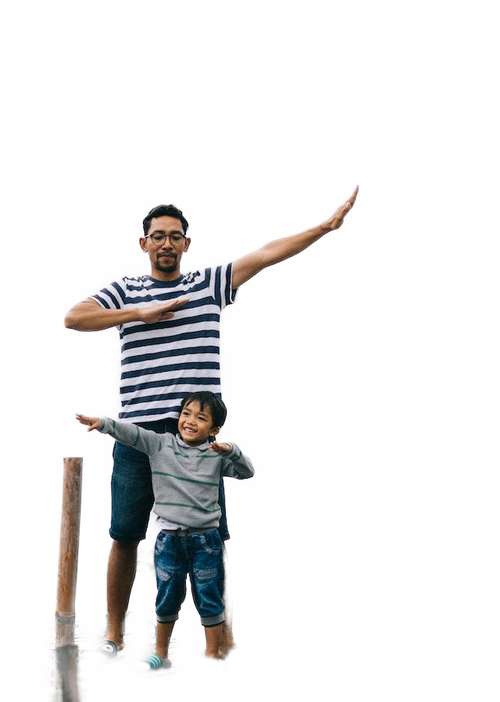
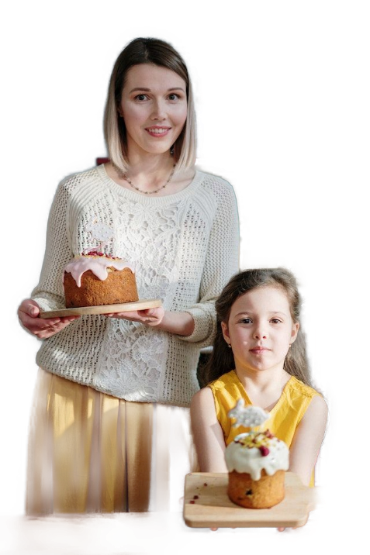
Think about it …
When have you seen a person’s mannerisms resemble someone influential in his or her life?
Consider how your mannerisms, attitudes, and actions influence those whom you mentor.
When we mentor and shape someone’s life, our goal is to lead those we disciple to a place of spiritual maturity.

Slide 4
Listen for a new opportunity.
Acts 16:1-5 (NIV) He came to Derbe and then to Lystra, where a disciple named Timothy lived, whose mother was a Jewess and a believer, but whose father was a Greek. 2 The brothers at Lystra and Iconium spoke well of him. 3 Paul wanted to take him along on the journey, so he circumcised him because

Slide 5
Listen for a new opportunity.
of the Jews who lived in that area, for they all knew that his father was a Greek. 4 As they traveled from town to town, they delivered the decisions reached by the apostles and elders in Jerusalem for the people to obey. 5 So the churches were strengthened in the faith and grew daily in numbers.

Slide 6
Mentoring through Partnership and Observation
Why do you think Paul chose Timothy as his companion on his missionary journeys? What qualities or characteristics do you see in Timothy that might have made him an ideal choice?
According to the passage, the churches in the region were strengthened in their faith daily. What do you think contributed to this growth and strengthening of the churches?

Slide 7
Mentoring through Partnership and Observation
How can we apply these principles in the ministries of our churches today?
Paul was known for adapting his approach to different cultures and contexts. How can we follow his example in our interactions with people from different backgrounds, cultures, and belief systems?

Slide 8
Listen for how to replicate a ministry.
2 Timothy 2:1-2 (NIV) You then, my son, be strong in the grace that is in Christ Jesus. 2 And the things you have heard me say in the presence of many witnesses entrust to reliable men who will also be qualified to teach others.

Slide 9
Mature Disciples Disciple Others
What words and phrases suggest the deep relationship between Paul and Timothy?
Paul tells Timothy to “be strong.” What does Paul mean by being “strong” spiritually?
The source of Timothy’s strength was to be the “grace that is in Christ Jesus.” Why was it essential for him (or us today) to find strength in grace? What does that mean?

Slide 10
Mature Disciples Disciple Others
What was Paul’s plan for ensuring the spread of the gospel?
What is the point of training others … why is this not just “passing the buck?”

Slide 11
Mature Disciples Disciple Others
Consider the following qualities a believer should have to be a disciple maker. Why are these important qualities?
Friendly, personable
Good knowledge of scripture
Good communicator
Able to focus on what’s really important

Slide 12
Mature Disciples Disciple Others
Consider these additional qualities a believer should have to be a disciple maker. Why are these important qualities?
A good role model, an exemplary life
Filled with the Holy Spirit
Willing to follow directions of those in leadership

Slide 13
Listen for a sober “heads up” from Paul.
2 Timothy 3:10-12 (NIV) You, however, know all about my teaching, my way of life, my purpose, faith, patience, love, endurance, 11 persecutions, sufferings--what kinds of things

Slide 14
Listen for a sober “heads up” from Paul.
happened to me in Antioch, Iconium and Lystra, the persecutions I endured. Yet the Lord rescued me from all of them. 12 In fact, everyone who wants to live a godly life in Christ Jesus will be persecuted.

Slide 15
Ongoing and Growing Walk with Christ
What words and phrases tell us how Paul modeled the kind of life he desired for Timothy?
Why would a maturing spirituality not only involve avoiding bad influences from your past, but instead, continuing to follow good examples of godliness?

Slide 16
Ongoing and Growing Walk with Christ
Paul is reminding Timothy of what he (Timothy) had learned from him (Paul). What kinds of folks were a positive influence on your life as a young person?
What was it about them that caused you to want to follow their example?

Slide 17
Ongoing and Growing Walk with Christ
The passage states that "all who desire to live a godly life in Christ Jesus will be persecuted" (verse 12). How do you reconcile this truth with the modern idea of a comfortable and prosperous Christian life?
What can we learn from his example about responding to adversity and opposition?

Slide 18
Application
Evaluate.
Examine your life in light of the qualities listed in 2 Timothy 3:10.
Thank God for the areas where you see growth and ask Him for wisdom and strength in growing in other areas.

Slide 19
Application
Mutually support.
Meet with another believer and discuss together the qualities listed in 2 Timothy 3:10.
Help each other evaluate your progress and work together in helping each other grow.

Slide 20
Application
Mentor.
Now that this six-session study on mentoring is complete, find someone you can disciple.
Walk alongside this individual, mentoring and discipling even as Paul did with Timothy.

Slide 21
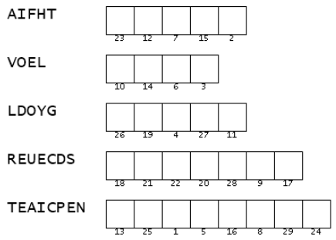
Family Activities
This secret document is the key to decoding an important message from the underground church in Tiusnga Isey. Unscramble the words and use the numbers to decode your copy of the message. Technical help is available at https://tinyurl.com/bdcjk3aj You can also find the family discussion link.

Slide 22
Paul and Timothy
July 9

