Slide 1
Overcoming Worry
January 3

Slide 2

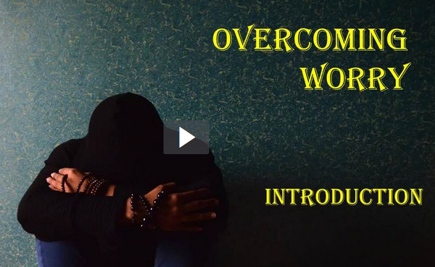
Introduction Video
View Video

Slide 3
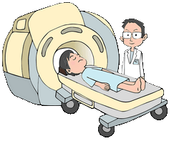


Think about it …
What sometimes threatens your peace of mind or sense of security?
Today we look at Psalm 23 where David talks of things which tended to cause worry.
  He tells us that God’s presence provides peace of mind and security.

Slide 4
Listen for the shepherd’s tasks.
Psalm 23:1-3 (NIV) The LORD is my shepherd, I shall not be in want. 2 He makes me lie down in green pastures, he leads me beside quiet waters, 3 he restores my soul. He guides me in paths of righteousness for his name's sake.

Slide 5
Trust God’s Guidance
Why was the metaphor of the Lord as shepherd a fitting one for David to use?
What shepherding functions or tasks are prominent in these verses?
What would following God to “green pastures” and “quiet waters” look like in your life?

Slide 6
Trust God’s Guidance
David is talking about how he was aware of God’s presence with him. Name some ways in which you are aware of Christ’s constant presence with you.
Some translations say “makes me lie down.” Why would God force us to rest?
Other translations say “lets me lie down.” How is this translation just as valid?

Slide 7
Trust God’s Guidance
David says God restores or renews his soul. What kind of renewal or restoration did God provide for David (and for us)?
David spoke of a shepherd and sheep—what metaphor could you use to picture your relationship with the Lord? Finish the phrase, “The Lord is my ________”

Slide 8
Listen how David addresses God personally.
Psalm 23:4-5 (NIV) Even though I walk through the valley of the shadow of death, I will fear no evil, for you are with me; your rod and your staff, they comfort me. 5 You prepare a table before me in the presence of my enemies. You anoint my head with oil; my cup overflows.

Slide 9
Trust God’s Presence
What might be the dark time David alluded to in verse 4?
Why was he convinced he had no cause to fear?
What might the rod and staff represent?
What kinds of things keep us from recognizing God’s presence?
How can we intentionally enjoy or practice being in God’s presence?

Slide 10
Listen for a view to the future.
Psalm 23:6 (NIV) Surely goodness and love will follow me all the days of my life, and I will dwell in the house of the LORD forever.

Slide 11
Trust God’s Goodness
What is David’s future hope?
In what ways does this verse suggest the security that comes from being in a relationship with the Lord?
What does it mean to you that God’s goodness and love follow or pursue you?

Slide 12
Trust God’s Goodness
What would be better about God pursuing us rather than us pursuing Him?
How can we help each other feel more confident in God’s love?
As a believer, how can confidence in your eternal security affect your approach to daily life?

Slide 13
Application
Worship.
  Trust is expressed as you worship because it keeps you focused on Christ.
  Make the decision to actively engage in worship both with your church and in your private devotional life.

Slide 14
Application
Study.
  Identify Bible verses that teach what God says about the issue of depression and sadness in our lives.
  Share them with others.

Slide 15
Application
Seek help.
  Do a serious personal evaluation about what causes depression in your life.
  Admit that it is real and it is serious.
  It might be time to talk with a close friend, pastor, or counselor about it.

Slide 16

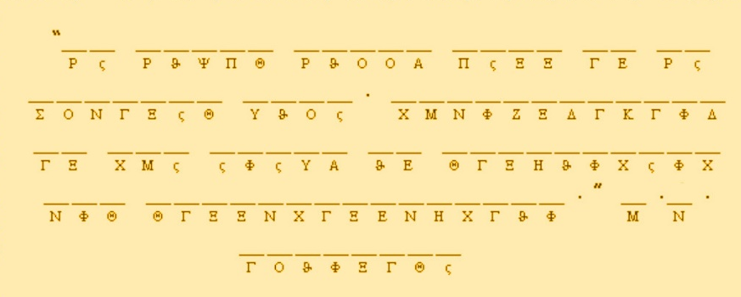

Family Activities
One of our South American agents found this message washed up on the shore in a Brazilian soft drink bottle. It’s an important concept … we don’t want to be worrying about it. You can help us. Technical help is available at https://tinyurl.com/yb9qlnff . There you will find other messages of import as well.

Slide 17
Overcoming Worry
January 3

