Slide 1
Open Arms
September 9

Slide 2
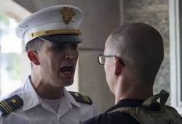
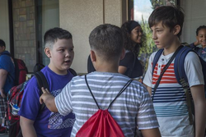
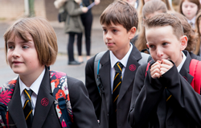
Remember when …
When have you felt like “the new kid”?
For new visitors in our church, those are the same feelings, no matter what their age.
  We want them to feel welcome, despite those feelings.
  We need to realize that a true welcome goes beyond a friendly handshake

Slide 3
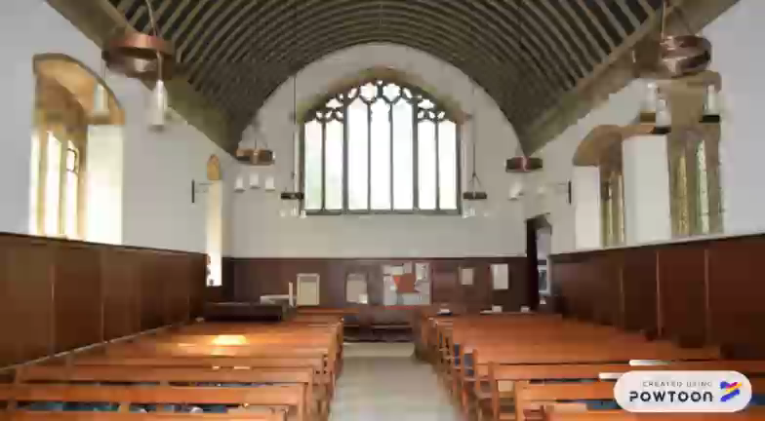
Listen for how prejudice was shown.

Slide 4
Listen for how prejudice was shown.
James 2:1-4 (NIV) My brothers, as believers in our glorious Lord Jesus Christ, don't show favoritism. 2 Suppose a man comes into your meeting wearing a gold ring and fine clothes, and a poor man in shabby clothes also comes in. 3 If you show special attention

Slide 5
Listen for how prejudice was shown.
to the man wearing fine clothes and say, "Here's a good seat for you," but say to the poor man, "You stand there" or "Sit on the floor by my feet," 4 have you not discriminated among yourselves and become judges with evil thoughts?

Slide 6
Treat Everyone the Same
What examples of prejudice and partiality does James describe?
What rationale might an usher or deacon give for such treatment to someone today?
What other ways might such treatment happen in today’s churches?

Slide 7
Treat Everyone the Same
What criteria might cause special treatment (either positive or negative)?
Why do we often treat rich people as more important than poor people?
How does James characterize those who engage in these attitudes or actions?

Slide 8
Treat Everyone the Same
⇒ You only discover that when you get to know the person … God wants you NOT to show favoritism, NOT to have an attitude of prejudice
How is showing favoritism or preference to one person or group an act of “prejudging?”
What are some examples of wrong pre-judgments you have made with people you know?

Slide 9
Listen for how God sees people is different from our view.
James 2:5-7 (NIV) Listen, my dear brothers: Has not God chosen those who are poor in the eyes of the world to be rich in faith and to inherit the kingdom he promised those who love him? 6 But you have

Slide 10
Listen for how God sees people is different from our view.
insulted the poor. Is it not the rich who are exploiting you? Are they not the ones who are dragging you into court? 7 Are they not the ones who are slandering the noble name of him to whom you belong?

Slide 11
No Partiality with God
So, let’s make the contrast … how does God, how do we see people?
Why do you think God has a special concern for poor people?
What do rich people have a history of doing to people in the church?
How God Sees People | How We See People

Slide 12
No Partiality with God
What are some dangers of showing favoritism?
Why does favoritism within a group (family, church, etc.) lead to disasters in relationships?
What steps can we take to overcome favoritism?

Slide 13
Listen for what is the “royal law.”
James 2:8-10 (NIV) If you really keep the royal law found in Scripture, "Love your neighbor as yourself," you are doing right. 9 But if you show favoritism, you sin and are convicted by the law as lawbreakers. 10 For whoever keeps the whole law and yet stumbles at just one point is guilty of breaking all of it.

Slide 14
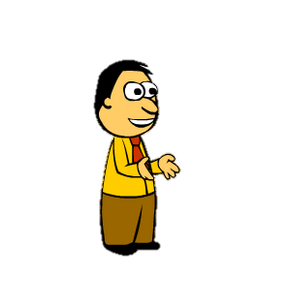
God Is Love
What was the “royal law?”
Why is it “royal?”
What does the Royal Law have to do with prejudice and favoritism?
Finish the sentence:
⇒ We don’t tend to include favoritism into the same category as these …
“Showing favoritism isn’t as bad as __________.”

Slide 15
God Is Love
But what does James say about favoritism or prejudice being a sin.
Why might we have more responsibility towards those whom we find it difficult to love?
How does showing love (instead of favoritism) cause us to obey other laws?

Slide 16

Application
Remind yourself.
  Identify a practical way you can remind yourself of the gospel this week.
Remember

Slide 17

Application
List.
  Create a list of things that, in your opinion, would be the ideal way to “do” church.
  Identify which of those items are integral to the mission and ministry of the church and which ones are based on your personal preferences.

Slide 18
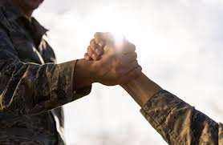
Application
Befriend.
  Make an intentional effort to befriend someone who is different than you.
  Consider what you can do to make that person feel welcome in your church

Slide 19
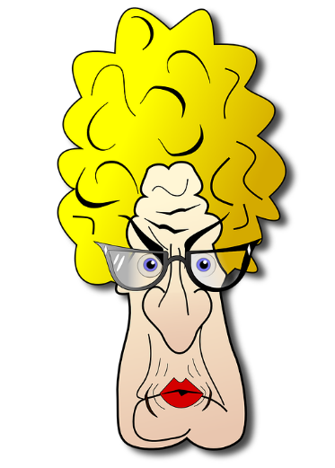
Family Activities
Say, I remember you … 9th grade English. And you owe me a book report! Oh well, too late now. But you should go to the Family Activities page and do that Crossword puzzle.
https://tinyurl.com/ybpwklak
There’s some other things there too. They’ll doubtless be good for you!
Humph!

Slide 20
Open Arms
September 9

