Slide 1
Obey God’s Word
November 13

Slide 2

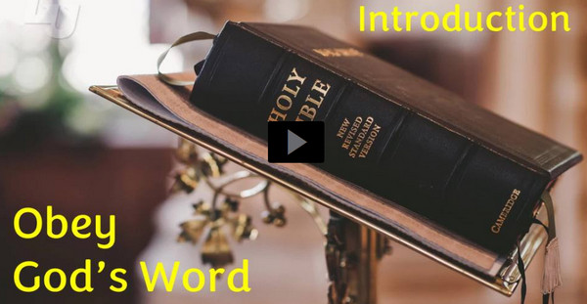
Video Introduction
View Video

Slide 3

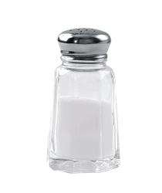

Admit it …
What is good advice that people often ignore?
God’s Word gives us direction and specific advice.
  We are wise not to ignore it
  We display the truth and value of God’s Word as we live it out.

Slide 4
Listen for advice for righteous living
James 1:19-21 (NIV) My dear brothers, take note of this: Everyone should be quick to listen, slow to speak and slow to become angry, 20 for man's anger does not bring about the righteous life that God desires. 21 Therefore, get rid of all moral filth and the evil that is so prevalent and humbly accept the word planted in you, which can save you.

Slide 5
Respond to God’s Word with Humility
James is speaking to the issue of righteous living. What actions are believers to take to prepare themselves to receive God’s Word?
James mentions “moral filth” and “evil”. What kinds of these elements do we struggle with in our society?
What makes it hard for us to be good listeners when we are in a conversation?

Slide 6

Respond to God’s Word with Humility
Consider the Rotary Club Four Way
Test for when you speak.
  Is it the TRUTH?
  Is it FAIR to all concerned?
  Will it build GOODWILL and BETTER FRIENDSHIPS?
  Will it be BENEFICAL to all concerned?

Slide 7
Respond to God’s Word with Humility
How can being quick to speak and quick to anger get you into trouble?
What do you think he means by “the word planted in you”?
What powerful effect does the reception of the Word of God have on these issues in the lives of individuals?

Slide 8
Listen for why to put Scripture into practice.
James 1:22-25 (NIV) Do not merely listen to the word, and so deceive yourselves. Do what it says. 23 Anyone who listens to the word but does not do what it says is like a man who looks at his face in a mirror 24 and, after looking at himself, goes

Slide 9
Listen for why to put Scripture into practice.
away and immediately forgets what he looks like. 25 But the man who looks intently into the perfect law that gives freedom, and continues to do this, not forgetting what he has heard, but doing it--he will be blessed in what he does.

Slide 10
Obey Scripture without Delay
What do you think James meant when he advised readers to “not merely listen”?
What has happened to you when you either forgot to look in the mirror before leaving home or when you did look, you didn’t really pay attention?

Slide 11
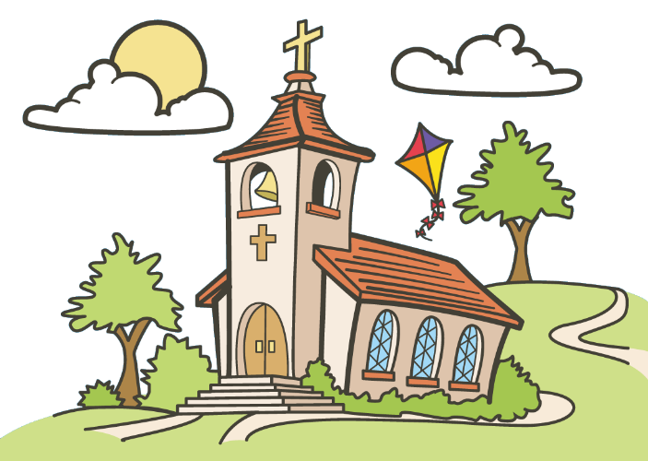
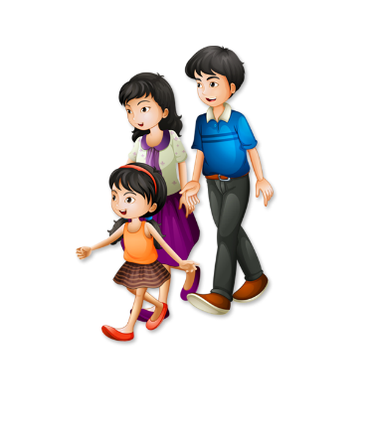
Obey Scripture without Delay
So how does that illustrate the need to look “intently into the law that gives freedom”?
What helps us move beyond just being hearers of God’s Word as we approach a Bible study session or a preaching service?

Slide 12
Listen for examples of being doers of the Word.
James 1:26-27 (NIV) If anyone considers himself religious and yet does not keep a tight rein on his tongue, he deceives himself and his religion is worthless. 27 Religion that God our Father accepts as pure and faultless is this: to look after orphans and widows in their distress and to keep oneself from being polluted by the world.

Slide 13
Don’t Have “Worthless” Faith
How did James characterize religion that was void of actual practice?
What are some consequences when our words and actions don’t align?
How is a person’s speech related to the credibility of his or her faith?

Slide 14
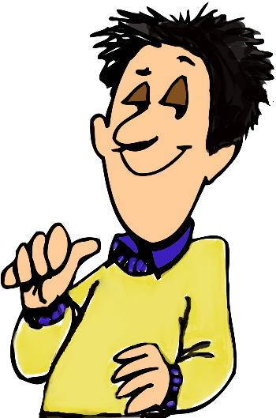
Don’t Have “Worthless” Faith
How can pride (a lack of humility) keep you from hearing and obeying what God’s Word says to you personally?

Slide 15
Application
Confess.
  Is there a sin in your life that God’s Word is revealing to you?
  Allow God to wipe it off.
  Confess that sin to Him.
  Receive His forgiveness and choose to walk in obedience.

Slide 16
Application
Commit.
  Is there a specific command or task God’s Word is calling you to do, but you have been procrastinating?
  Commit to follow through and carry out that task. Pursue obedience.

Slide 17
Application
Counsel.
  You may know someone who is ignoring or struggling with obedience to God’s Word.
  Encourage that person, pray for and help him or her pursue a life of obedience.

Slide 18
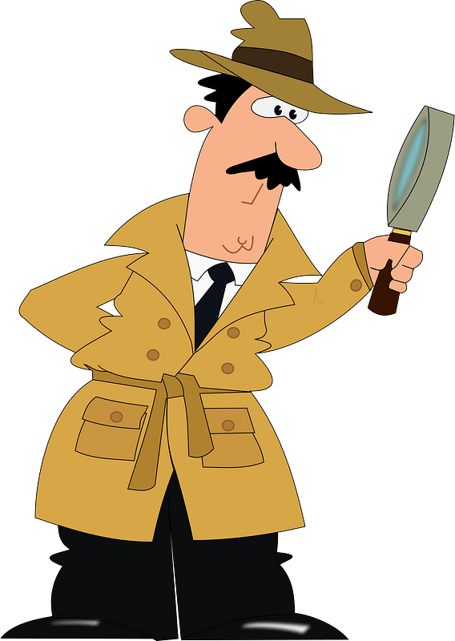
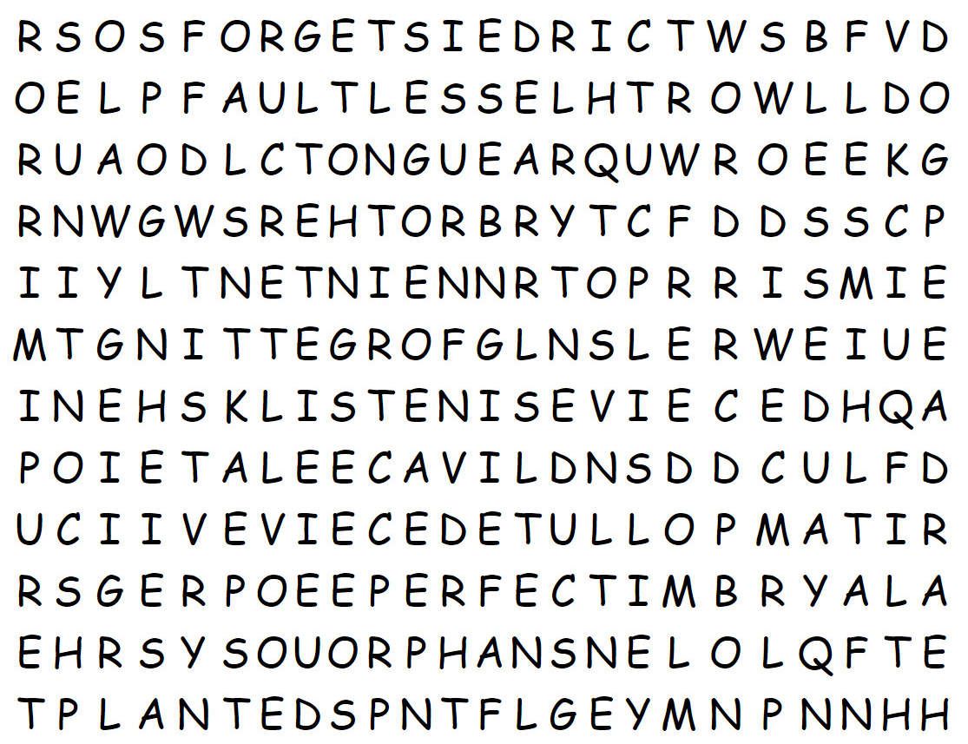
Family Activities
Stop, look, and see “LISTEN”.
Start by just finding words you can see and checking them off the list. Then look more carefully for words not yet found. Help is available at https://tinyurl.com/2sv2x4jp

Slide 19
Obey God’s Word
November 13

