Slide 1
Noah: Faith That Pleases God
June 1

Slide 2
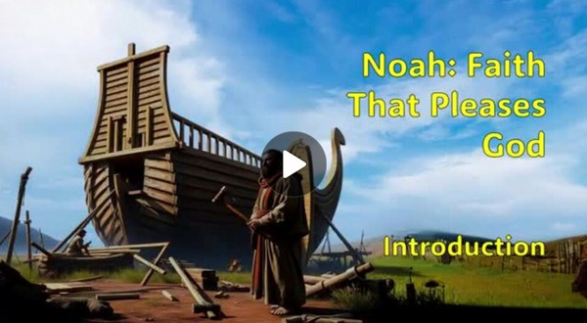
Video Introduction
View Video

Slide 3
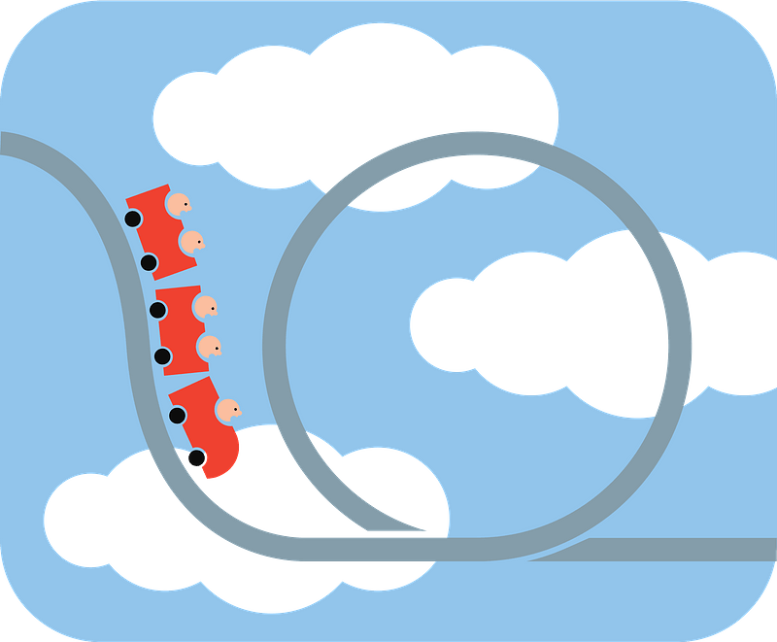
It was crazy!
What’s the biggest “I must be crazy doing this” risk you’ve ever taken?
Today we look at the “crazy risk” Noah took.
That really took faith
Living by faith begins with a righteous relationship with God.

Slide 4
Listen for a unique person.
Genesis 6:5-9 (NIV) The LORD saw how great man's wickedness on the earth had become, and that every inclination of the thoughts of his heart was only evil all the time. 6 The LORD was grieved that he had made man on the earth, and his heart was filled with pain. 7 So the LORD said, "I will wipe mankind, whom I have created,

Slide 5
Listen for a unique person.
from the face of the earth--men and animals, and creatures that move along the ground, and birds of the air--for I am grieved that I have made them." 8 But Noah found favor in the eyes of the LORD. 9 This is the account of Noah. Noah was a righteous man, blameless among the people of his time, and he walked with God.

Slide 6
Living in a Right Relationship
What did seeing the wickedness of humankind stir up in the Lord?
What did He decide to do?
What do we learn about God’s character from these verses?

Slide 7
Living in a Right Relationship
God saw wickedness everywhere on earth. What does it mean that Noah “found favor in the eyes of the Lord”? How might that relate to faith?
We can imagine Noah faced peer pressure from people of his society. In what areas of our culture are believers pressured to follow the crowd?

Slide 8
Living in a Right Relationship
How does Noah's faith challenge the idea that faith is only belief and not obedience?
What does Noah’s example teach us about trusting God when His commands don’t seem to make sense to others—or even to us?

Slide 9
Listen for specific instructions.
Genesis 6:17-22 (NIV) I am going to bring floodwaters on the earth to destroy all life under the heavens, every creature that has the breath of life in it. Everything on earth will perish. 18 But I will establish my covenant with you, and you will enter the ark--you and

Slide 10
Listen for specific instructions.
your sons and your wife and your sons' wives with you. 19 You are to bring into the ark two of all living creatures, male and female, to keep them alive with you. 20 Two of every kind of bird, of every kind of animal and of every kind of creature that

Slide 11
Listen for specific instructions.
moves along the ground will come to you to be kept alive. 21 You are to take every kind of food that is to be eaten and store it away as food for you and for them." 22 Noah did everything just as God commanded him.

Slide 12
Living with Obedience
God’s judgment would be to destroy everything through a flood. What was His personal word to Noah and on what was it conditioned?
What additional assignment was Noah given?
Certainly, Noah could have felt overwhelmed. What are some reasons it would have been difficult for Noah to obey God’s instructions?

Slide 13
Living with Obedience
What does it look like in your daily life to “do everything just as God commands”? What are some small or big examples?

Slide 14
Listen for a promise.
Genesis 8:20-22 (NIV) Then Noah built an altar to the LORD and, taking some of all the clean animals and clean birds, he sacrificed burnt offerings on it. 21 The LORD smelled the pleasing aroma and said in his heart: "Never again will I curse the ground because

Slide 15
Listen for a promise.
of man, even though every inclination of his heart is evil from childhood. And never again will I destroy all living creatures, as I have done. 22 "As long as the earth endures, seedtime and harvest, cold and heat, summer and winter, day and night will never cease."

Slide 16
Living to Honor and Worship God
Noah’s initial act after exiting the ark was to build an altar and sacrifice burnt offerings. What indicates Noah’s act of worship was pleasing to the Lord?
How would this act be a demonstration of his faith in God?
What promises did the Lord give not only to Noah but to all humankind?

Slide 17
Living to Honor and Worship God
In what ways can worship be a natural and faithful response to God's goodness—even before we see all His promises fulfilled?
What are some areas in our lives where God could be calling us to respond with faith and worship instead of fear or self-focus?

Slide 18
Application
Confess.
Do you want a living faith in God?
Living faith begins by establishing a relationship with God through Jesus Christ.
Romans 10:9 says, “If you confess with your mouth, ‘Jesus is Lord,’ and believe in you heart that God raised him from the dead, you will be saved.”
Talk to your group leader for more help.

Slide 19
Application
Grow.
Your relationship with God must grow.
Your faith will grow as you learn more about God.
Before you became a follower of Jesus, your faith may have been in your career, your money, your education, or your family.
Now, your faith is in the Creator and Sustainer of the universe.
Study the Bible and the Holy Spirit will help you know God better.

Slide 20
Application
Share.
Your faith is meant to be shared.
Talk with someone who is far from God about the ways God has made Himself known to you.
You can begin by sharing how God saved Noah!

Slide 21
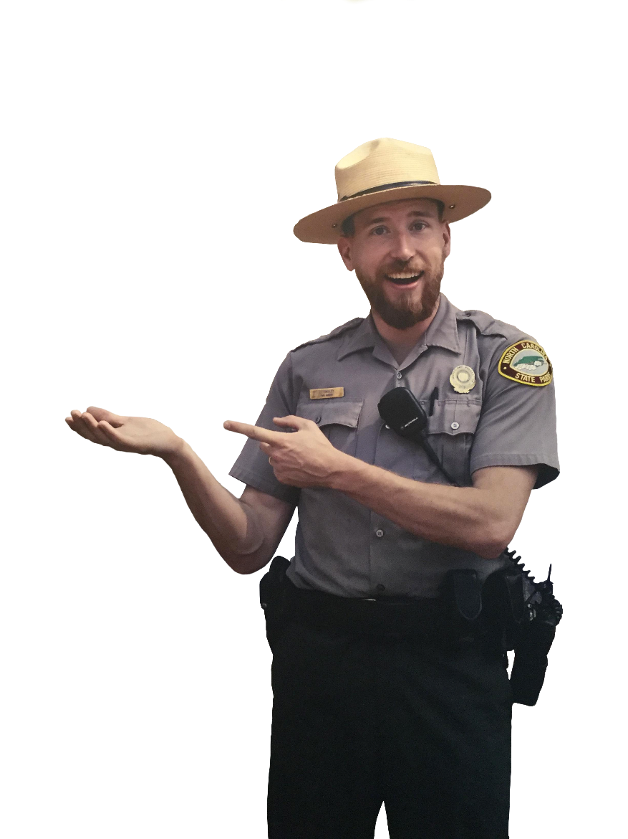
Family Activities
The grizzly bear did his thing. Now we need you to undo his thing. Put the letters back in the row where they belong to repair the church sign. Rather do the color page? Go to https://tinyurl.com/4h92553v

Slide 22
Noah: Faith That Pleases God
June 1

