Slide 1
Nehemiah - Prayer
July 22

Slide 2

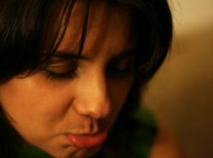
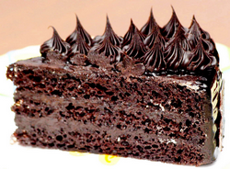
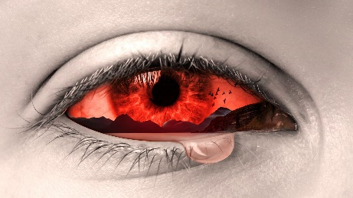

What do you think?
What are some ways people respond to bad news?
Nehemiah received bad news about his people in Jerusalem
  Today we look at his reaction
  Like him, we should be quick to pour out our hearts to God in prayer.

Slide 3
Listen for who is in trouble.
Nehemiah 1:1-3 (NIV) The words of Nehemiah son of Hacaliah: In the month of Kislev in the twentieth year, while I was in the citadel of Susa, 2 Hanani, one of my brothers, came from Judah with some other men, and I questioned them about the Jewish remnant that survived the exile,

Slide 4

Listen for who is in trouble.
and also about Jerusalem. 3 They said to me, "Those who survived the exile and are back in the province are in great trouble and disgrace. The wall of Jerusalem is broken down, and its gates have been burned with fire."

Slide 5
Aware of Needs
What was the distressful news Nehemiah heard from his visitors?
What are some examples of great trouble and disgrace among God’s people today?
What is the spiritual equivalent of a broken down wall and a burned gate?

Slide 6
Aware of Needs
What obstacles hinder us from recognizing the needs of others?
What helps you become aware of the needs around you where you could be of help?

Slide 7
Listen for a confession.
Nehemiah 1:4-7 (NIV) When I heard these things, I sat down and wept. For some days I mourned and fasted and prayed before the God of heaven. 5 Then I said: "O LORD, God of heaven, the great and awesome God, who keeps his covenant of love with those who love him and obey his commands, 6 let your ear be attentive and your eyes open to hear the prayer your

Slide 8
Listen for a confession.
servant is praying before you day and night for your servants, the people of Israel. I confess the sins we Israelites, including myself and my father's house, have committed against you. 7 We have acted very wickedly toward you. We have not obeyed the commands, decrees and laws you gave your servant Moses.

Slide 9
Acknowledge God,
Confess Sins
How did Nehemiah describe God in his prayer?
What are the benefits of focusing on the attributes of God?
On whose behalf did Nehemiah pray and fast?
Nehemiah responded with mourning, praying, and fasting. When should we incorporate these practices in our lives?

Slide 10
Acknowledge God,
Confess Sins
How would you describe the relationship between fasting and prayer?
In addition to praise to the Lord, what other key aspect of prayer did Nehemiah include, even before he made any petition?

Slide 11
Acknowledge God,
Confess Sins
Why was Nehemiah confessing his own sin when other people were in trouble?
Of what sins were the Israelites guilty?
To summarize this passage, what admirable traits do you see demonstrated by Nehemiah?

Slide 12
Listen for Nehemiah’s request.
Nehemiah 1:8-11 (NIV) Remember the instruction you gave your servant Moses, saying, 'If you are unfaithful, I will scatter you among the nations, 9 but if you return to me and obey my commands, then even if your exiled people are at the farthest horizon, I will gather them from there and bring them to the place I have chosen as a dwelling for my Name.' 10 "They are

Slide 13
Listen for Nehemiah’s request.
your servants and your people, whom you redeemed by your great strength and your mighty hand. 11 O Lord, let your ear be attentive to the prayer of this your servant and to the prayer of your servants who delight in revering your name. Give your servant success today by granting him favor in the presence of this man." I was cupbearer to the king.

Slide 14
Look to God for Guidance
What promise of the Lord could the Israelites claim, according to Nehemiah?
What specific request did Nehemiah ask God to grant him?
Why does God want Christians to pray?
In what circumstances do you think it would be wise to fast and pray?

Slide 15
Look to God for Guidance
Note the pattern of Nehemiah’s prayers … what are some elements of Nehemiah’s prayer life we could model to improve our personal prayer lives?

Slide 16
Application
Pray
  Follow Nehemiah’s example in your prayers.
  Surrender to Christ’s lordship and in obedience to His will.
  Confess your sin.
  Ask God to give you the guidance to do His will.

Slide 17
Application
Read
  Prayer is never detached from God’s Word, you can’t pray well without reading the Word, you can’t read the Bible well without praying.
  Pray about what you read.
  Ask God to open your eyes to the wonderful truths in His Word.
  Then commit in prayer to follow what He shows you in His Word.

Slide 18
Application
Write
  Write a handwritten encouraging note to someone after praying for him or her.
  Ask God to make His name great through this prayerful interaction.

Slide 19
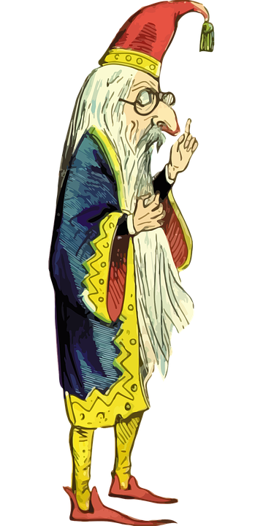
Family Activities
If you would be wise, involve your family in God’s Word. Consider the Family Activities at
https://tinyurl.com/ydy4k7br

Slide 20
Nehemiah - Prayer
July 22

