Slide 1
Moses and Joshua
June 11

Slide 2
Video Introduction

Slide 3
Remember that person …
What are some things you do that you were taught by someone else?
For most things we are grateful for the people who taught us these kinds of skills.
Today we consider how Moses prepared his successor.
God calls us to mentor and disciple those who come after us.

Slide 4
Listen for Moses’ request.
Numbers 27:12-17 (NIV) Then the LORD said to Moses, "Go up this mountain in the Abarim range and see the land I have given the Israelites. 13 After you have seen it, you too will be gathered to your people, as your brother Aaron was,

Slide 5
Listen for Moses’ request.
for when the community rebelled at the waters in the Desert of Zin, both of you disobeyed my command to honor me as holy before their eyes." (These were the waters of Meribah Kadesh, in the Desert of Zin.) 15 Moses said to the LORD,

Slide 6
Listen for Moses’ request.
"May the LORD, the God of the spirits of all mankind, appoint a man over this community 17 to go out and come in before them, one who will lead them out and bring them in, so the LORD's people will not be like sheep without a shepherd."

Slide 7
Seek God’s Direction
What did the Lord invite Moses to do?
Why would Moses be denied the opportunity to lead the people into the land?
Since Moses would not be entering the Promised Land, what did he request from God?
Why did they need a god-appointed leader?

Slide 8
Seek God’s Direction
What are some ways one generation typically passes along wisdom to the next generation?
What might keep us from passing the torch to the next generation?
How can recognizing our own mortality help us as mentors, whether it’s our children or our jobs?

Slide 9
Listen for God’s response to Moses’ request.
Numbers 27:18-20 (NIV) So the LORD said to Moses, "Take Joshua son of Nun, a man in whom is the spirit, and lay your hand on him. 19 Have him stand before Eleazar the priest and the entire assembly and commission him in their presence. 20 Give him some of your authority so the whole Israelite community will obey him.

Slide 10
Empower the One you Mentor
Why did God name Joshua?
What are some ways in which people reflect the character of God?
We note that neither Moses nor the people chose Joshua. Why is this important?
What important role was Moses to take in this transition of leadership?

Slide 11
Empower the One you Mentor
What are some ways we can publicly affirm God’s work in the next generation?
What are some ways others have helped you follow Jesus? What people in God’s family have you relied on and considered important?

Slide 12
Listen for Moses’ response to God’s instruction.
Numbers 27:21-23 (NIV) He is to stand before Eleazar the priest, who will obtain decisions for him by inquiring of the Urim before the LORD. At his command he and the entire community of the Israelites will go out, and at his command

Slide 13
Listen for Moses’ response to God’s instruction.
they will come in." 22 Moses did as the LORD commanded him. He took Joshua and had him stand before Eleazar the priest and the whole assembly. 23 Then he laid his hands on him and commissioned him, as the LORD instructed through Moses.

Slide 14
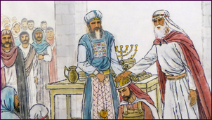
What was the role of Eleazar in the eventual transition of leadership from Moses to Joshua?
Art by Wong Chim Yuen

Slide 15
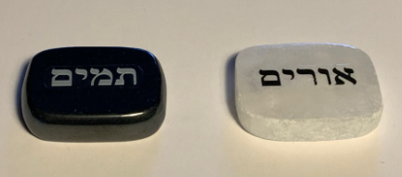
Publicly Affirm God’s Work
The Urim and Thummim
Set of two objects (stones) used by the High Priest
Used to answer a question or reveal the will of God
More than just chance like rolling dice or drawing straws
Kept in the breastplate worn by the High Priest
Modern replicas available on Etsy

Slide 16
Publicly Affirm God’s Work
What and who were to be influenced by the decisions of the Lord rendered through Eleazar?
How was Moses a positive role model in this incident?
How can we encourage people to fulfill God’s calling in their lives?

Slide 17
Application
Seek.
Pray and seek God’s direction regarding someone you might help and encourage.

Slide 18
Application
Affirm.
Everyone needs encouragement.
Write a note to someone you see is beginning to grow and serve others in some capacity.
Thank this person, encourage this individual, and offer to help as needed.

Slide 19
Application
Equip.
Consider what role you carry out in the service of the church and kingdom of God.
Create a list of things you would want to pass on about that service to someone else.
Using the list, begin informally training someone else for a potential role.

Slide 20
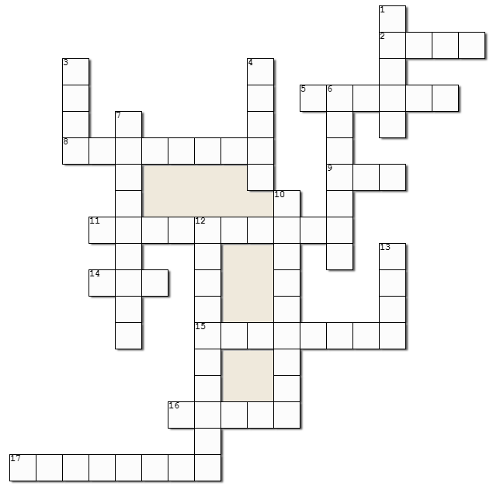
Family Activities
No decoding today. Our decoders are back from summer church camp. And so many of you have requested the return of the Crossword Puzzle. Now remember, the words and clues come from Numbers 27:12 – 23 (NIV). If you need help or want to do decoding just for practice, go to https://tinyurl.com/5474xsrb

Slide 21
Moses and Joshua
June 11

