Slide 1
Mordecai and Esther
June 25

Slide 2


Video Introduction
View Video

Slide 3
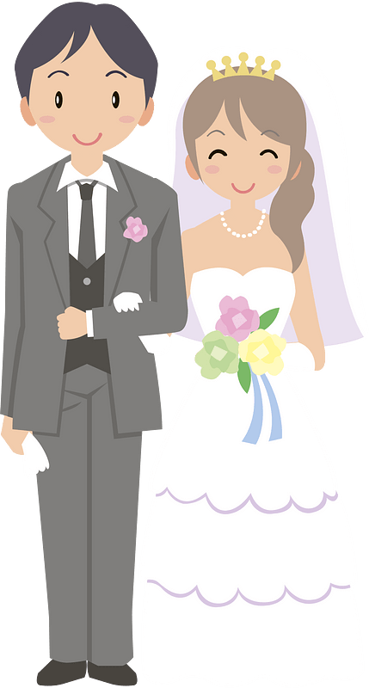


Think about it …
What is a risk you have been willing to take?
In a sense, there’s a risk to follow God’s direction in life.
  God calls us to trust His leadership.
  We need to encourage others to follow God’s leadership – no matter what the risk or cost.

Slide 4
Listen for an orphan.
Esther 2:5-7 (NIV) Now there was in the citadel of Susa a Jew of the tribe of Benjamin, named Mordecai son of Jair, the son of Shimei, the son of Kish, 6 who had been carried into exile from Jerusalem by Nebuchadnezzar king of Babylon, among those taken captive with

Slide 5
Listen for an orphan.
Jehoiachin king of Judah. 7 Mordecai had a cousin named Hadassah, whom he had brought up because she had neither father nor mother. This girl, who was also known as Esther, was lovely in form and features, and Mordecai had taken her as his own daughter when her father and mother died.

Slide 6
Don’t Overlook Potential
What background information does the passage give us about Mordecai?
What troubles to you see in Esther's life?
What about advantages she experienced?
Esther is the only book in the Old Testament that does not mention God. What might the author be communicating through this interesting omission?

Slide 7
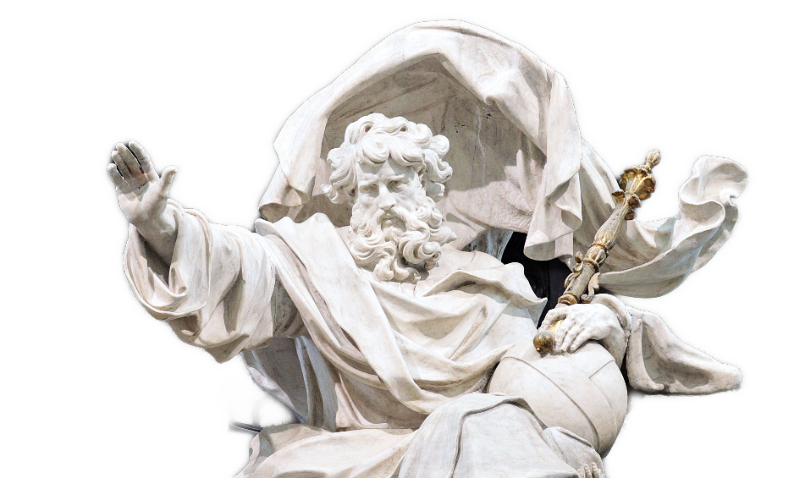
Don’t Overlook Potential
When have you been able to recognize God at work in your own background, maybe even not until much later?

Slide 8
Listen for a chilling government decree.
Esther 4:8-14 (NIV) He also gave him the edict for their annihilation, which had been published in Susa, to show to Esther and explain it to her, and he told him to urge her to go into the king's presence to beg for mercy and plead with him for her people. 9 Hathach went back and reported to Esther what Mordecai had said.

Slide 9
Listen for a chilling government decree.
Then she instructed him to say to Mordecai, 11 "All the king's officials and the people of the royal provinces know that for any man or woman who approaches the king in the inner court without being summoned the king has but one law: that he be put to death. The only exception to this is for the king to extend the gold scepter to him and spare his life

Slide 10
Listen for a chilling government decree.
But thirty days have passed since I was called to go to the king." 12 When Esther's words were reported to Mordecai, 13 he sent back this answer: "Do not think that because you are in the king's house you alone of all the Jews

Slide 11
Listen for a chilling government decree.
will arise from another place, but you and your father's family will perish. And who knows but that you have come to royal position for such a time as this?"

Slide 12
Challenge Others to Do What Is Right
What did Mordecai encourage cousin/Queen Esther to do to intervene on behalf of the Jews, her own people?
What reason did Esther offer for questioning the viability of Mordecai’s suggestion?

Slide 13
Challenge Others to Do What Is Right
What probing question did Mordecai ask Esther to consider in determining her role in the deliverance of her people?
Esther had Mordecai to mentor her in the role God had for her. How do we recognize the role God may have for us to play as mentor to someone?

Slide 14
Listen for Esther’s response to Mordecai’s appeal.
Esther 4:15-17 (NIV) Then Esther sent this reply to Mordecai: 16 "Go, gather together all the Jews who are in Susa, and fast for me. Do not eat or drink for three days, night or day.

Slide 15
Listen for Esther’s response to Mordecai’s appeal.
I and my maids will fast as you do. When this is done, I will go to the king, even though it is against the law. And if I perish, I perish." 17 So Mordecai went away and carried out all of Esther's instructions.

Slide 16
Pray and Fast
What conclusion did Esther come to? What did she ask Mordecai to do?
What is significant of the comment “If I perish, I perish.”
Even though he was a mentor to Esther, what trait does Mordecai demonstrate in his response to her bidding?

Slide 17
Pray and Fast
How does fasting sharpen our focus on God for answers?
Sometimes we are tempted to jump into action without asking God to be the ultimate influencer. In what kind of circumstances is it good for Christians to fast and pray?

Slide 18
Pray and Fast
What are some reasons we hesitate to ask others to pray for us (for things besides physical needs)?
What are some reasons that we should request the prayer support of fellow believers?

Slide 19
Application
Evaluate.
  Spend time this week evaluating how prepared you are to face antagonism toward your faith in Jesus Christ.
  What do you need to do to strengthen your resolve?
  Set several short-term goals for spiritual growth.

Slide 20
Application
Pray and fast.
  Choose a day in the near future for an extended time of prayer and fasting.
  Pray for both the person you are mentoring and the spiritual renewal that our country needs.

Slide 21
Application
Be accountable.
  Plan to meet weekly with another believer for prayer and for holding one another accountable in your walk with Christ.
  This could be the person you are mentoring or another strong believer.
  We are better together.

Slide 22
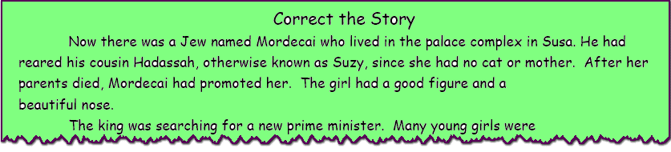
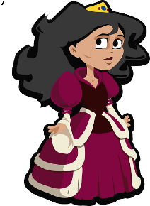


Family Activities
My editor has been sabotaged. Please assist her in correcting my story. Technical assistance is available at https://tinyurl.com/5ckbb4d3 You can also find the color page of my story.

Slide 23
Mordecai and Esther
June 25

