Slide 1
Mentoring
July 14

Slide 2
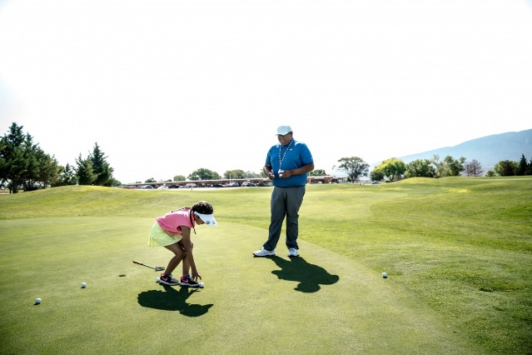

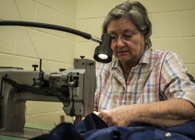
Remember how it was?
What’s something interesting you learned to do because somebody showed you how?
Today we study how Paul helped Timothy in his spiritual growth
  Someone helped you grow in Christ; you can do the same for someone else.

Slide 3
Listen for Paul’s exhortation.
2 Timothy 2:1-2 (NIV) You then, my son, be strong in the grace that is in Christ Jesus. 2 And the things you have heard me say in the presence of many witnesses entrust to reliable men who will also be qualified to teach others.

Slide 4
Intentional Relationship
What words or phrases suggest the strong relationship that Paul had with Timothy?
What was Paul’s plan for ensuring the spread of the gospel?
What is the point of training others … why is this not just “passing the buck?”

Slide 5
Intentional Relationship
When has someone taken you under their wing to help you grow spiritually? Who has had a significant role in your spiritual growth and development?
What qualities do you think a believer should have to be a disciple maker? Why are these important qualities?
What are some ways we can intentionally pass on what we believe to others?

Slide 6
Listen for how Paul invited Timothy to follow his example.
2 Timothy 3:10-13 (NIV) You, however, know all about my teaching, my way of life, my purpose, faith, patience, love, endurance, 11 persecutions, sufferings--what kinds of things happened to me in Antioch, Iconium and Lystra, the

Slide 7
Listen for how Paul invited Timothy to follow his example.
persecutions I endured. Yet the Lord rescued me from all of them. 12 In fact, everyone who wants to live a godly life in Christ Jesus will be persecuted, 13 while evil men and impostors will go from bad to worse, deceiving and being deceived.

Slide 8
Walking Together in Life’s Ups and Downs
What did Timothy know about Paul?
What do you suppose could have gone through Timothy’s mind when Paul also included persecutions and afflictions?
Why is it important to share both the ups and downs of life with those you mentor?

Slide 9
Walking Together in Life’s Ups and Downs
When have you seen difficult seasons of life create opportunities to encourage others?
Why would a maturing spirituality not only involve avoiding bad influences, but continuing to follow good examples of godliness?

Slide 10
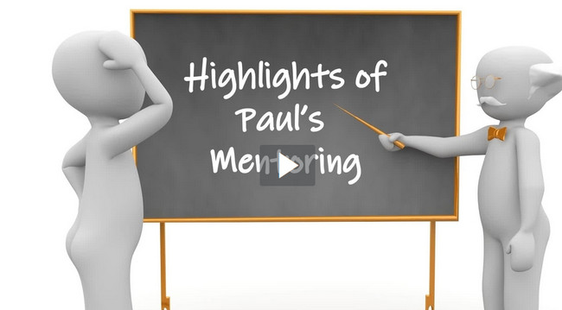
Highlights Video
View Video

Slide 11
Listen for the role of God’s Word.
2 Timothy 3:14-17 (NIV) But as for you, continue in what you have learned and have become convinced of, because you know those from whom you learned it, 15 and how from infancy you have known the holy Scriptures, which are able to

Slide 12
Listen for the role of God’s Word.
make you wise for salvation through faith in Christ Jesus. 16 All Scripture is God-breathed and is useful for teaching, rebuking, correcting and training in righteousness, 17 so that the man of God may be thoroughly equipped for every good work.

Slide 13
Staying Grounded in God’s Word
What regular practice did Paul urge Timothy to engage in?
What could Timothy point to for confidence that what he had been taught was credible and reliable for faithful living?
What did Paul say that Scripture was useful for?

Slide 14
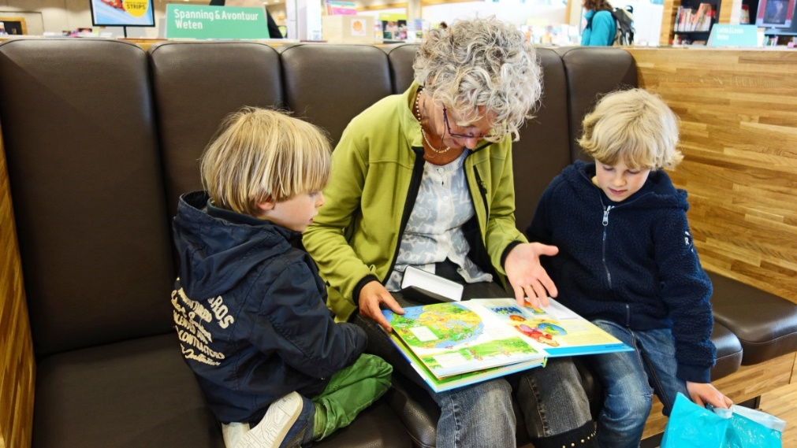
Staying Grounded in God’s Word
How do parents and grandparents instill this attitude and usage of the scriptures in a child?

Slide 15
Application
Pray.
  Ask God for someone who might help and mentor you in the faith.
  Keep your eyes open for a potential mentor.

Slide 16
Application
Invite.
  Invite someone to share a meal with you.
  Share your testimony, and learn more about the other person.
  Trust the Lord in whether that meeting will begin a mentoring relationship.

Slide 17
Application
Commit.
  Make a commitment to meet regularly (at least twice per month) with someone.
  If you need help in the mentoring process, read Mentor by Chuck Lawless (Nashville: LifeWay, 2018).

Slide 18
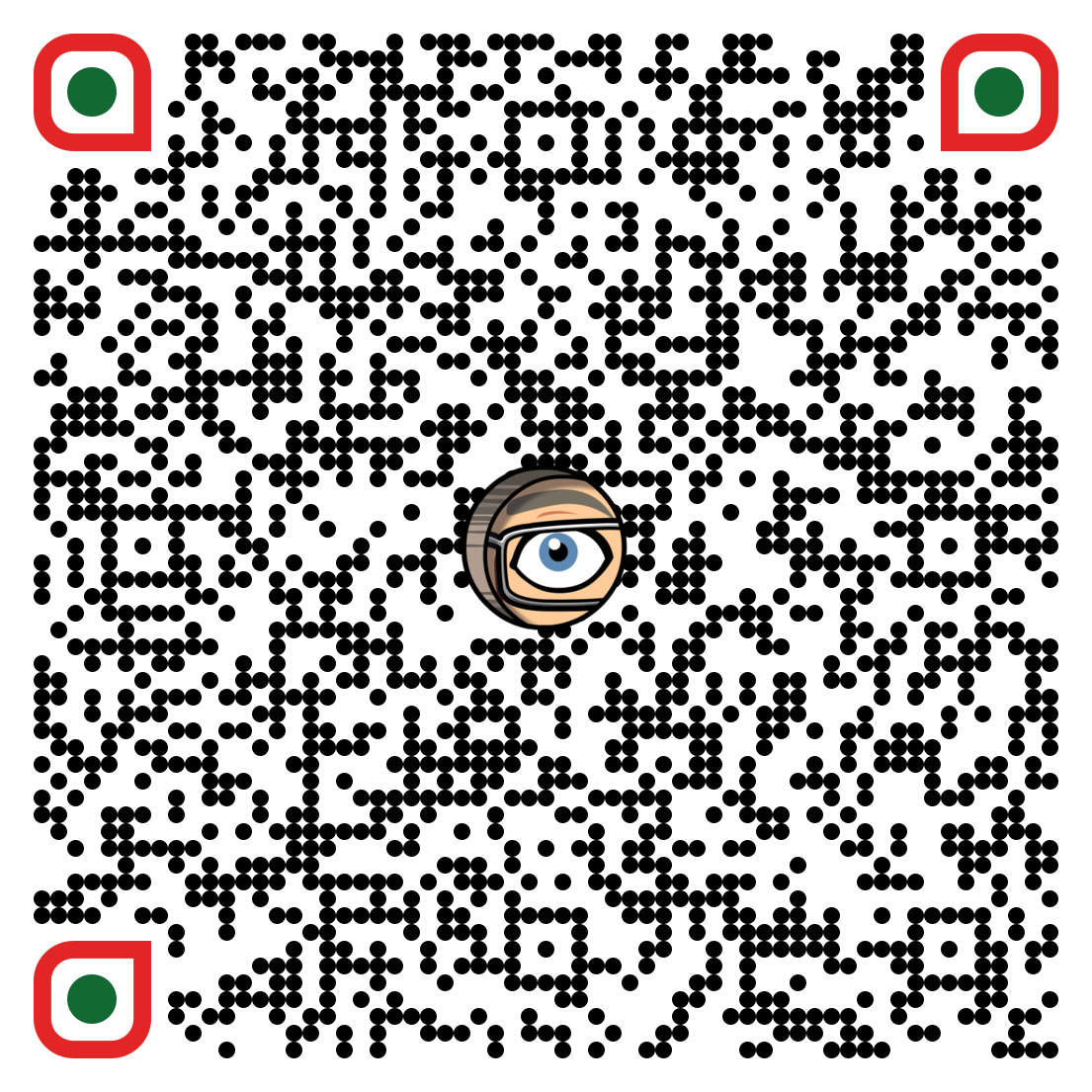
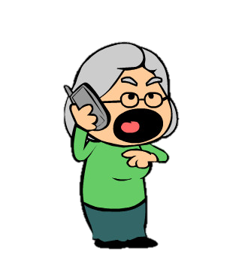
Family Activities
No, I don’t know what that square is with the creepy eye in the middle. The Family Activities Page says it’s a “QR code,” whatever that means. And it’s on the Cryptogram Puzzle, too. Can you get my grandson over here with his smart phone to figure it out. Maybe he can help me with the Cryptogram, while he’s here.

Slide 19
Mentoring
July 14

