Slide 1
Meeting Needs
June 7

Slide 2

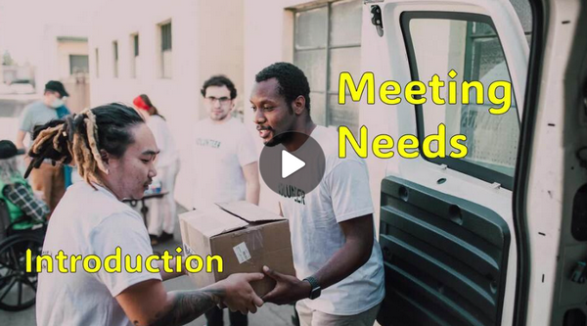
Video Introduction
View Video

Slide 3
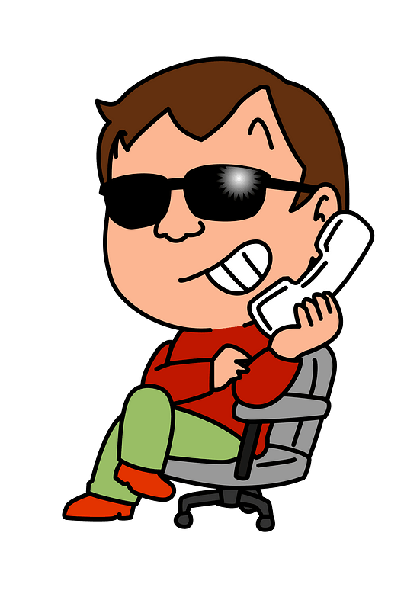
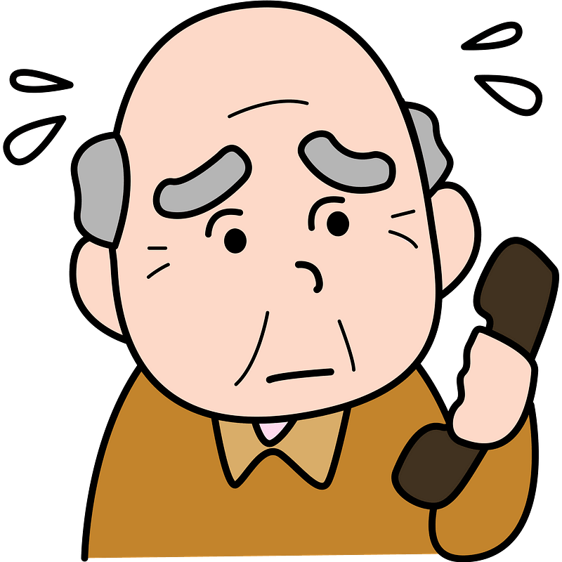
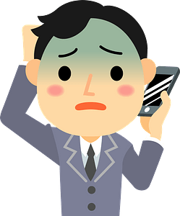
You want what?
When have you been caught off-guard by an unexpected request for help?
People have all kinds of needs.
  Jesus met needs for all kinds of people.
  Meeting needs is an opportunity to introduce others to Jesus.

Slide 4
Listen for who is willing.
Luke 5:12-16 (NIV) While Jesus was in one of the towns, a man came along who was covered with leprosy. When he saw Jesus, he fell with his face to the ground and begged him, "Lord, if you are willing, you can make me clean." 13 Jesus reached out

Slide 5
Listen for who is willing.
his hand and touched the man. "I am willing," he said. "Be clean!" And immediately the leprosy left him. 14 Then Jesus ordered him, "Don't tell anyone, but go, show yourself to the priest and offer the sacrifices that Moses commanded for

Slide 6
Listen for who is willing.
your cleansing, as a testimony to them." 15 Yet the news about him spread all the more, so that crowds of people came to hear him and to be healed of their sicknesses. 16 But Jesus often withdrew to lonely places and prayed.

Slide 7
Be Willing to Help when You Can
How did the sick man show boldness?
Why do you think he questioned Jesus even though he believed Jesus was capable of healing him?
"Lord, if you are willing, you can make me clean."

Slide 8
Be Willing to Help when You Can
Jesus received the man, proving His willingness to heal.
  “I am willing”
  “Be clean”
Jesus gave double instructions, “Don’t” and “Do” … why?
Don’t | Do

Slide 9
Be Willing to Help when You Can
Being affected with a disease that made him an outcast, what must it have been like for the man to have been touched by Jesus?
What are some of the ways in which Jesus will use us and still manages to “touch” people who are sick and in need today?

Slide 10
Be Willing to Help when You Can
Note what drove Jesus to withdraw in solitude to pray.
  Despite Jesus’ warning, the news about the healing spread.
  News about Him spread more and more.
  Crowds of people came for healing.
  Jesus needed time alone with God the Father.
  Implies that in our busyness we need a similar time with God.

Slide 11
Listen for obedience.
Luke 5:27-28 (NIV) After this, Jesus went out and saw a tax collector by the name of Levi sitting at his tax booth. "Follow me," Jesus said to him, 28 and Levi got up, left everything and followed him.

Slide 12

Invite Others to Follow Jesus
Some translations say Levi was a “publican”. What is a “publican”?
  In this context, NOT a person who
  operates a “pub” or in England, a
  “public house” where alcohol and
  food is served
  In this passage it was a person who collected taxes and tolls for the Roman government
  They supplemented their income by collecting an added on percentage of whatever the government tax was

Slide 13

Invite Others to Follow Jesus
What invitation did Jesus give to this tax collector? How did Levi respond?
We know this was a similar invitation or call to what Jesus gave to disciples who had been fishermen. How would leaving this job been different from leaving a fisherman’s occupation?

Slide 14
Invite Others to Follow Jesus
What reasons could Jesus have had for calling Levi, an unpopular Jewish official, and then a deserter to the Roman government, to follow Him?
What do people find most difficult to leave behind when they follow Jesus?

Slide 15
Invite Others to Follow Jesus
When Jesus called Matthew to “follow” Him, it included a literal coming along with Jesus and following Him around for 3 years. How can we “follow” Christ today?

Slide 16
Listen for an accusation.
Luke 5:29-32 (NIV) Then Levi held a great banquet for Jesus at his house, and a large crowd of tax collectors and others were eating with them. 30 But the Pharisees and the teachers of the law who belonged to their sect complained

Slide 17
Listen for an accusation.
to his disciples, "Why do you eat and drink with tax collectors and 'sinners'?" 31 Jesus answered them, "It is not the healthy who need a doctor, but the sick. 32 I have not come to call the righteous, but sinners to repentance."

Slide 18
Invite Everybody, “Come to Jesus!”
What did Levi do that suggests the depth of his commitment to Jesus and his desire that others come to know Jesus as he did?
Why would this gathering be suspect to some like scribes and Pharisees?
How did Jesus answer their critical inquiry? Who needs Jesus?

Slide 19
Invite Everybody, “Come to Jesus!”
God could be using you in your circle of acquaintances to draw people to Jesus.
  People you hang out with
  Fellow workers
  Neighbors
  Family members
  In general people you know and associate with or do business with … who need Jesus

Slide 20
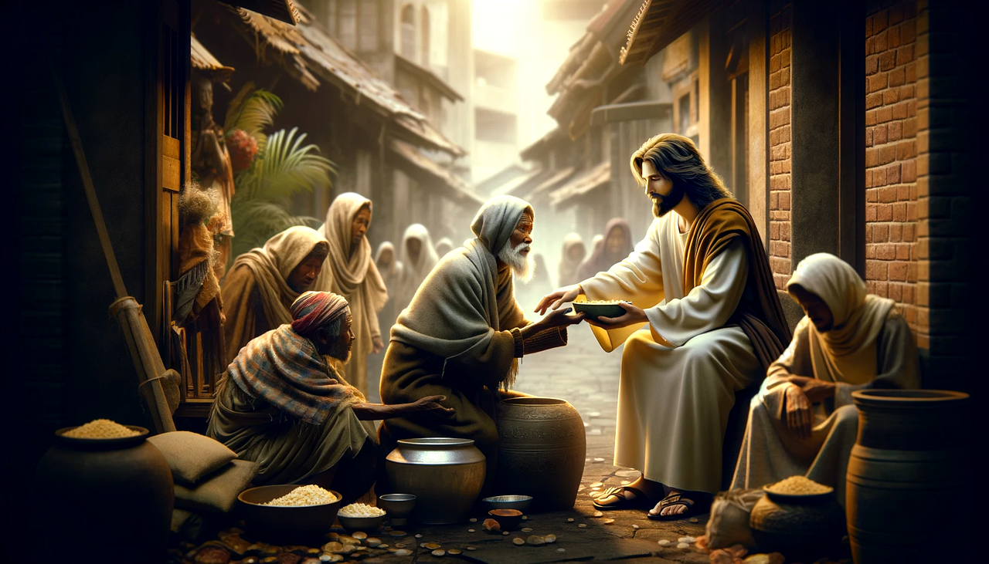
Invite Everybody, “Come to Jesus!”
How can we follow Jesus’ example of associating with society’s and religion’s outcasts without compromising Christian values?

Slide 21
Application
Confess.
  Pray and ask God to reveal sinful thoughts or prejudices that might negatively impact your compassion for people.
  Confess your sin to God and genuinely repent.

Slide 22
Application
Assess.
  Prayerfully consider your circle of family, friends, and acquaintances.
  What unmet needs do they have?
  Select one person to help and develop an action plan to meet the need compassionately.

Slide 23
Application
Express.
  Share your desire to serve with your pastor, a staff member at your church, or a mature believer.
  Consider ways you can meet unmet needs in the church and in your community.

Slide 24
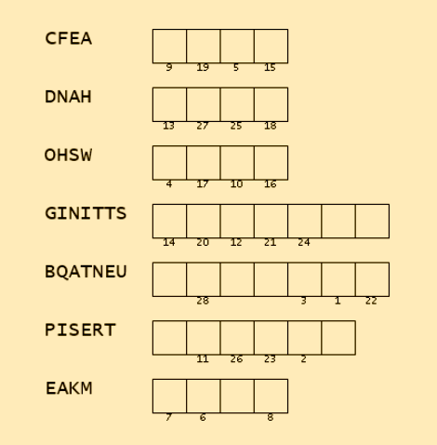

Family Activities
Ah, Mes amis, our good Baptist consulate in Magan Naniuegas has transmitted to us a communiqué of the utmost delicacy from two trusted agents among the local faithful. The underground church desires that their dear brothers and sisters in Christ should not forget a truth most profound and essential. Use these clue words (from the Bible study) to complete the message. Assistance is to be found at https://tinyurl.com/4cnnvntw

Slide 25
Meeting Needs
June 7

