Slide 1
Meditate on God’s Word
November 6

Slide 2
Video Introduction
View Video

Slide 3
Admit it now …
What song or jingle often gets stuck in your head?
Finish the jingle
Like a good neighbor …
I wish I was an …
Lucky Charms, they’re …
Plop, plop, …
I’m stuck on ______ cause ….

Slide 4
The Point
What gets “stuck in your head” shows what you’ve heard or thought of often.
Consider daily reading and thinking about God’s Word.
Saturating our minds with Scripture keeps us focused on the things of God.

Slide 5
Listen for a description of the godly person.
Psalm 1:1-3 (NIV) Blessed is the man who does not walk in the counsel of the wicked or stand in the way of sinners or sit in the seat of mockers. 2 But his delight is in the law of the LORD,

Slide 6
Listen for a description of the godly person.
and on his law he meditates day and night. 3 He is like a tree planted by streams of water, which yields its fruit in season and whose leaf does not wither. Whatever he does prospers.

Slide 7
Blessing and Delight
The passage starts with “blessed” is the man. What are some synonyms for the word blessed?
Avoiding what three negative actions lead to spiritual happiness and blessing?
What kind of progression can we see in these activities?

Slide 8
Blessing and Delight
How and where we invest our time sets us up for the influence we receive. Why does that happen?
Alternatively, what kinds of things does the righteous person pursue?
How do we position ourselves to be influenced by godly people?

Slide 9
Blessing and Delight
What does the image of the tree tell us about the righteous person?
What do you think it means to meditate on God’s law day and night?
When has a Bible verse stuck with you during a season of life?
How can you recognize someone who delights in God’s Word?

Slide 10
Listen for contrast to the previous verses.
Psalm 1:4-6 (NIV) Not so the wicked! They are like chaff that the wind blows away. 5 Therefore the wicked will not stand in the judgment, nor sinners in the assembly of the righteous. 6 For the LORD watches over the way of the righteous, but the way of the wicked will perish.

Slide 11
Pursue Righteous Living
What illustration did the psalmist use to contrast the ungodly with the righteous described in verse 1-3? How do the ungodly differ?
What is the destiny of the ungodly?
What is an assurance for the righteous?
How can we demonstrate our delight in God’s Word?

Slide 12
Listen for what should fill our thoughts.
Philippians 4:8 (NIV) Finally, brothers, whatever is true, whatever is noble, whatever is right, whatever is pure, whatever is lovely, whatever is admirable--if anything is excellent or praiseworthy--think about such things.

Slide 13
Focused on Right Thoughts
What are the qualities of wholesome thoughts, according to the passage? What are their opposites?
How does thinking on these things affect the way we act.
How can we practice the things Paul taught in the passage? How do you keep your focus on godly thinking that leads to godly living?
Wholesome Thoughts | Opposites

Slide 14
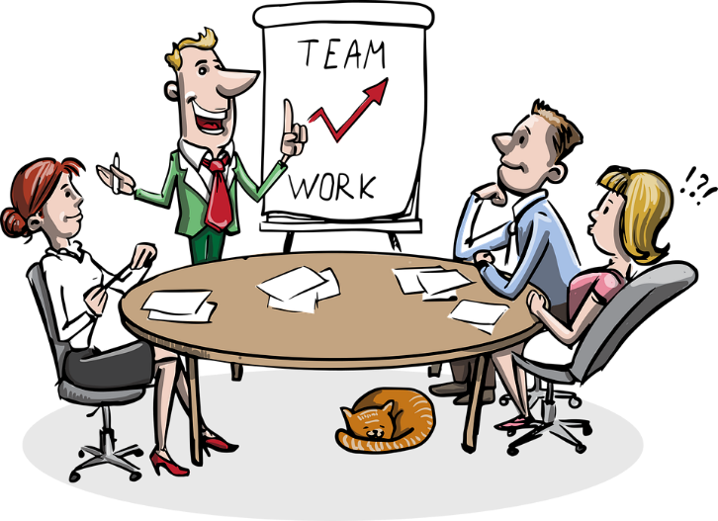
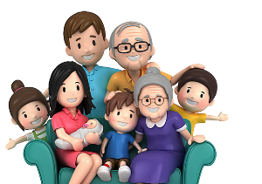
Focused on Right Thoughts
In addition to these qualities Paul taught about, he also modeled them before those around him. Who in our lives needs to see us model these qualities?

Slide 15
Application
Make some room.
Most of us spend more time in front of a screen than we would want to admit.
Consider reducing that time by thirty minutes per day to make some room in your schedule for Bible intake and meditation.

Slide 16
Application
Make a list.
In a journal or on a device, identify ten meaningful verses you would like to commit to memory.
Devise a plan to start memorizing Scripture.
Consider reaching out to a trusted leader, mentor, or friend to help you get started or to hold you accountable.

Slide 17
Application
Take a retreat.
Take a half day or full day to get alone with God and your Bible.
Don’t rush through reading Scripture, but as you read, pray about what you read.
Meditate on its words, meaning, and application to your life.

Slide 18
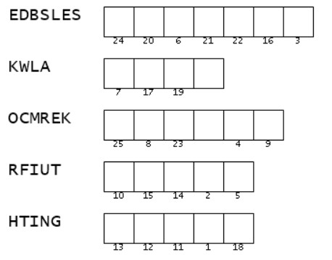
Family Activities
Whoa … those words make my eyes cross. You can find words in the Bible passage that match these, but are in the right order. Then you can use them to figure out the message about God’s Word! If you get stuck, go to https://tinyurl.com/yvnmfthp There’s also that favorite, the crossword – for you ladies in the back row who complain when it’s not available. ☺

Slide 19
Meditate on God’s Word
November 6

