Slide 1
Maturing Faith
February 25

Slide 2
Maturing Faith
February 25

Slide 3
Video Introduction
View Video

Slide 4
Remember the time …
What event in your life made you feel like you had finally experienced “being an adult”?
Those are milestones in our maturing experiences.
Our faith is also a maturing experience.
Faith matures as you humbly obey God.

Slide 5
Listen for a warning.
Luke 17:1-4 (NIV) Jesus said to his disciples: "Things that cause people to sin are bound to come, but woe to that person through whom they come. 2 It would be better for him to be thrown into the sea with a millstone tied around his neck than

Slide 6
Listen for a warning.
for him to cause one of these little ones to sin. 3 So watch yourselves. "If your brother sins, rebuke him, and if he repents, forgive him. 4 If he sins against you seven times in a day, and seven times comes back to you and says, 'I repent,' forgive him."

Slide 7
Mature Faith Forgives
So watch yourselves. "If your brother sins, rebuke him, and if he repents, forgive him. If he sins against you seven times in a day, and seven times comes back to you and says, 'I repent,' forgive him."
How did Jesus illustrate the severity of being the cause of someone being tempted to sin?
How can we guard against tempting others to sin?
What steps did Jesus offer for dealing with someone who offends us?
How are we to deal with the repeat offender? What principle of forgiveness was Jesus promoting?

Slide 8
Mature Faith Forgives
What do you find most difficult about forgiving the same person repeatedly?
Though not explicit in these verses, why do you think being willing to forgive calls for a mature faith?

Slide 9
Listen for faith in action.
Luke 17:5-6 (NIV) The apostles said to the Lord, "Increase our faith!" 6 He replied, "If you have faith as small as a mustard seed, you can say to this mulberry tree, 'Be uprooted and planted in the sea,' and it will obey you.

Slide 10
Mature Faith Goes into Action
In the context of this passage, why would the disciples make this request?

Slide 11
Mature Faith Goes into Action
Mature faith vs. “quantity” of faith
Faith not like a muscle to be “strengthened”.
Doesn’t depend on squinting, kneeling, raising hands.
Does depend on object of our faith.
Defective chair?
Sturdy chair?
Must be convinced of love, power, authority of the Object of our faith … Jesus

Slide 12
Mature Faith Goes into Action
How do these concepts fit in with Jesus’ example of the mustard seed?
What are some ways God has increased your faith (made you more convinced) on your spiritual journey?
What are the obstacles that prevent believers from acting in faith?

Slide 13
Listen for who is in charge.
Luke 17:7-10 (NIV) "Suppose one of you had a servant plowing or looking after the sheep. Would he say to the servant when he comes in from the field, 'Come along now and sit down to eat'? 8 Would he not rather say, 'Prepare my supper, get yourself ready and

Slide 14
Listen for who is in charge.
wait on me while I eat and drink; after that you may eat and drink'? 9 Would he thank the servant because he did what he was told to do? 10 So you also, when you have done everything you were told to do, should say, 'We are unworthy servants; we have only done our duty.'"

Slide 15
Mature Faith Does Not Seek Acclaim
What are the anticipated answers to the rhetorical questions used in telling the story?
Would he say, “Come eat with me”?
Would he say, Fix my meal, serve it”?
Would he thank him for obedience?
What attitude should we have in working for the Lord? How are we to look at our faithful service to the Lord?

Slide 16
Mature Faith Does Not Seek Acclaim
What kinds of things might we be tempted to wish for as a result of our involvement in church ministries?
What should be our attitude toward serving the Lord in practical ways?
⇨This is another element of mature faith

Slide 17
Application
Clean the Slate.
Have you caused someone to stumble?
If possible, ask if you could meet to talk and ask to be forgiven.
Is there someone you need to forgive?
Has someone hurt you or wronged you? Choose to start the process of forgiving that person this week.

Slide 18
Application
Pray.
Is there something that God is leading you to do, but you have found it difficult to take the leap of faith and just do it?
Ask God to increase your faith (your conviction that God is powerful, sovereign, and loving) and take the plunge.

Slide 19
Application
Dare.
Step outside your comfort zone by serving a friend lavishly, and even anonymously.
See what happens!

Slide 20
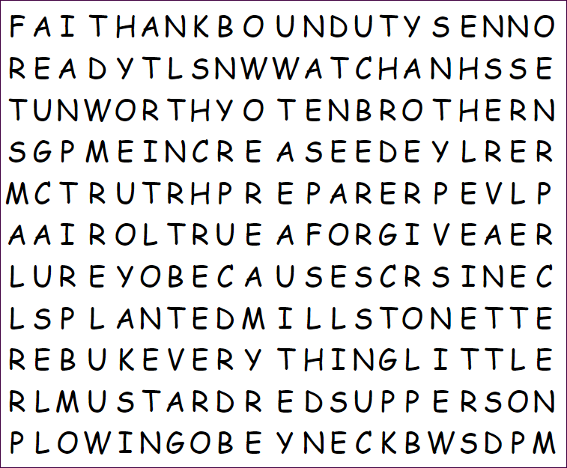
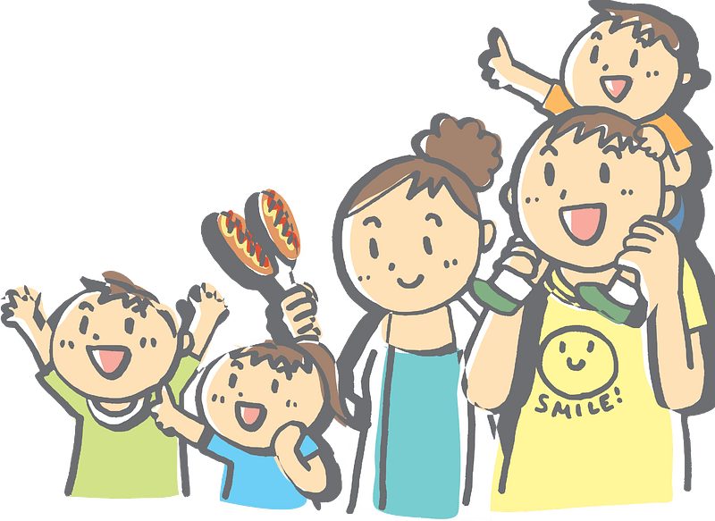
Family Activities
And look, I can see four words just in the first row!
Oh boy! It’s a Word Search.

Slide 21
Maturing Faith
February 25

